Slide 1
P3
Tagging Guide

Slide 2
Common

Slide 3
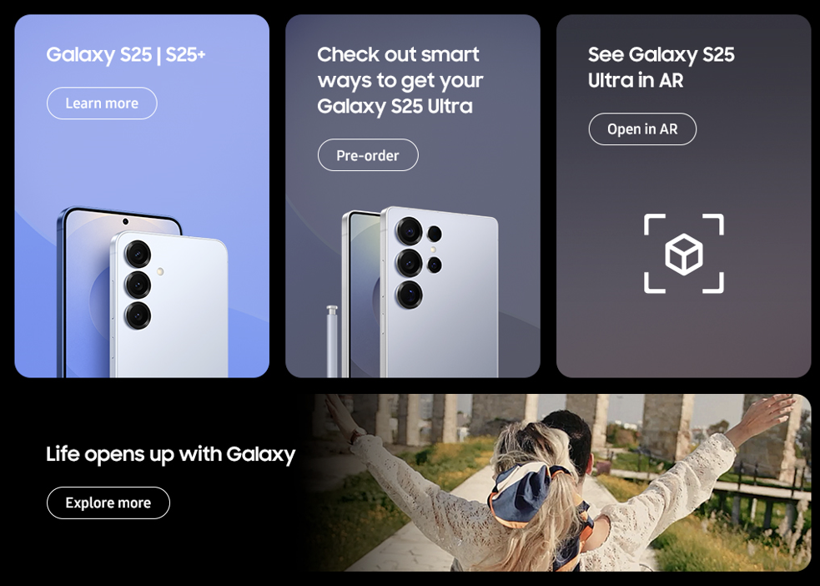
Common(Bottom Banner) - features
1
3
2
4
No. |  | Tagging Source
1 |  | Click to go Galaxy S25 MKT PD Features page
 | AA | data-omni-type="microsite_contentinter" data-omni="galaxy-s25-ultra:features:bottom^bnn:link-page:galaxy-s25"
 | GA | ga-ca="content click" ga-ac="feature" ga-la="galaxy-s25-ultra:features:bottom^bnn:link-page:galaxy-s25"
2 |  | Pre-order
 | AA | data-omni-type="microsite_buyAction" data-omni="galaxy-s25-ultra:features:btm^banner:conv-pdt:pre-order|;SM-S938"
 | GA | ga-ca="buy cta" ga-ac="pre-order" ga-la="galaxy-s25-ultra:features:btm^banner:conv-pdt:pre-order"
 |  | Buy now
 | AA | data-omni-type="microsite_buyAction" data-omni="galaxy-s25-ultra:features:btm^banner:conv-pdt:buy-now|;SM-S938"
 | GA | ga-ca="buy cta" ga-ac="buy now" ga-la="galaxy-s25-ultra:features:btm^banner:conv-pdt:buy-now"
 |  | Reserve-now
 | AA | data-omni-type="microsite_buyAction" data-omni="galaxy-s25-ultra:features:btm^banner:conv-pdt:reserve-now|;SM-S938"
 | GA | ga-ca="buy cta" ga-ac="reserve now" ga-la="galaxy-s25-ultra:features:btm^banner:conv-pdt:reserve-now"
 |  | Where to buy
 | AA | data-omni-type="microsite_buyAction" data-omni="galaxy-s25-ultra:features:btm^banner:conv-pdt:where-to-buy|;SM-S938"
 | GA | ga-ca="buy cta" ga-ac="where to buy" ga-la="galaxy-s25-ultra:features:btm^banner:conv-pdt:where-to-buy"
3 |  | Click to go Open in AR page
 | AA | data-omni-type="microsite_contentinter" data-omni="galaxy-s25-ultra:features:bottom^bnn:link-page:open-in-ar"
 | GA | ga-ac="feature" ga-la="galaxy-s25-ultra:features:bottom^bnn:link-page:open-in-ar"
4 |  | Click to go Why Galaxy page
 | AA | data-omni-type="microsite_contentinter" data-omni="galaxy-s25-ultra:features:bottom^bnn:link-page:why-galaxy"
 | GA | ga-ca="content click" ga-ac="feature" ga-la="galaxy-s25-ultra:features:bottom^bnn:link-page:why-galaxy"

Slide 4
Common(Bottom Banner) - Accessories
1
3
2
4
No. |  | Tagging Source
1 |  | Click to go Galaxy S25 MKT PD Features page
 | AA | data-omni-type="microsite_contentinter" data-omni="galaxy-s25-ultra:accessories:bottom^bnn:link-page:galaxy-s25"
 | GA | ga-ca="content click" ga-ac="feature" ga-la="galaxy-s25-ultra:accessories:bottom^bnn:link-page:galaxy-s25"
2 |  | Pre-order
 | AA | data-omni-type="microsite_buyAction" data-omni="galaxy-s25-ultra:accessories:btm^banner:conv-pdt:pre-order|;SM-S938"
 | GA | ga-ca="buy cta" ga-ac="pre-order" ga-la="galaxy-s25-ultra:accessories:btm^banner:conv-pdt:pre-order"
2 |  | Buy now
 | AA | data-omni-type="microsite_buyAction" data-omni="galaxy-s25-ultra:accessories:btm^banner:conv-pdt:buy-now|;SM-S938"
 | GA | ga-ca="buy cta" ga-ac="buy now" ga-la="galaxy-s25-ultra:accessories:btm^banner:conv-pdt:buy-now"
2 |  | Reserve-now
 | AA | data-omni-type="microsite_buyAction" data-omni="galaxy-s25-ultra:accessories:btm^banner:conv-pdt:reserve-now|;SM-S938"
 | GA | ga-ca="buy cta" ga-ac="reserve now" ga-la="galaxy-s25-ultra:accessories:btm^banner:conv-pdt:reserve-now"
2 |  | Where to buy
 | AA | data-omni-type="microsite_buyAction" data-omni="galaxy-s25-ultra:accessories:btm^banner:conv-pdt:where-to-buy|;SM-S938"
 | GA | ga-ca="buy cta" ga-ac="where to buy" ga-la="galaxy-s25-ultra:accessories:btm^banner:conv-pdt:where-to-buy"
3 |  | Click to go Open in AR page
 | AA | data-omni-type="microsite_contentinter" data-omni="galaxy-s25-ultra:accessories:bottom^bnn:link-page:open-in-ar"
 | GA | ga-ac="feature" ga-la="galaxy-s25-ultra:accessories:bottom^bnn:link-page:open-in-ar"
4 |  | Click to go Why Galaxy page
 | AA | data-omni-type="microsite_contentinter" data-omni="galaxy-s25-ultra:accessories:bottom^bnn:link-page:why-galaxy"
 | GA | ga-ca="content click" ga-ac="feature" ga-la="galaxy-s25-ultra:accessories:bottom^bnn:link-page:why-galaxy"

Slide 5
features

Slide 6
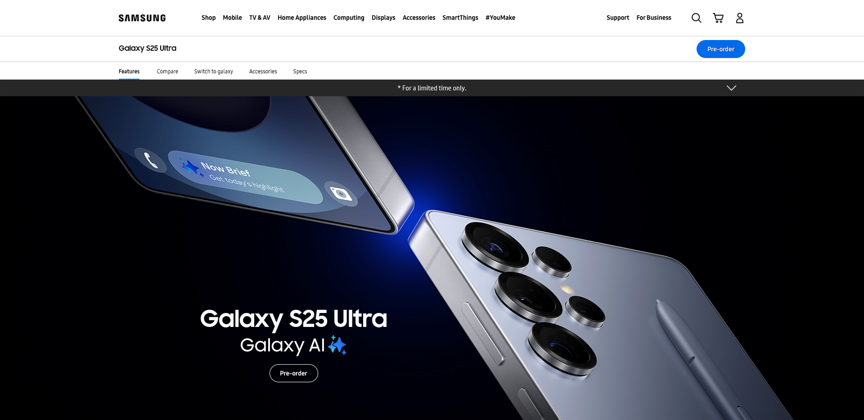
Features-KV
1
1 | 클릭 시, 오퍼 메시지 열기
2 | 클릭 시, 오퍼 메시지 닫기
3456 | 클릭 시 Galaxy S25 Ultra Buying 페이지로 이동 CTA TEXT : Pre-order / Buy now / Pre-reserve / Where to buy
2
3
No. |  | Tagging Source
1 |  | KV Drop down - Open
 | AA | data-omni-type="microsite_pcontentinter" data-omni="galaxy-s25-ultra:features:kv:acdn-open:offer"
 | GA | ga-ca="indication" ga-ac="accordion" ga-la="galaxy-s25-ultra:features:kv:acdn-open:offer"
2 |  | KV Drop down - Close
 | AA | data-omni-type="microsite_pcontentinter" data-omni="galaxy-s25-ultra:features:kv:acdn-close:offer"
 | GA | ga-ca="indication" ga-ac="accordion" ga-la="galaxy-s25-ultra:features:kv:acdn-close:offer"
3 |  | Pre-order
 | AA | data-omni-type="microsite_buyAction" data-omni="galaxy-s25-ultra:features:key-vis^img:conv-pdt:pre-order|;SM-S938"
 | GA | ga-ca="buy cta" ga-ac="pre-order-now" ga-la="galaxy-s25-ultra:features:key-vis^img:conv-pdt:pre-order"
4 |  | Buy now
 | AA | data-omni-type="microsite_buyAction" data-omni="galaxy-s25-ultra:features:key-vis^img:conv-pdt:buy-now|;SM-S938"
 | GA | ga-ca="buy cta" ga-ac="buy-now" ga-la="galaxy-s25-ultra:features:key-vis^img:conv-pdt:buy-now"
5 |  | Reserve now
 | AA | data-omni-type="microsite_buyAction" data-omni="galaxy-s25-ultra:features:key-vis^img:conv-pdt:reserve-now|;SM-S938"
 | GA | ga-ca="buy cta" ga-ac="reserve-now" ga-la="galaxy-s25-ultra:features:key-vis^img:conv-pdt:reserve-now"
6 |  | Where to buy
 | AA | data-omni-type="microsite_buyAction" data-omni="galaxy-s25-ultra:features:key-vis^img:conv-pdt:where-to-buy|;SM-S938"
 | GA | ga-ca="buy cta" ga-ac="where-to-buy" ga-la="galaxy-s25-ultra:features:key-vis^img:conv-pdt:where-to-buy"

Slide 7
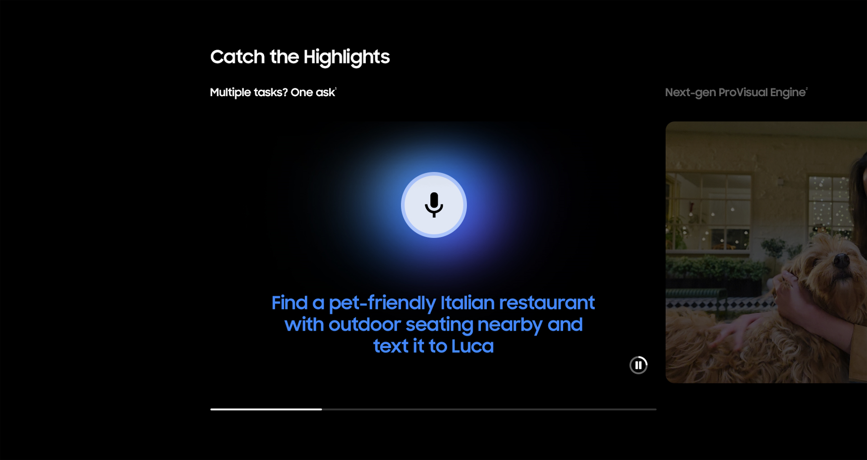

Features-Highlights (1/4)
1 | 클릭 시, 영상 Play
2 | 클릭 시, 영상 Pause
3 | 클릭 시, 해당 캐러셀로 이동
1
2
3
No. |  | Tagging Source
1 |  | Click to Play
 | AA | data-omni-type="microsite_contentinter" data-omni="galaxy-s25-ultra:features:highlights^galaxy-ai:movi-play:main-movie"
 | GA | ga-ca="content click" ga-ac="feature" ga-la="galaxy-s25-ultra:features:highlights^galaxy-ai:movi-play:main-movie"
2 |  | Click to Pause
 | AA | data-omni-type="microsite_contentinter" data-omni="galaxy-s25-ultra:features:highlights^galaxy-ai:movi-pause:main-movie"
 | GA | ga-ca="content click" ga-ac="feature" ga-la="galaxy-s25-ultra:features:highlights^galaxy-ai:movi-pause:main-movie"
3 |  | Click to Carousel
 | AA | data-omni-type="microsite_gallery" data-omni="galaxy-s25-ultra:features:highlights:sldr-dots:1"
 | GA | ga-ca="gallery" ga-ac="feature gallery" ga-la="galaxy-s25-ultra:features:highlights:sldr-dots:1"

Slide 8
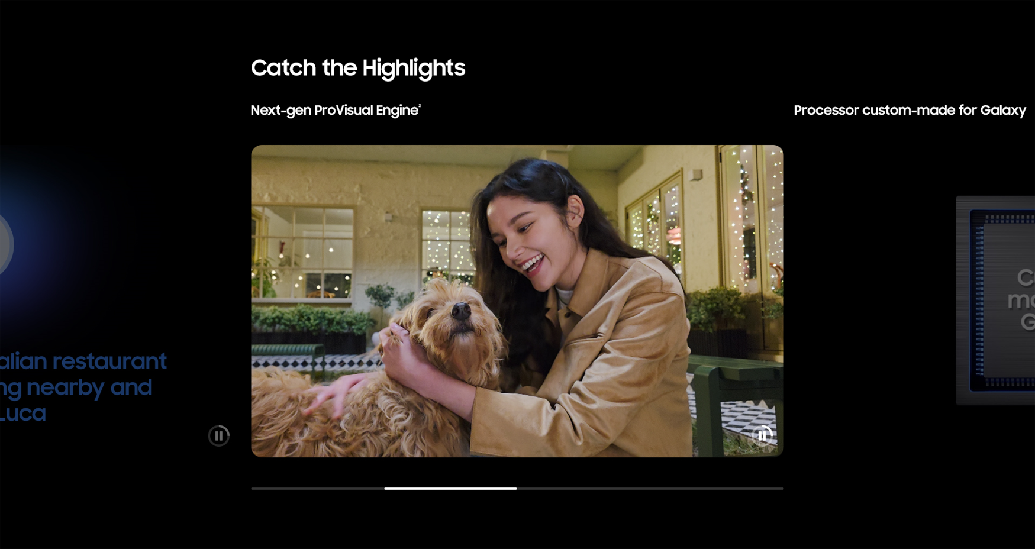
Features-Highlights (2/4)
1 | 클릭 시, 영상 Play
2 | 클릭 시, 영상 Pause
3 | 클릭 시, 해당 캐러셀로 이동
1
2
3
No. |  | Tagging Source
1 |  | Click to Play
 | AA | data-omni-type="microsite_contentinter" data-omni="galaxy-s25-ultra:features:highlights^camera:movi-play:main-movie"
 | GA | ga-ca="content click" ga-ac="feature" ga-la="galaxy-s25-ultra:features:highlights^camera:movi-play:main-movie"
2 |  | Click to Pause
 | AA | data-omni-type="microsite_contentinter" data-omni="galaxy-s25-ultra:features:highlights^camera:movi-pause:main-movie"
 | GA | ga-ca="content click" ga-ac="feature" ga-la="galaxy-s25-ultra:features:highlights^camera:movi-pause:main-movie"
3 |  | Click to Carousel
 | AA | data-omni-type="microsite_gallery" data-omni="galaxy-s25-ultra:features:highlights:sldr-dots:2"
 | GA | ga-ca="gallery" ga-ac="feature gallery" ga-la="galaxy-s25-ultra:features:highlights:sldr-dots:2"

Slide 9
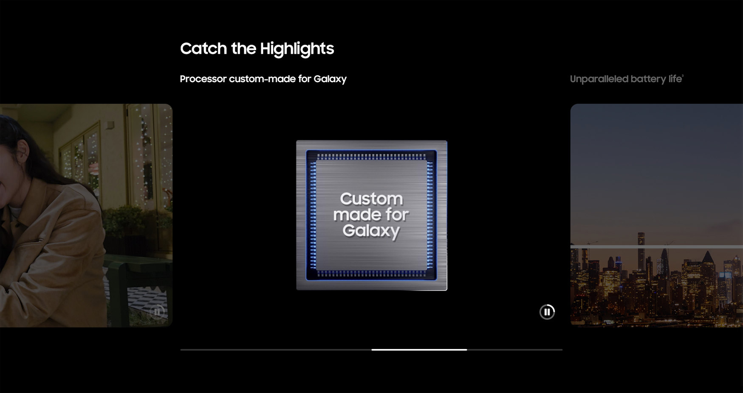
Features-Highlights (3/4)
1 | 클릭 시, 영상 Play
2 | 클릭 시, 영상 Pause
3 | 클릭 시, 해당 캐러셀로 이동
1
2
3
No. |  | Tagging Source
1 |  | Click to Play
 | AA | data-omni-type="microsite_contentinter" data-omni="galaxy-s25-ultra:features:highlights^performance:movi-play:main-movie"
 | GA | ga-ca="content click" ga-ac="feature" ga-la="galaxy-s25-ultra:features:highlights^performance:movi-play:main-movie"
2 |  | Click to Pause
 | AA | data-omni-type="microsite_contentinter" data-omni="galaxy-s25-ultra:features:highlights^performance:movi-pause:main-movie"
 | GA | ga-ca="content click" ga-ac="feature" ga-la="galaxy-s25-ultra:features:highlights^performance:movi-pause:main-movie"
3 |  | Click to Carousel
 | AA | data-omni-type="microsite_gallery" data-omni="galaxy-s25-ultra:features:highlights:sldr-dots:3"
 | GA | ga-ca="gallery" ga-ac="feature gallery" ga-la="galaxy-s25-ultra:features:highlights:sldr-dots:3"

Slide 10
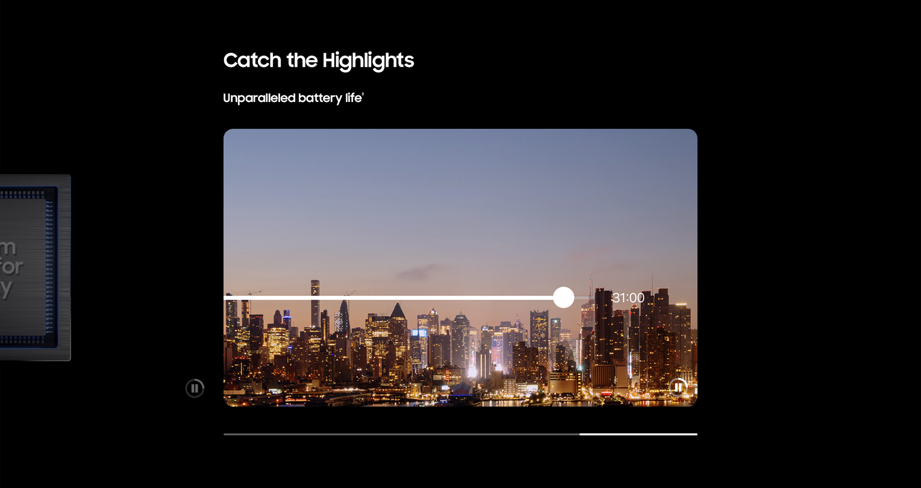
Features-Highlights (4/4)
1 | 클릭 시, 영상 Play
2 | 클릭 시, 영상 Pause
3 | 클릭 시, 해당 캐러셀로 이동
1
2
3
No. |  | Tagging Source
1 |  | Click to Play
 | AA | data-omni-type="microsite_contentinter" data-omni="galaxy-s25-ultra:features:highlights^battery:movi-play:main-movie"
 | GA | ga-ca="content click" ga-ac="feature" ga-la="galaxy-s25-ultra:features:highlights^battery:movi-play:main-movie"
2 |  | Click to Pause
 | AA | data-omni-type="microsite_contentinter" data-omni="galaxy-s25-ultra:features:highlights^battery:movi-pause:main-movie"
 | GA | ga-ca="content click" ga-ac="feature" ga-la="galaxy-s25-ultra:features:highlights^battery:movi-pause:main-movie"
3 |  | Click to Carousel
 | AA | data-omni-type="microsite_gallery" data-omni="galaxy-s25-ultra:features:highlights:sldr-dots:4"
 | GA | ga-ca="gallery" ga-ac="feature gallery" ga-la="galaxy-s25-ultra:features:highlights:sldr-dots:4"

Slide 11
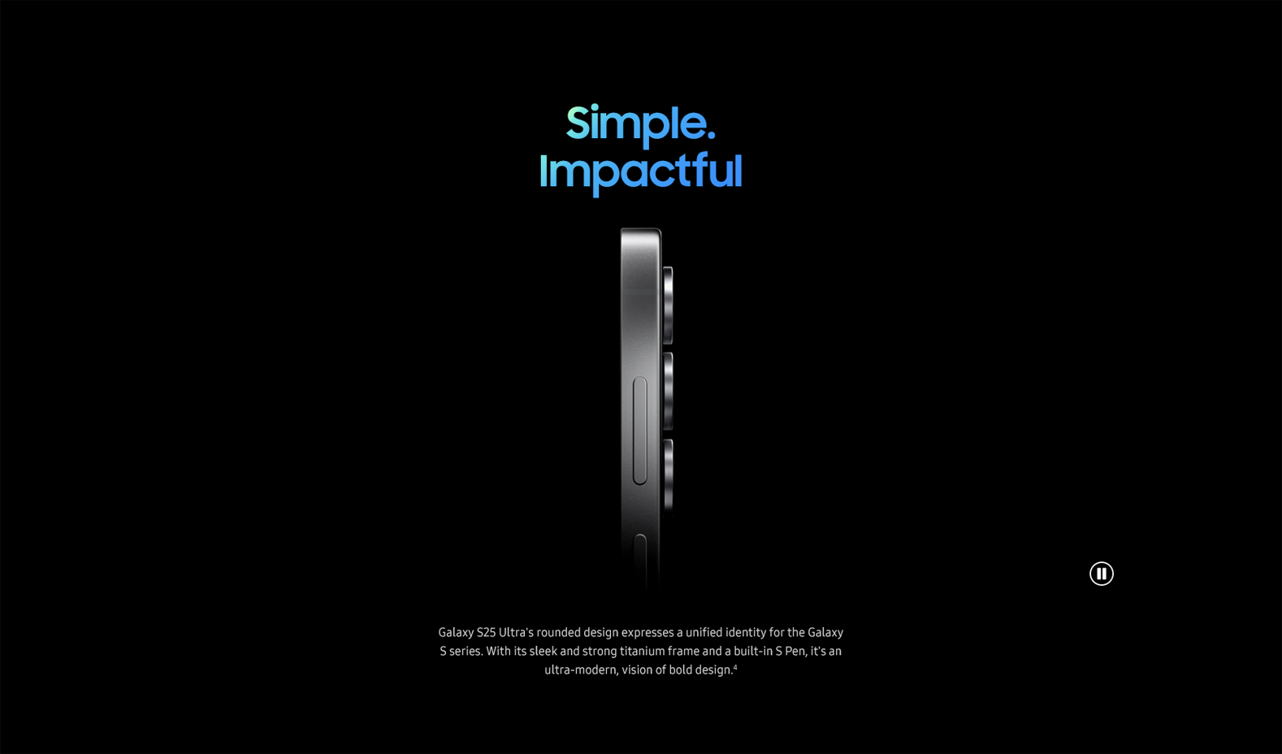

Features-Formfactor
1 | 클릭 시, 영상 Play
2 | 클릭 시, 영상 Pause
1
2
No. |  | Tagging Source
1 |  | Click to Play
 | AA | data-omni-type="microsite_contentinter" data-omni="galaxy-s25-ultra:features:design^form-factor:movi-play:main-movie"
 | GA | ga-ca="content click" ga-ac="feature" ga-la="galaxy-s25-ultra:features:design^form-factor:movi-play:main-movie"
2 |  | Click to Pause
 | AA | data-omni-type="microsite_contentinter" data-omni="galaxy-s25-ultra:features:highlights^battery:movi-pause:main-movie"
 | GA | ga-ca="content click" ga-ac="feature" ga-la="galaxy-s25-ultra:features:highlights^battery:movi-pause:main-movie"

Slide 12
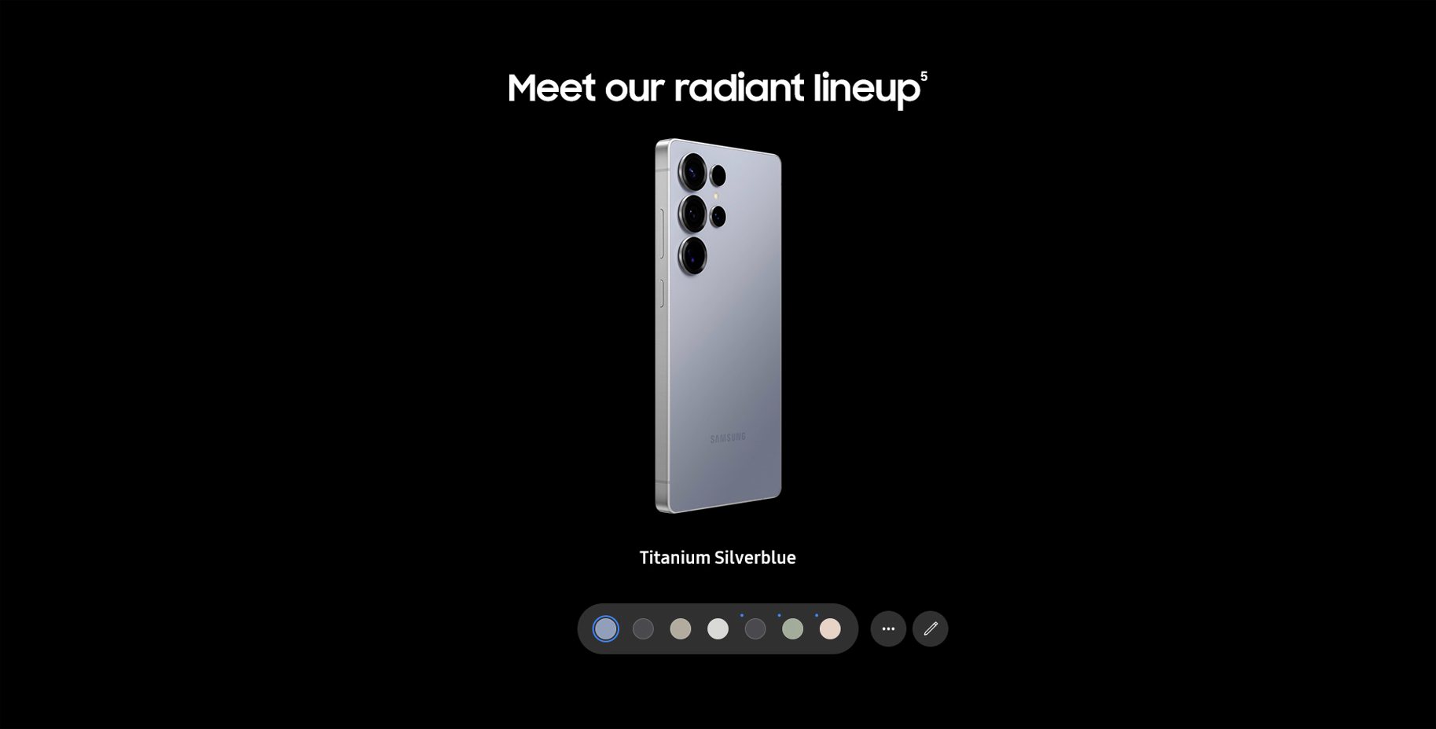
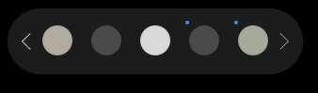
Features-Colors (1/3)
1 | Titanium Silverblue 컬러 선택
2 | Titanium black 컬러 선택
3 | Titanium gray 컬러 선택
4 | Titanium whitesilver 컬러 선택
5 | 온전 컬러 > Titanium jetblack 컬러 선택
6 | 온전 컬러 > Titanium jadegreen 컬러 선택
7 | 온전 컬러 > Titanium pinkgold 컬러 선택
1
2
3
4
5
6
7
Mobile only
No. |  | Tagging Source
1 |  | Colorchip – titanium silverblue
 | AA | data-omni-type="microsite_gallery" data-omni="galaxy-s25-ultra:features:design^colors:slct-color:galaxy-s25-ultra^titanium-silverblue"
 | GA | ga-ca="gallery" ga-ac="feature gallery" ga-la="galaxy-s25-ultra:features:design^colors:slct-color:galaxy-s25-ultra^titanium-silverblue"
2 |  | Colorchip – titanium black
 | AA | data-omni-type="microsite_gallery" data-omni="galaxy-s25-ultra:features:design^colors:slct-color:galaxy-s25-ultra^titanium-black"
 | GA | ga-ca="gallery" ga-ac="feature gallery" ga-la="galaxy-s25-ultra:features:design^colors:slct-color:galaxy-s25-ultra^titanium-black"
3 |  | Colorchip – titanium gray
 | AA | data-omni-type="microsite_gallery" data-omni="galaxy-s25-ultra:features:design^colors:slct-color:galaxy-s25-ultra^titanium-gray"
 | GA | ga-ca="gallery" ga-ac="feature gallery" ga-la="galaxy-s25-ultra:features:design^colors:slct-color:galaxy-s25-ultra^titanium-gray"
4 |  | Colorchip – titanium whitesilver
 | AA | data-omni-type="microsite_gallery" data-omni="galaxy-s25-ultra:features:design^colors:slct-color:galaxy-s25-ultra^titanium-whitesilver"
 | GA | ga-ca="gallery" ga-ac="feature gallery" ga-la="galaxy-s25-ultra:features:design^colors:slct-color:galaxy-s25-ultra^titanium-whitesilver"
5 |  | Colorchip – Online exclusive > titanium jetblack
 | AA | data-omni-type="microsite_gallery" data-omni="galaxy-s25-ultra:features:design^exclusivecolors:slct-color:galaxy-s25-ultra^titanium-jetblack"
 | GA | ga-ca="gallery" ga-ac="feature gallery" ga-la="galaxy-s25-ultra:features:design^exclusivecolors:slct-color:galaxy-s25-ultra^titanium-jetblack"
6 |  | Colorchip – Online exclusive > titanium jade green
 | AA | data-omni-type="microsite_gallery" data-omni="galaxy-s25-ultra:features:design^exclusivecolors:slct-color:galaxy-s25-ultra^titanium-jadegreen"
 | GA | ga-ca="gallery" ga-ac="feature gallery" ga-la="galaxy-s25-ultra:features:design^exclusivecolors:slct-color:galaxy-s25-ultra^titanium-jadegreen"
7 |  | Colorchip – Online exclusive > titanium pinkgold
 | AA | data-omni-type="microsite_gallery" data-omni="galaxy-s25-ultra:features:design^exclusivecolors:slct-color:galaxy-s25-ultra^titanium-pinkgold"
 | GA | ga-ca="gallery" ga-ac="feature gallery" ga-la="galaxy-s25-ultra:features:design^exclusivecolors:slct-color:galaxy-s25-ultra^titanium-pinkgold"

Slide 13
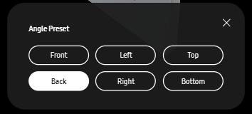

Features-Colors (2/3)
8 | 클릭 시, 왼쪽으로 이동 (Mobile only)
9 | 클릭 시, 오른쪽으로 이동 (Mobile only)
10 | 클릭 시, 앵글 프리셋 팝업 노출
11 | 클릭 시, 펜 ON
12 | 클릭 시, 펜 OFF
10
11
Mobile only
12
8
9
No. |  | Tagging Source
8 |  | Previous Arrow
 | AA | data-omni-type="microsite_pcontentinter" data-omni="galaxy-s25-ultra:features:design^colors:galaxy-s25-ultra^colorchip:arrow:previous"
 | GA | ga-ca="indication" ga-ac="carousel" ga-la="galaxy-s25-ultra:features:design^colors:galaxy-s25-ultra^colorchip:arrow:previous"
9 |  | Next Arrow
 | AA | data-omni-type="microsite_pcontentinter" data-omni="galaxy-s25-ultra:features:design^colors:galaxy-s25-ultra^colorchip:arrow:next"
 | GA | ga-ca="indication" ga-ac="carousel" ga-la="galaxy-s25-ultra:features:design^colors:galaxy-s25-ultra^colorchip:arrow:next"
10 |  | Angle Preset Button
 | AA | data-omni-type="microsite_contentinter" data-omni="galaxy-s25-ultra:features:design^colors:lypu-open:galaxy-s25-ultra"
 | GA | ga-ca="content click" ga-ac="feature" ga-la="galaxy-s25-ultra:features:design^colors:lypu-open:galaxy-s25-ultra"
11 |  | S Pen On Button
 | AA | data-omni-type="microsite_contentinter" data-omni="galaxy-s25-ultra:features:design^colors:slct-pen:galaxy-s25-ultra^pen-on"
 | GA | ga-ca="content click" ga-ac="feature" ga-la="galaxy-s25-ultra:features:design^colors:slct-pen:galaxy-s25-ultra^pen-on"
12 |  | S Pen Off Button
 |  | data-omni-type="microsite_contentinter" data-omni="galaxy-s25-ultra:features:design^colors:slct-pen:galaxy-s25-ultra^pen-off"
 |  | ga-ca="content click" ga-ac="feature" ga-la="galaxy-s25-ultra:features:design^colors:slct-pen:galaxy-s25-ultra^pen-off"

Slide 14
Features-Colors (3/3)
13 | 클릭 시, 앵글 프리셋 팝업창 닫기
14 | 클릭 시, 제품 Front 노출
15 | 클릭 시, 제품 Left 노출
16 | 클릭 시, 제품 Top 노출
17 | 클릭 시, 제품 Back 노출
18 | 클릭 시, 제품 Right 노출
19 | 클릭 시, 제품 Bottom 노출
13
14
15
16
17
18
19
Mobile only
No. |  | Tagging Source
13 |  | Angle preset pop-up close
 | AA | data-omni-type="microsite_contentinter" data-omni="galaxy-s25-ultra:features:design^colors:lypu-close:galaxy-s25-ultra"
 | GA | ga-ca="content click" ga-ac="feature" ga-la="galaxy-s25-ultra:features:design^colors:lypu-close:galaxy-s25-ultra"
14 |  | Front angle
 | AA | data-omni-type="microsite_contentinter" data-omni="galaxy-s25-ultra:features:design^colors:slct-angle:galaxy-s25-ultra^front"
 | GA | ga-ca="content click" ga-ac="feature" ga-la="galaxy-s25-ultra:features:design^colors:slct-angle:galaxy-s25-ultra^front"
15 |  | Left angle
 | AA | data-omni-type="microsite_contentinter" data-omni="galaxy-s25-ultra:features:design^colors:slct-angle:galaxy-s25-ultra^left"
 | GA | ga-ca="content click" ga-ac="feature" ga-la="galaxy-s25-ultra:features:design^colors:slct-angle:galaxy-s25-ultra^left"
16 |  | Top angle
 | AA | data-omni-type="microsite_contentinter" data-omni="galaxy-s25-ultra:features:design^colors:slct-angle:galaxy-s25-ultra^top"
 | GA | ga-ca="content click" ga-ac="feature" ga-la="galaxy-s25-ultra:features:design^colors:slct-angle:galaxy-s25-ultra^top"
17 |  | Back angle
 | AA | data-omni-type="microsite_contentinter" data-omni="galaxy-s25-ultra:features:design^colors:slct-angle:galaxy-s25-ultra^back"
 | GA | ga-ca="content click" ga-ac="feature" ga-la="galaxy-s25-ultra:features:design^colors:slct-angle:galaxy-s25-ultra^back"
18 |  | Right angle
 | AA | data-omni-type="microsite_contentinter" data-omni="galaxy-s25-ultra:features:design^colors:slct-angle:galaxy-s25-ultra^right"
 | GA | ga-ca="content click" ga-ac="feature" ga-la="galaxy-s25-ultra:features:design^colors:slct-angle:galaxy-s25-ultra^right"
19 |  | Bottom angle
 | AA | data-omni-type="microsite_contentinter" data-omni="galaxy-s25-ultra:features:design^colors:slct-angle:galaxy-s25-ultra^bottom"
 | GA | ga-ca="content click" ga-ac="feature" ga-la="galaxy-s25-ultra:features:design^colors:slct-angle:galaxy-s25-ultra^bottom"

Slide 15
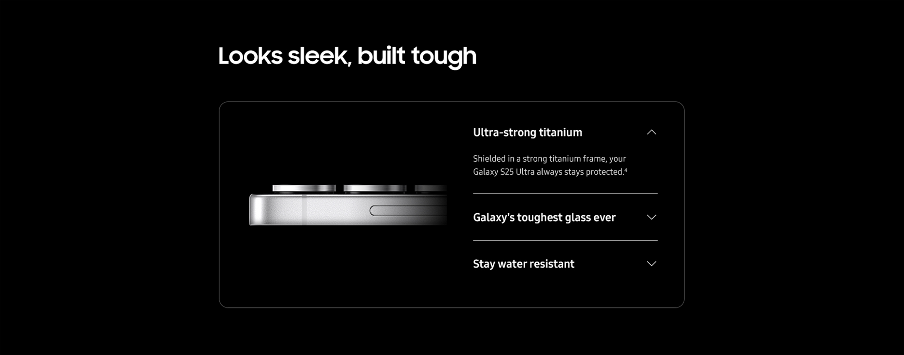

Features-Durability
1 | 클릭 시, Drawer 닫기
2 | 클릭 시, Drawer 열기
3 | 클릭 시, Drawer 열기
4 | 클릭 시, Drawer 닫기
5 | 클릭 시, Drawer 열기
6 | 클릭 시, Drawer 닫기
1
2
3
4
5
6
No. |  | Tagging Source
1 |  | Drawer close
 | AA | data-omni-type="microsite_pcontentinter" data-omni="galaxy-s25-ultra:features:design^durability:acdn-close:aluminum-frame"
 | GA | ga-ca="indication" ga-ac="accordion" ga-la="galaxy-s25-ultra:features:design^durability:acdn-close:aluminum-frame"
2 |  | Drawer open
 | AA | data-omni-type="microsite_pcontentinter" data-omni="galaxy-s25-ultra:features:design^durability:acdn-open:aluminum-frame"
 | GA | ga-ca="indication" ga-ac="accordion" ga-la="galaxy-s25-ultra:features:design^durability:acdn-open:aluminum-frame"
3 |  | Drawer open
 | AA | data-omni-type="microsite_pcontentinter" data-omni="galaxy-s25-ultra:features:design^durability:acdn-open:gorilla-glass"
 | GA | ga-ca="indication" ga-ac="accordion" ga-la="galaxy-s25-ultra:features:design^durability:acdn-open:gorilla-glass"
4 |  | Drawer close
 | AA | data-omni-type="microsite_pcontentinter" data-omni="galaxy-s25-ultra:features:design^durability:acdn-close:gorilla-glass"
 | GA | ga-ca="indication" ga-ac="accordion" ga-la="galaxy-s25-ultra:features:design^durability:acdn-close:gorilla-glass"
5 |  | Drawer open
 | AA | data-omni-type="microsite_pcontentinter" data-omni="galaxy-s25-ultra:features:design^durability:acdn-open:water-resistant"
 | GA | ga-ca="indication" ga-ac="accordion" ga-la="galaxy-s25-ultra:features:design^durability:acdn-open:water-resistant"
6 |  | Drawer close
 | AA | data-omni-type="microsite_pcontentinter" data-omni="galaxy-s25-ultra:features:design^durability:acdn-close:water-resistant"
 | GA | ga-ca="indication" ga-ac="accordion" ga-la="galaxy-s25-ultra:features:design^durability:acdn-close:water-resistant"

Slide 16
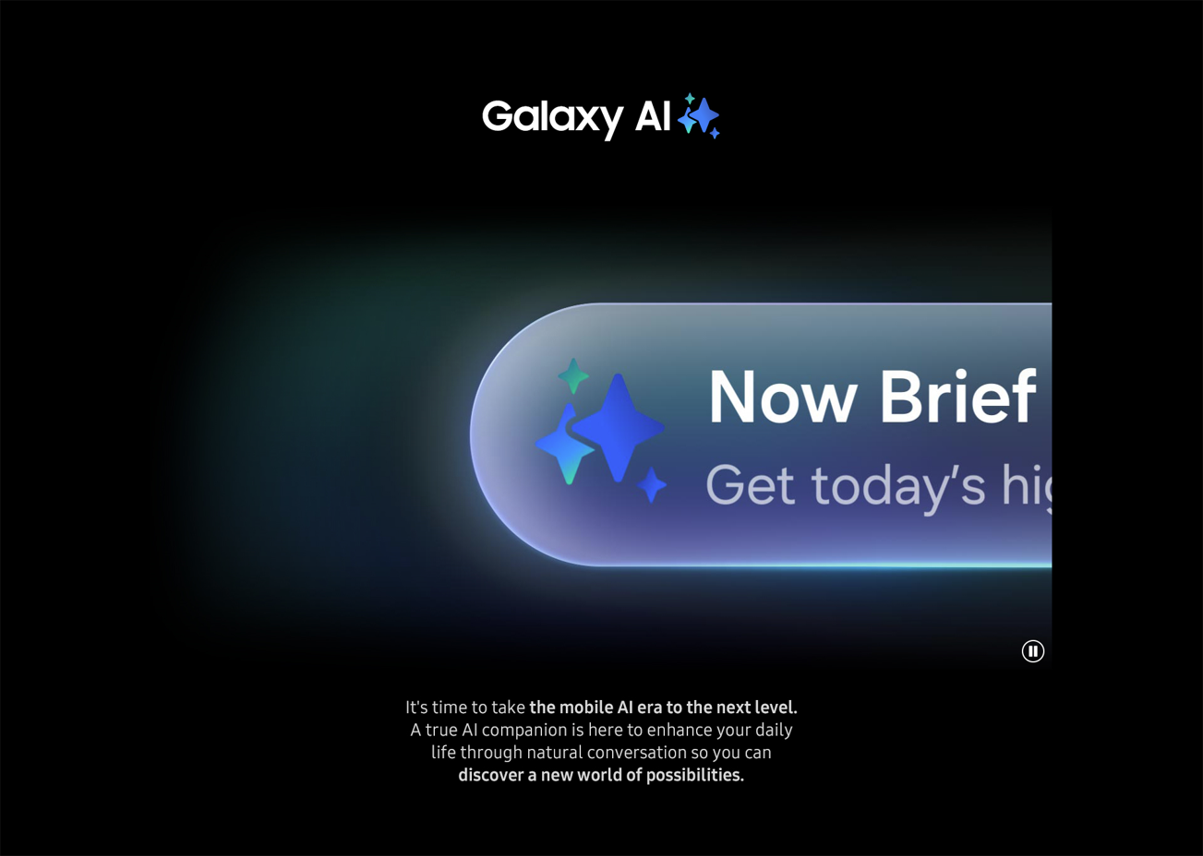
Features-Galaxy AI Overview
1 | 클릭 시, 영상 Play
2 | 클릭 시, 영상 Pause
1
2
No. |  | Tagging Source
1 |  | Click to Play
 | AA | data-omni-type="microsite_contentinter" data-omni="galaxy-s25-ultra:features:galaxy-ai^ai-overview:movi-play:main-movie"
 | GA | ga-ca="content click" ga-ac="feature" ga-la="galaxy-s25-ultra:features:galaxy-ai^ai-overview:movi-play:main-movie"
2 |  | Click to Pause
 | AA | data-omni-type="microsite_contentinter" data-omni="galaxy-s25-ultra:features:galaxy-ai^ai-overview:movi-pause:main-movie"
 | GA | ga-ca="content click" ga-ac="feature" ga-la="galaxy-s25-ultra:features:galaxy-ai^ai-overview:movi-pause:main-movie"

Slide 17
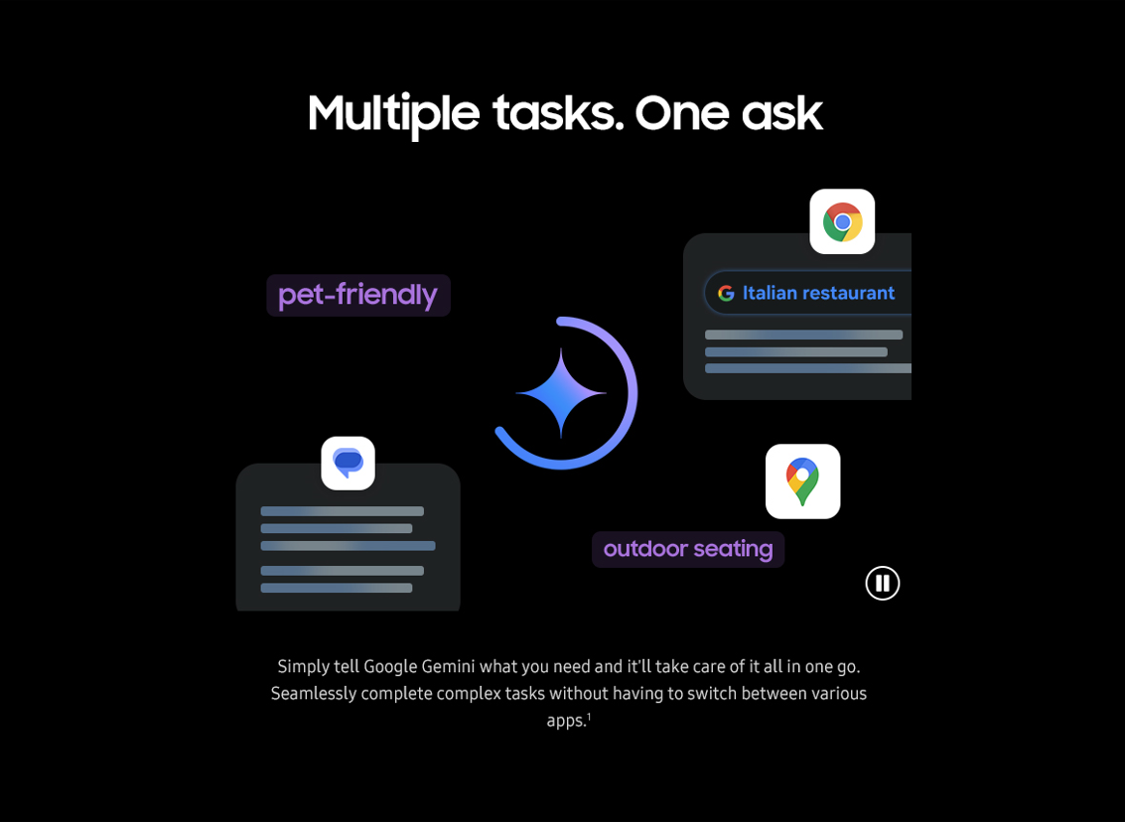

Features-Cross App Action
1 | 클릭 시, 영상 Play
2 | 클릭 시, 영상 Pause
3 | 클릭 시, How to 팝업창 노출
2
1
3
No. |  | Tagging Source
1 |  | Click to Play
 | AA | data-omni-type="microsite_contentinter" data-omni="galaxy-s25-ultra:features:ai^cross-app-action:movi-play:main-movie"
 | GA | ga-ca="content click" ga-ac="feature" ga-la="galaxy-s25-ultra:features:ai^cross-app-action:movi-play:main-movie"
2 |  | Click to Pause
 | AA | data-omni-type="microsite_contentinter" data-omni="galaxy-s25-ultra:features:ai^cross-app-action:movi-pause:main-movie"
 | GA | ga-ca="content click" ga-ac="feature" ga-la="galaxy-s25-ultra:features:ai^cross-app-action:movi-pause:main-movie"
3 |  | Click to open pop-up
 | AA | data-omni-type="microsite_contentinter" data-omni="galaxy-s25-ultra:features:ai^cross-app-action:how-to-use-cross-app-action"
 | GA | ga-ca="content click" ga-ac="feature" ga-la="galaxy-s25-ultra:features:ai^cross-app-action:how-to-use-cross-app-action"

Slide 18
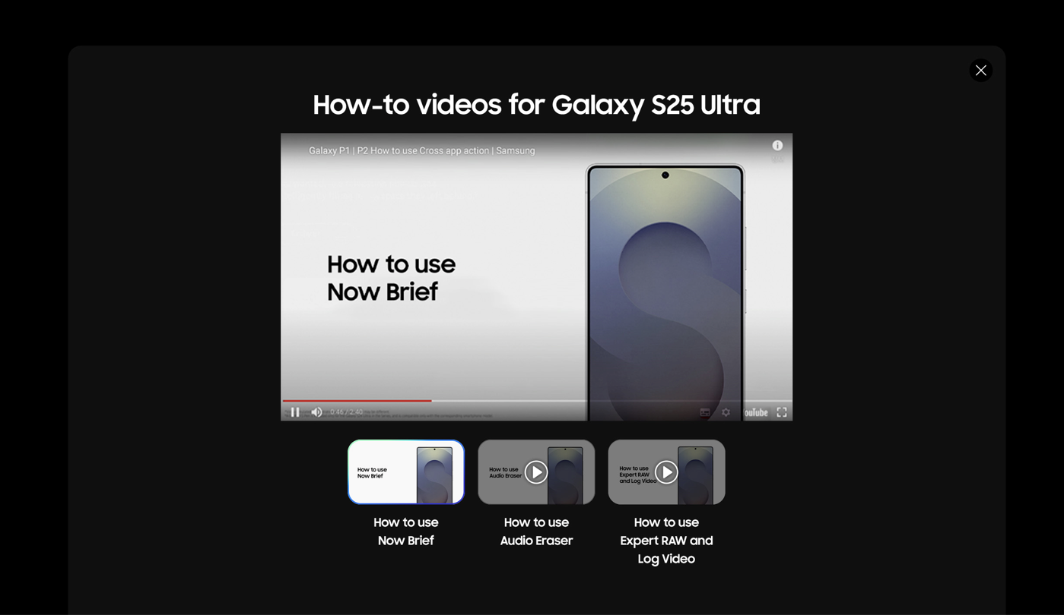

Features – How to Pop up
1
1 | 클릭 시, 팝업창 닫기
2 | 클릭 시, 영상 Play
3 | 클릭 시, 영상 Play
4 | 클릭 시, 영상 Play
2
3
4
1
2
No. |  | Tagging Source
1 |  | Click to Close Pop up
 | AA | data-omni-type="microsite_contentinter" data-omni="galaxy-s25-ultra:features:how-to-popup:lypu-close:close"
 | GA | ga-ca="content click" ga-ac="feature" ga-la="galaxy-s25-ultra:features:how-to-popup:lypu-close:close"
2 |  | Click to Play Video 1
 | AA | data-omni-type="microsite_contentinter" data-omni="galaxy-s25-ultra:features:how-to-popup:slct-video:1"
 | GA | ga-ca="content click" ga-ac="feature" ga-la="galaxy-s25-ultra:features:how-to-popup:slct-video:1"
3 |  | Click to Play Video 3
 | AA | data-omni-type="microsite_contentinter" data-omni="galaxy-s25-ultra:features:how-to-popup:slct-video:2"
 | GA | ga-ca="content click" ga-ac="feature" ga-la="galaxy-s25-ultra:features:how-to-popup:slct-video:2"
4 |  | Click to Play Video 4
 | AA | data-omni-type="microsite_contentinter" data-omni="galaxy-s25-ultra:features:how-to-popup:slct-video:3"
 | GA | ga-ca="content click" ga-ac="feature" ga-la="galaxy-s25-ultra:features:how-to-popup:slct-video:3"

Slide 19
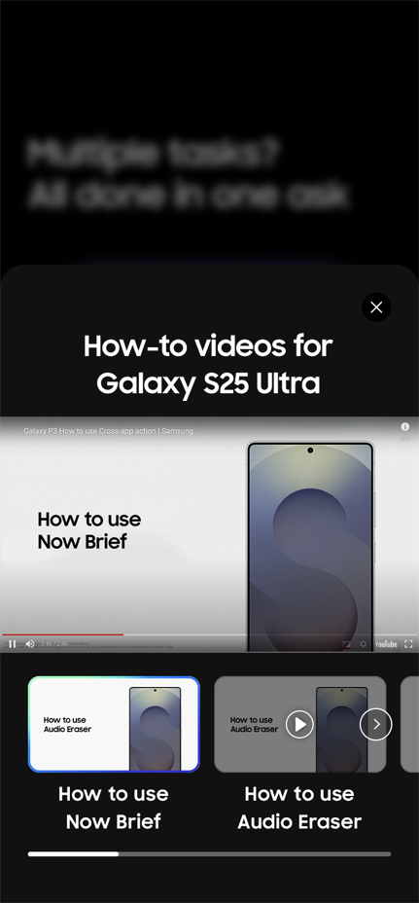
Features – How to Pop up (MO)
1 | 클릭 시, 첫번째 슬라이드로 이동
2 | 클릭 시, 두번째 슬라이드로 이동
1
2
No. |  | Tagging Source
1 |  | Click to Move Slide 1
 | AA | data-omni-type="microsite_contentinter" data-omni="galaxy-s25-ultra:features:how-to-popup:arrow:previous"
 | GA | ga-ca="content click" ga-ac="feature" ga-la="galaxy-s25-ultra:features:how-to-popup:arrow:previous"
2 |  | Click to Move Slide 2
 | AA | data-omni-type="microsite_contentinter" data-omni="galaxy-s25-ultra:features:how-to-popup:arrow:next"
 | GA | ga-ca="content click" ga-ac="feature" ga-la="galaxy-s25-ultra:features:how-to-popup:arrow:next"

Slide 20
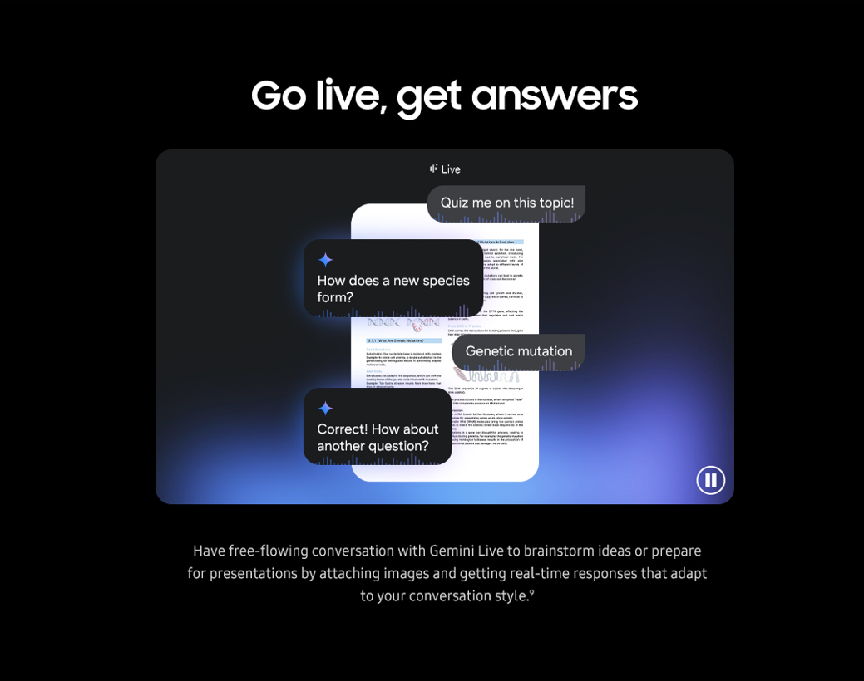
Features-Gemini Live
1 | 클릭 시, 영상 Play
2 | 클릭 시, 영상 Pause
2
1
No. |  | Tagging Source
1 |  | Click to Play
 | AA | data-omni-type="microsite_contentinter" data-omni="galaxy-s25-ultra:features:ai^gemini-live:movi-play:main-movie"
 | GA | ga-ca="content click" ga-ac="feature" ga-la="galaxy-s25-ultra:features:ai^gemini-live:movi-play:main-movie"
2 |  | Click to Pause
 | AA | data-omni-type="microsite_contentinter" data-omni="galaxy-s25-ultra:features:ai^gemini-live:movi-pause:main-movie"
 | GA | ga-ca="content click" ga-ac="feature" ga-la="galaxy-s25-ultra:features:ai^gemini-live:movi-pause:main-movie"

Slide 21
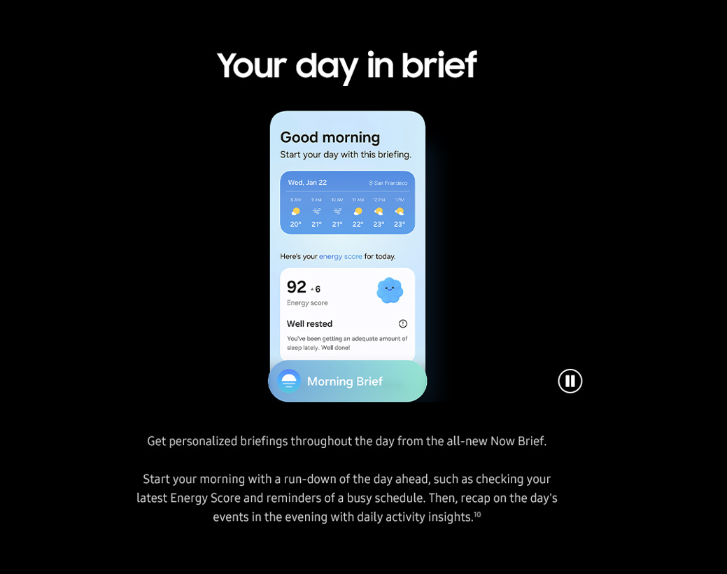

Features-Now Brief
1 | 클릭 시, 영상 Play
2 | 클릭 시, 영상 Pause
3 | 클릭 시, How to 팝업창 노출
2
1
3
No. |  | Tagging Source
1 |  | Click to Play
 | AA | data-omni-type="microsite_contentinter" data-omni="galaxy-s25-ultra:features:ai^now-brief:movi-play:main-movie"
 | GA | ga-ca="content click" ga-ac="feature" ga-la="galaxy-s25-ultra:features:ai^now-brief:movi-play:main-movie"
2 |  | Click to Pause
 | AA | data-omni-type="microsite_contentinter" data-omni="galaxy-s25-ultra:features:ai^now-brief:movi-pause:main-movie"
 | GA | ga-ca="content click" ga-ac="feature" ga-la="galaxy-s25-ultra:features:ai^now-brief:movi-pause:main-movie"
3 |  | Click to open pop-up
 | AA | data-omni-type="microsite_contentinter" data-omni="galaxy-s25-ultra:features:ai^now-brief:how-to-use-now-brief"
 | GA | ga-ca="content click" ga-ac="feature" ga-la="galaxy-s25-ultra:features:ai^now-brief:how-to-use-now-brief"

Slide 22
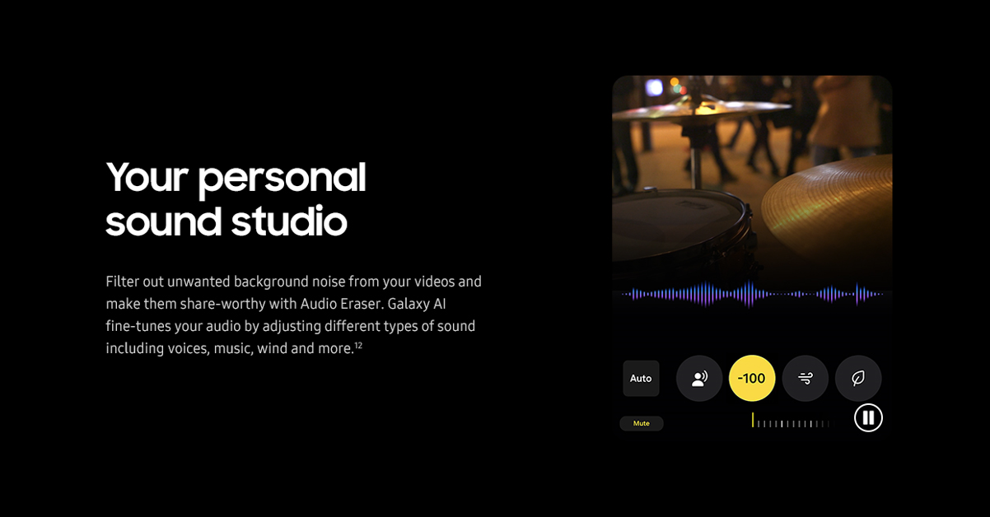

Features-Audio eraser
1 | 클릭 시, 영상 Play
2 | 클릭 시, 영상 Pause
3 | 클릭 시, How to 팝업창 노출
3
1
2
No. |  | Tagging Source
1 |  | Click to Play
 | AA | data-omni-type="microsite_contentinter" data-omni="galaxy-s25-ultra:features:ai^audio-eraser:movi-play:main-movie"
 | GA | ga-ca="content click" ga-ac="feature" ga-la="galaxy-s25-ultra:features:ai^audio-eraser:movi-play:main-movie"
2 |  | Click to Pause
 | AA | data-omni-type="microsite_contentinter" data-omni="galaxy-s25-ultra:features:ai^audio-eraser:movi-pause:main-movie"
 | GA | ga-ca="content click" ga-ac="feature" ga-la="galaxy-s25-ultra:features:ai^audio-eraser:movi-pause:main-movie"
3 |  | Click to open pop-up
 | AA | data-omni-type="microsite_contentinter" data-omni="galaxy-s25-ultra:features:ai^audio-eraser:how-to-use-audio-eraser"
 | GA | ga-ca="content click" ga-ac="feature" ga-la="galaxy-s25-ultra:features:ai^audio-eraser:how-to-use-audio-eraser"

Slide 23
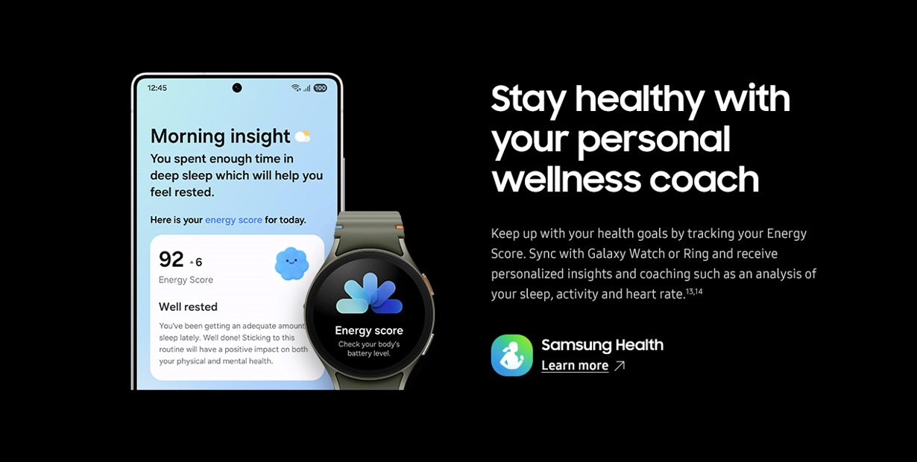
Features-Audio eraser
1 | 클릭 시, Samsung health Page 새 창 열기
1
No. |  | Tagging Source
1 |  | Click to go Samsung Health Page
 | AA | data-omni-type="microsite_contentinter" data-omni="galaxy-s25-ultra:features:ai^health-assist:link-page:apps^samsung-health"
 | GA | ga-ca="content click" ga-ac="feature" ga-la="galaxy-s25-ultra:features:ai^health-assist:link-page:apps^samsung-health"

Slide 24
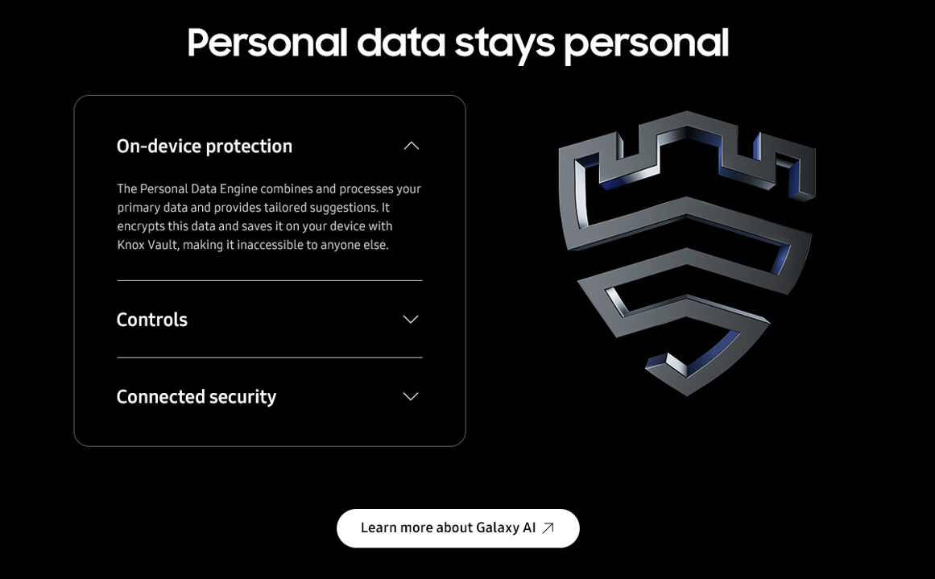
Features-Privacy
1 | 클릭 시, Drawer 닫기
2 | 클릭 시, Drawer 열기
3 | 클릭 시, Drawer 열기
4 | 클릭 시, Drawer 닫기
5 | 클릭 시, Drawer 열기
6 | 클릭 시, Drawer 닫기
7 | 클릭 시, Galaxy AI 페이지 새 창 열기
1
2
3
4
5
6
1
7
No. |  | Tagging Source
1 |  | Drawer close
 | AA | data-omni-type="microsite_pcontentinter" data-omni="galaxy-s25-ultra:features:ai^privacy:acdn-close:on-device"
 | GA | ga-ca="indication" ga-ac="accordion" ga-la="galaxy-s25-ultra:features:ai^privacy:acdn-close:on-device"
2 |  | Drawer open
 | AA | data-omni-type="microsite_pcontentinter" data-omni="galaxy-s25-ultra:features:ai^privacy:acdn-open:on-device"
 | GA | ga-ca="indication" ga-ac="accordion" ga-la="galaxy-s25-ultra:features:ai^privacy:acdn-open:on-device"
3 |  | Drawer open
 | AA | data-omni-type="microsite_pcontentinter" data-omni="galaxy-s25-ultra:features:ai^privacy:acdn-open:controls"
 | GA | ga-ca="indication" ga-ac="accordion" ga-la="galaxy-s25-ultra:features:ai^privacy:acdn-open:controls"
4 |  | Drawer close
 | AA | data-omni-type="microsite_pcontentinter" data-omni="galaxy-s25-ultra:features:ai^privacy:acdn-close:controls"
 | GA | ga-ca="indication" ga-ac="accordion" ga-la="galaxy-s25-ultra:features:ai^privacy:acdn-close:controls"
5 |  | Drawer open
 | AA | data-omni-type="microsite_pcontentinter" data-omni="galaxy-s25-ultra:features:ai^privacy:acdn-open:connected-devices"
 | GA | ga-ca="indication" ga-ac="accordion" ga-la="galaxy-s25-ultra:features:ai^privacy:acdn-open:connected-devices"
6 |  | Drawer close
 | AA | data-omni-type="microsite_pcontentinter" data-omni="galaxy-s25-ultra:features:ai^privacy:acdn-close:connected-devices"
 | GA | ga-ca="indication" ga-ac="accordion" ga-la="galaxy-s25-ultra:features:ai^privacy:acdn-close:connected-devices"
7 |  | Click to go Galaxy AI Page
 | AA | data-omni-type="microsite_contentinter" data-omni="galaxy-s25-ultra:features:privacy:link-page:galaxy-ai"
 | GA | ga-ca="content click" ga-ac="feature" ga-la="galaxy-s25-ultra:features:privacy:link-page:galaxy-ai"

Slide 25
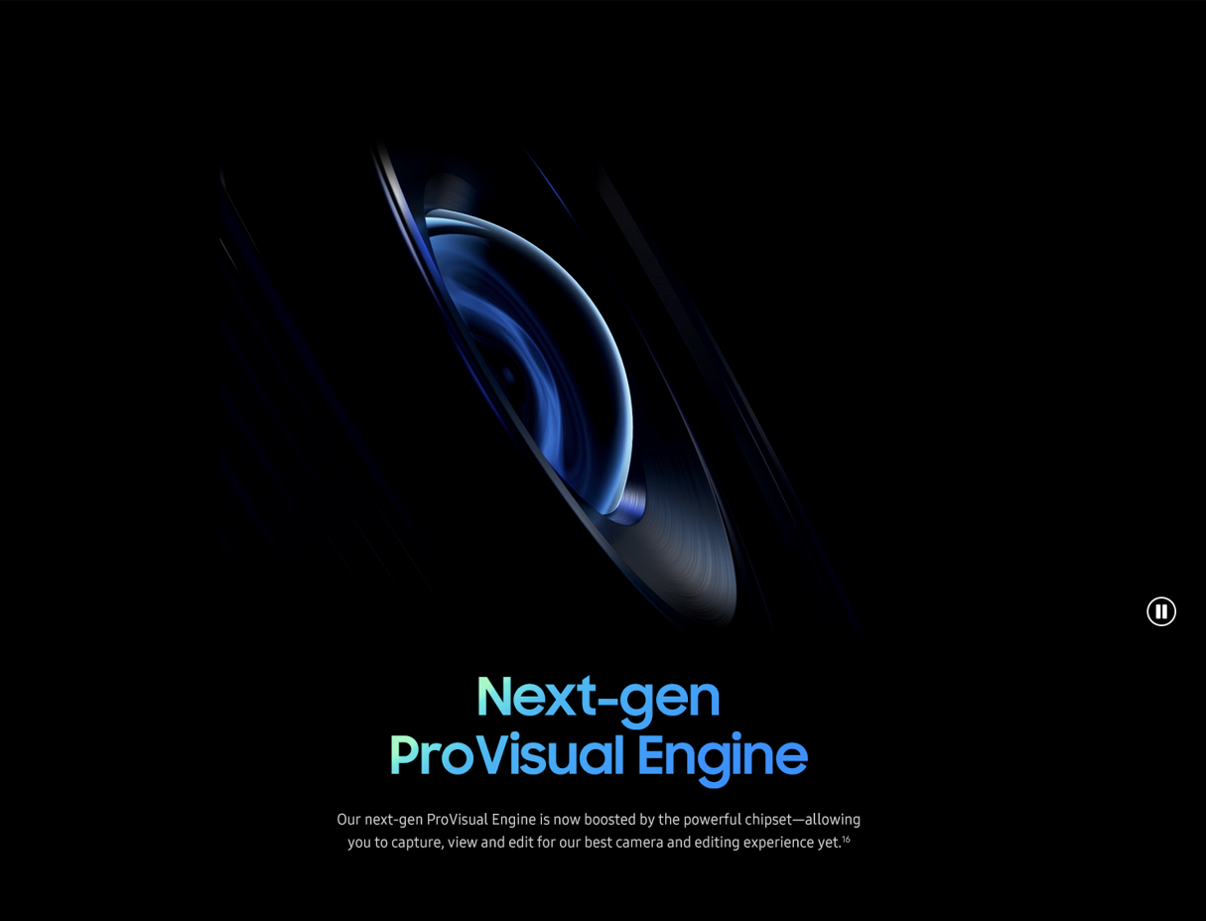
Features – Provisual Engine
1 | 클릭 시, 영상 Play
2 | 클릭 시, 영상 Pause
1
2
No. |  | Tagging Source
1 |  | Click to Play
 | AA | data-omni-type="microsite_contentinter" data-omni="galaxy-s25-ultra:features:camera^provisual-engine:movi-play:main-movie"
 | GA | ga-ca="content click" ga-ac="feature" ga-la="galaxy-s25-ultra:features:camera^provisual-engine:movi-play:main-movie"
2 |  | Click to Pause
 | AA | data-omni-type="microsite_contentinter" data-omni="galaxy-s25-ultra:features:camera^provisual-engine:movi-pause:main-movie"
 | GA | ga-ca="content click" ga-ac="feature" ga-la="galaxy-s25-ultra:features:camera^provisual-engine:movi-pause:main-movie"

Slide 26
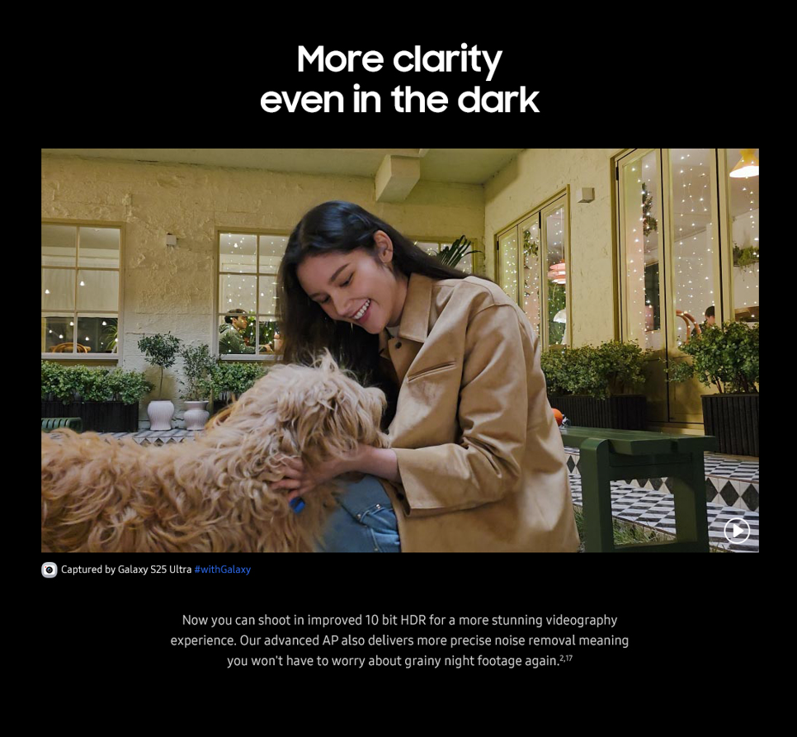

Features – Nightography
1 | 클릭 시, 영상 Play
2 | 클릭 시, 영상 Pause
1
2
No. |  | Tagging Source
1 |  | Click to Play
 | AA | data-omni-type="microsite_contentinter" data-omni="galaxy-s25-ultra:features:camera^nightography:movi-play:main-movie"
 | GA | ga-ca="content click" ga-ac="feature" ga-la="galaxy-s25-ultra:features:camera^nightography:movi-play:main-movie"
2 |  | Click to Pause
 | AA | data-omni-type="microsite_contentinter" data-omni="galaxy-s25-ultra:features:camera^nightography:movi-pause:main-movie"
 | GA | ga-ca="content click" ga-ac="feature" ga-la="galaxy-s25-ultra:features:camera^nightography:movi-pause:main-movie"

Slide 27
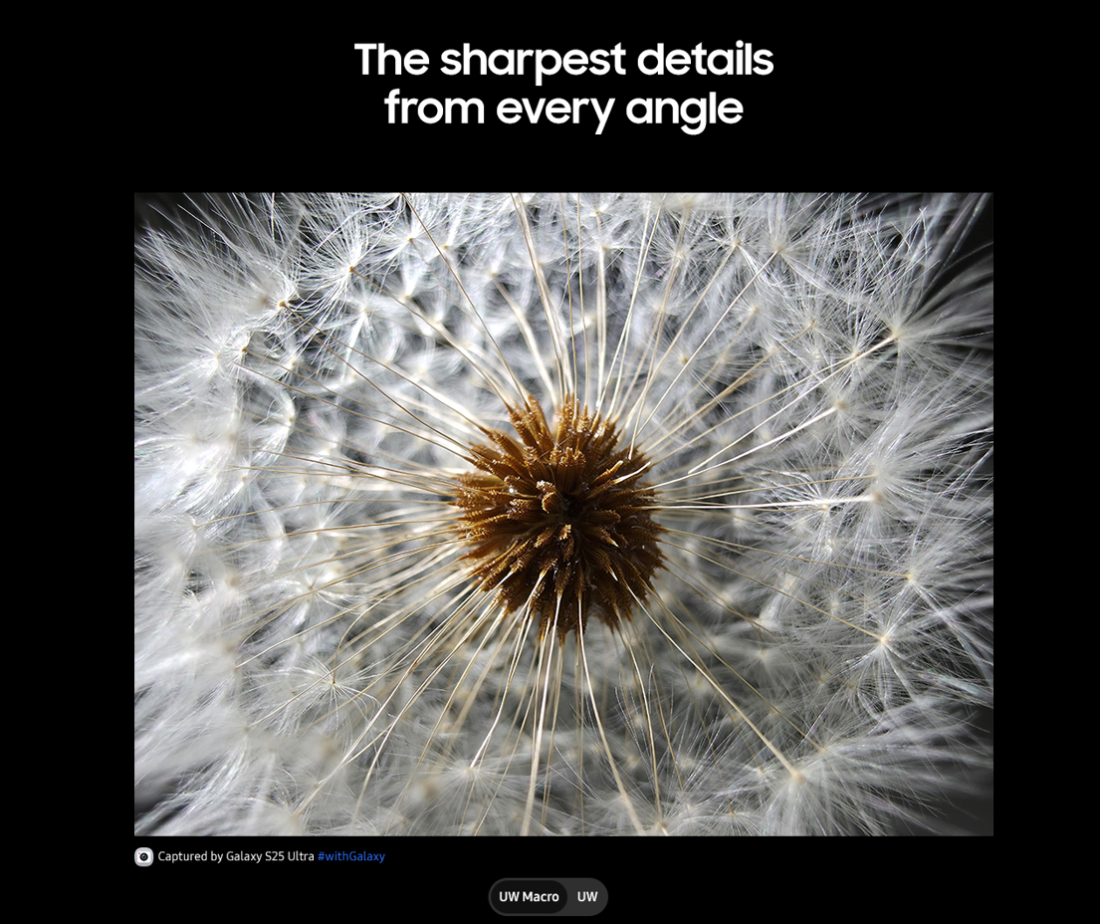
Features – High Resolution > Macro
1 | 클릭 시, UW Macro Image 이동
2 | 클릭 시, UW Image 이동
1
2
No. |  | Tagging Source
1 |  | Click to go UW Macro Image
 | AA | data-omni-type="microsite_contentinter" data-omni="galaxy-s25-ultra:features:camera^macro:slct-zoom:uw-macro"
 | GA | ga-ca="content click" ga-ac="feature" ga-la="galaxy-s25-ultra:features:camera^macro:slct-zoom:uw-macro"
2 |  | Click to go UW Image
 | AA | data-omni-type="microsite_contentinter" data-omni="galaxy-s25-ultra:features:camera^macro:slct-zoom:uw"
 | GA | ga-ca="content click" ga-ac="feature" ga-la="galaxy-s25-ultra:features:camera^macro:slct-zoom:uw"

Slide 28
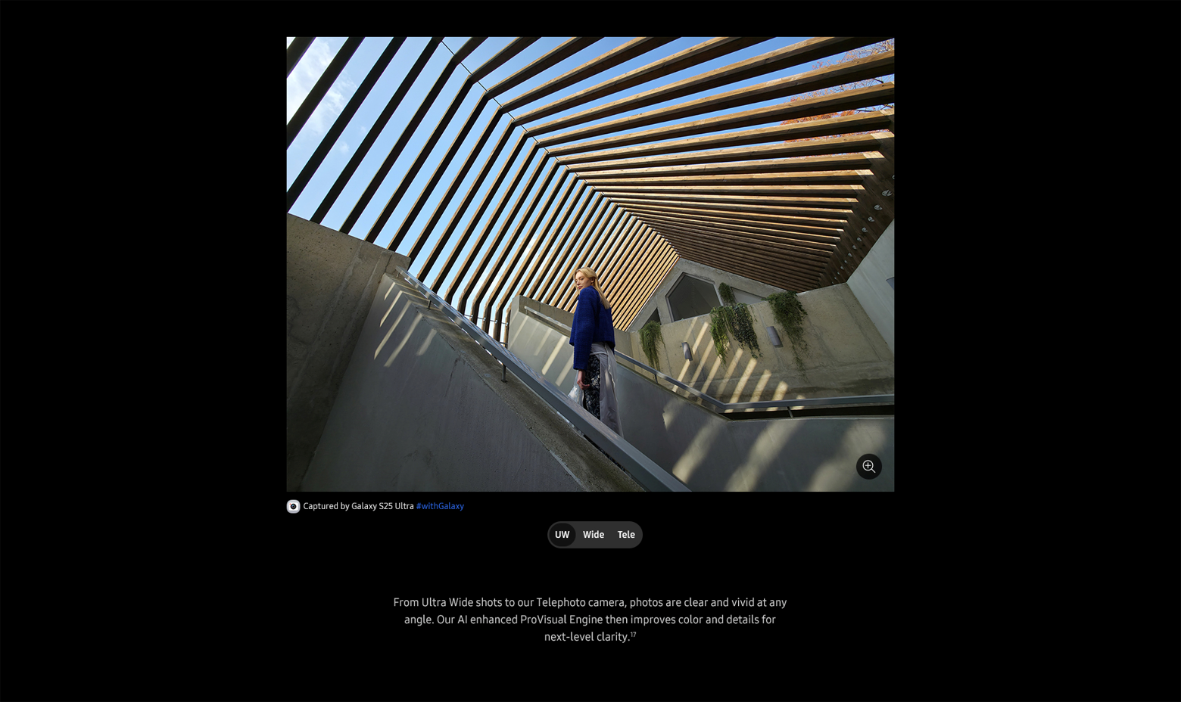
Features – High Resolution
1 | 클릭 시, 팝업 열기
2 | 클릭 시, UW Image 이동
3 | 클릭 시, Wide Image 이동
4 | 클릭 시, Tele Image 이동
1
2
3
4
No. |  | Tagging Source
1 |  | Click to Open Pop up
 | AA | data-omni-type="microsite_contentinter" data-omni="galaxy-s25-ultra:features:camera^high-resolution:lypu-open:uw"
 | GA | ga-ca="content click" ga-ac="feature" ga-la="galaxy-s25-ultra:features:camera^high-resolution:lypu-open:uw"
2 |  | Click to go UW Image
 | AA | data-omni-type="microsite_contentinter" data-omni="galaxy-s25-ultra:features:camera^high-resolution:slct-zoom:uw"
 | GA | ga-ca="content click" ga-ac="feature" ga-la="galaxy-s25-ultra:features:camera^high-resolution:slct-zoom:uw"
3 |  | Click to go Wide Image
 | AA | data-omni-type="microsite_contentinter" data-omni="galaxy-s25-ultra:features:camera^high-resolution:slct-zoom:wide"
 | GA | ga-ca="content click" ga-ac="feature" ga-la="galaxy-s25-ultra:features:camera^high-resolution:slct-zoom:wide"
4 |  | Click to go Tele Image
 | AA | data-omni-type="microsite_contentinter" data-omni="galaxy-s25-ultra:features:camera^high-resolution:slct-zoom:tele"
 | GA | ga-ca="content click" ga-ac="feature" ga-la="galaxy-s25-ultra:features:camera^high-resolution:slct-zoom:tele"

Slide 29
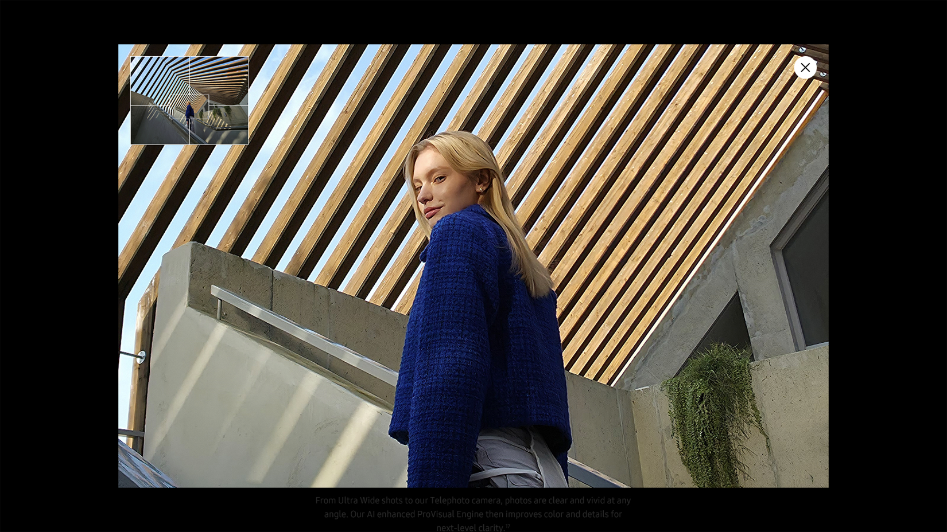
Features – High Resolution > UW > Pop up
1
1 | 클릭 시, 팝업 닫기
No. |  | Tagging Source
1 |  | Click to Close Pop up
 | AA | data-omni-type="microsite_contentinter" data-omni="galaxy-s25-ultra:features:camera^high-resolution^lypu-1:lypu-close:close"
 | GA | ga-ca="content click" ga-ac="feature" ga-la="galaxy-s25-ultra:features:camera^high-resolution^lypu-1:lypu-close:close"

Slide 30
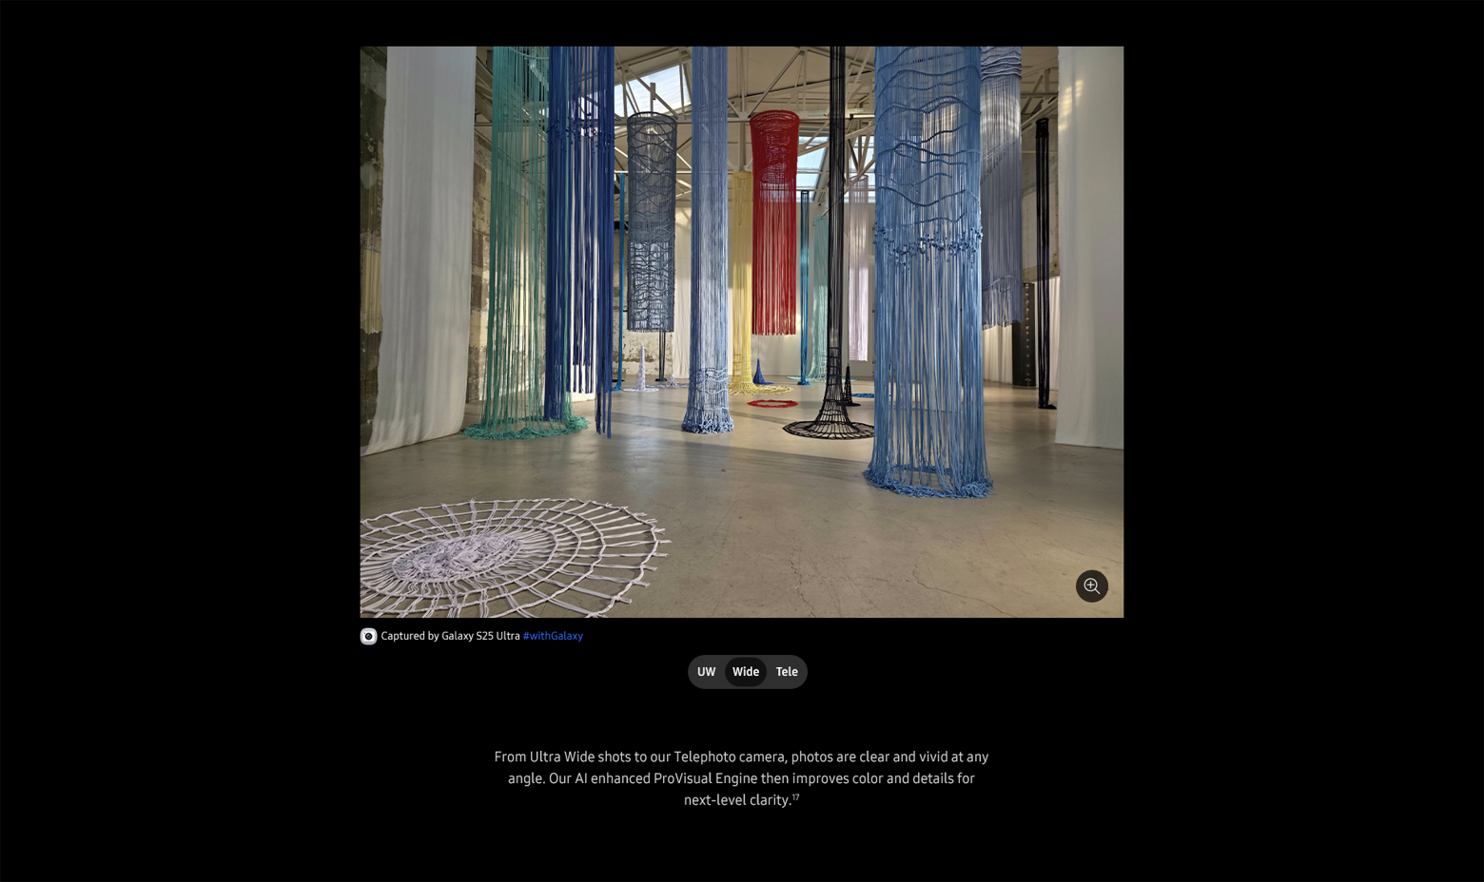
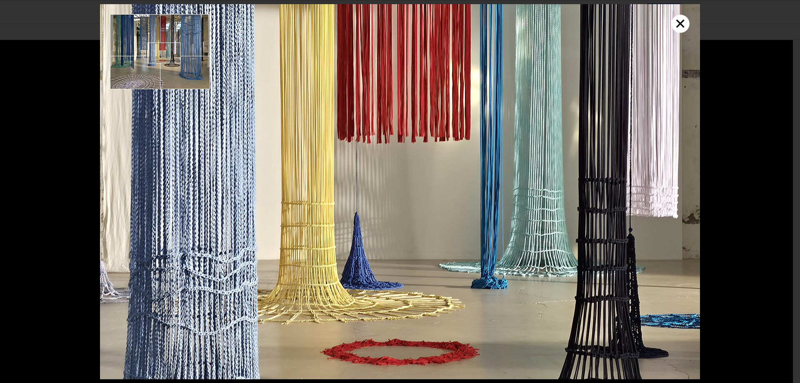
Features – High Resolution > Wide
1 | 클릭 시, 팝업 열기
1
No. |  | Tagging Source
1 |  | Click to Open Pop up
 | AA | data-omni-type="microsite_contentinter" data-omni="galaxy-s25-ultra:features:camera^high-resolution:lypu-open:wide"
 | GA | ga-ca="content click" ga-ac="feature" ga-la="galaxy-s25-ultra:features:camera^high-resolution:lypu-open:wide"

Slide 31
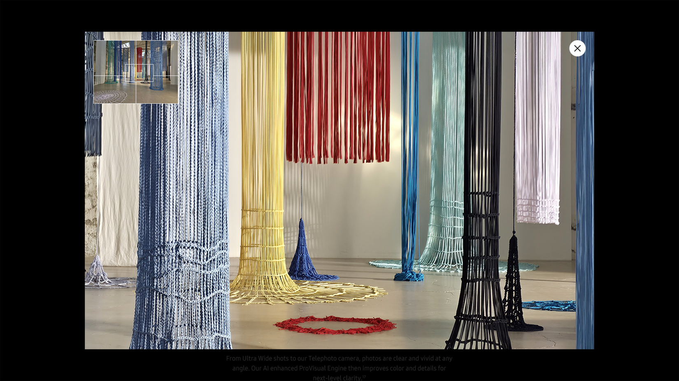
Features – High Resolution Pop up_2
1
1 | 클릭 시, 팝업 닫기
No. |  | Tagging Source
1 |  | Click to Close Pop up
 | AA | data-omni-type="microsite_contentinter" data-omni="galaxy-s25-ultra:features:camera^high-resolution^lypu-2:lypu-close:close"
 | GA | ga-ca="content click" ga-ac="feature" ga-la="galaxy-s25-ultra:features:camera^high-resolution^lypu-2:lypu-close:close"

Slide 32
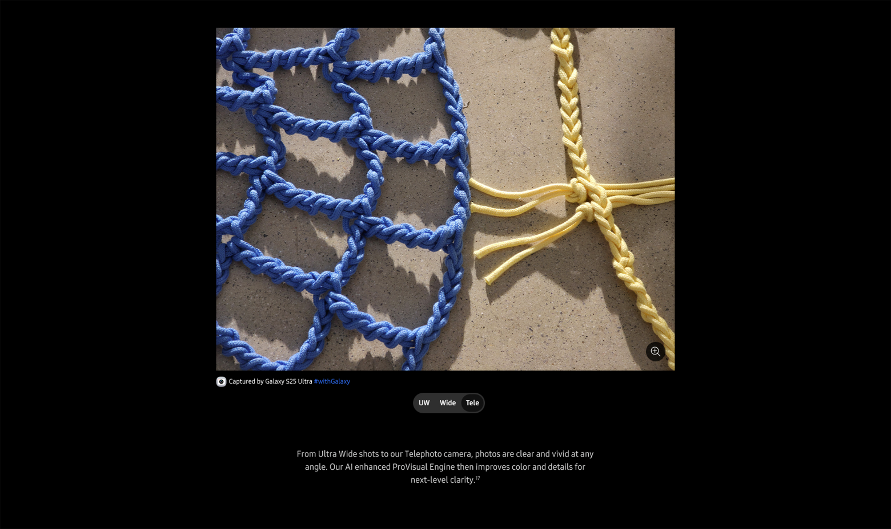
Features – High Resolution > Tele
1 | 클릭 시, 팝업 열기
1
No. |  | Tagging Source
1 |  | Click to Open Pop up
 | AA | data-omni-type="microsite_contentinter" data-omni="galaxy-s25-ultra:features:camera^high-resolution:lypu-open:tele"
 | GA | ga-ca="content click" ga-ac="feature" ga-la="galaxy-s25-ultra:features:camera^high-resolution:lypu-open:tele"

Slide 33
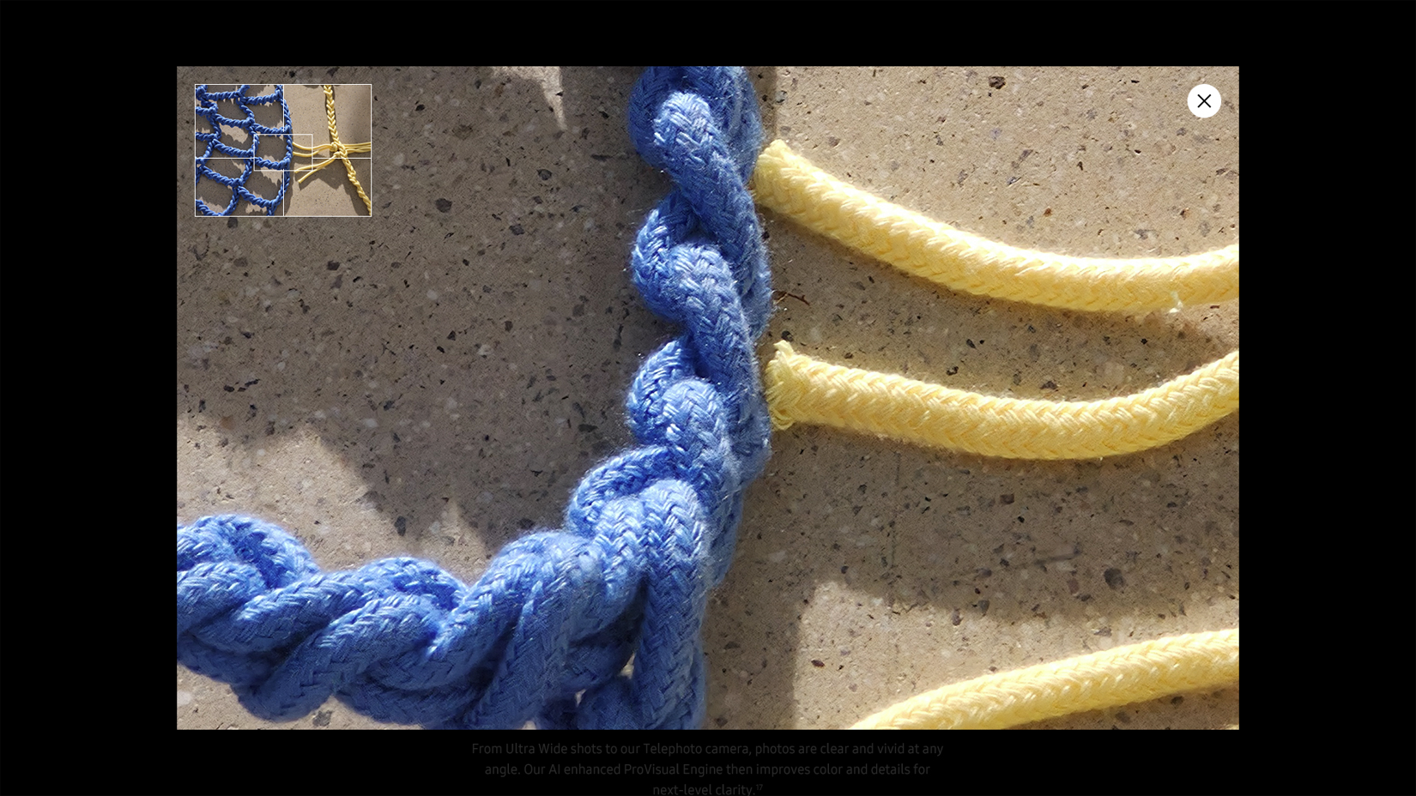
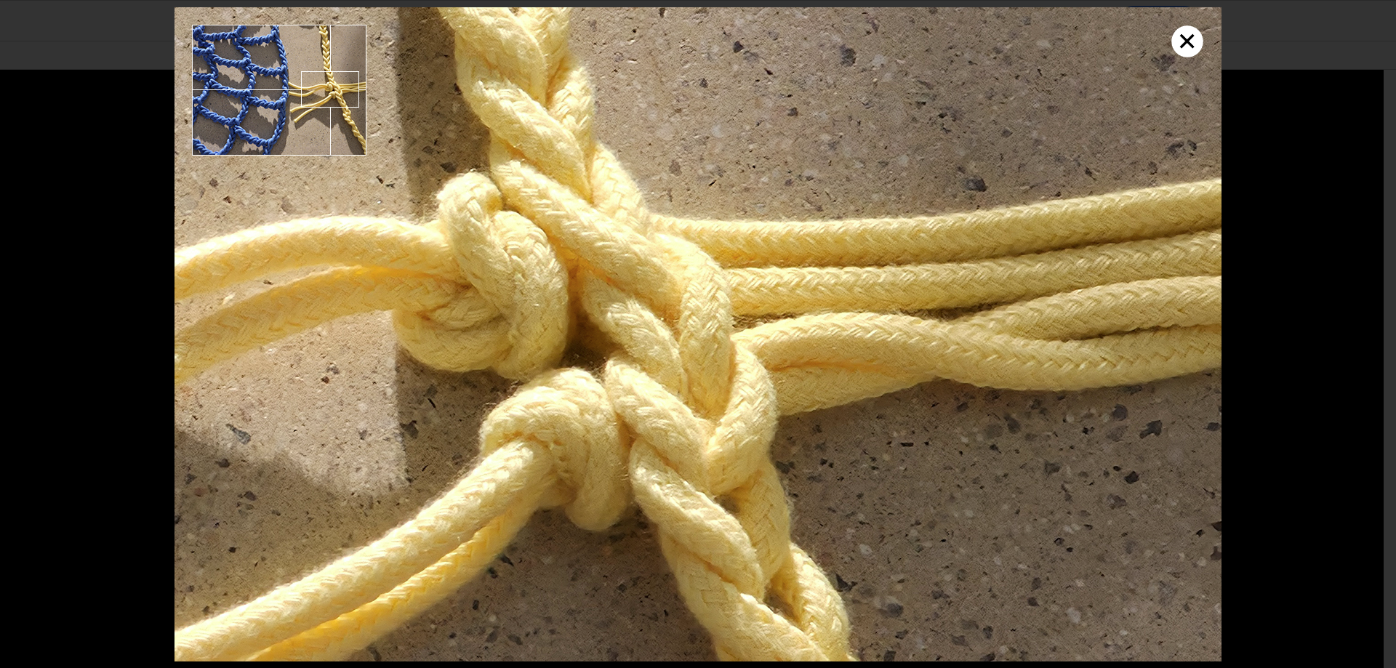
Features – High Resolution > Tele > Pop up
1
1 | 클릭 시, 팝업 닫기
No. |  | Tagging Source
1 |  | Click to Close Pop up
 | AA | data-omni-type="microsite_contentinter" data-omni="galaxy-s25-ultra:features:camera^high-resolution^lypu-3:lypu-close:close"
 | GA | ga-ca="content click" ga-ac="feature" ga-la="galaxy-s25-ultra:features:camera^high-resolution^lypu-3:lypu-close:close"

Slide 34
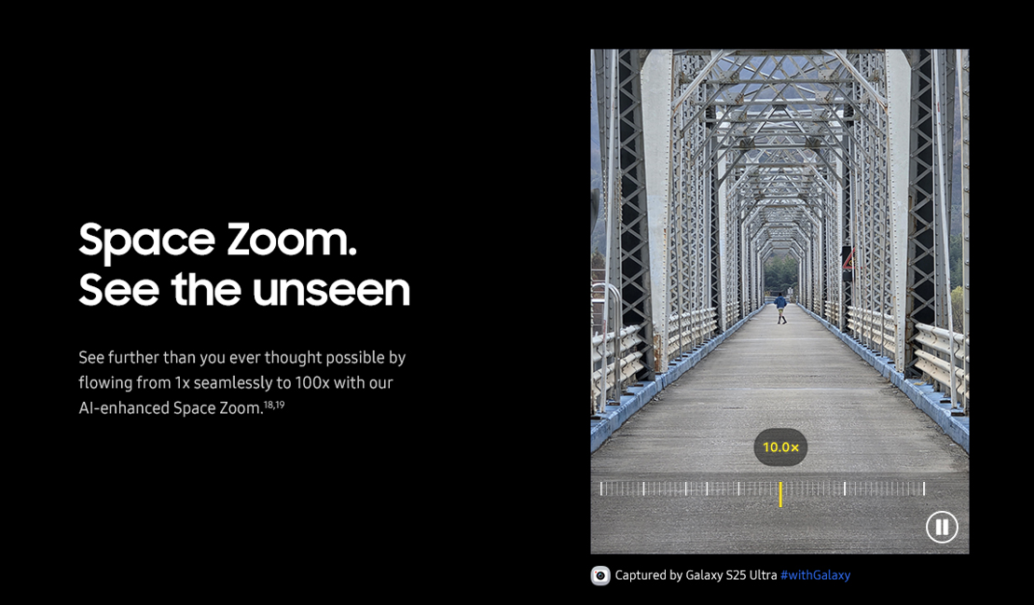
Features – Space Zoom
1 | 클릭 시, 영상 Play
2 | 클릭 시, 영상 Pause
1
2
No. |  | Tagging Source
1 |  | Click to Play
 | AA | data-omni-type="microsite_contentinter" data-omni="galaxy-s25-ultra:features:camera^space-zoom:movi-play:main-movie"
 | GA | ga-ca="content click" ga-ac="feature" ga-la="galaxy-s25-ultra:features:camera^space-zoom:movi-play:main-movie"
2 |  | Click to Pause
 | AA | data-omni-type="microsite_contentinter" data-omni="galaxy-s25-ultra:features:camera^space-zoom:movi-pause:main-movie"
 | GA | ga-ca="content click" ga-ac="feature" ga-la="galaxy-s25-ultra:features:camera^space-zoom:movi-pause:main-movie"

Slide 35
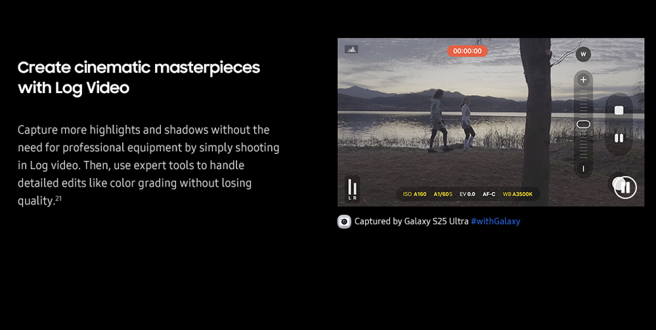
Features – Log Video
1 | 클릭 시, 영상 Play
2 | 클릭 시, 영상 Pause
1
2
No. |  | Tagging Source
1 |  | Click to Play
 | AA | data-omni-type="microsite_contentinter" data-omni="galaxy-s25-ultra:features:camera^log-video:movi-play:main-movie"
 | GA | ga-ca="content click" ga-ac="feature" ga-la="galaxy-s25-ultra:features:camera^log-video:movi-play:main-movie"
2 |  | Click to Pause
 | AA | data-omni-type="microsite_contentinter" data-omni="galaxy-s25-ultra:features:camera^log-video:movi-pause:main-movie"
 | GA | ga-ca="content click" ga-ac="feature" ga-la="galaxy-s25-ultra:features:camera^log-video:movi-pause:main-movie"

Slide 36
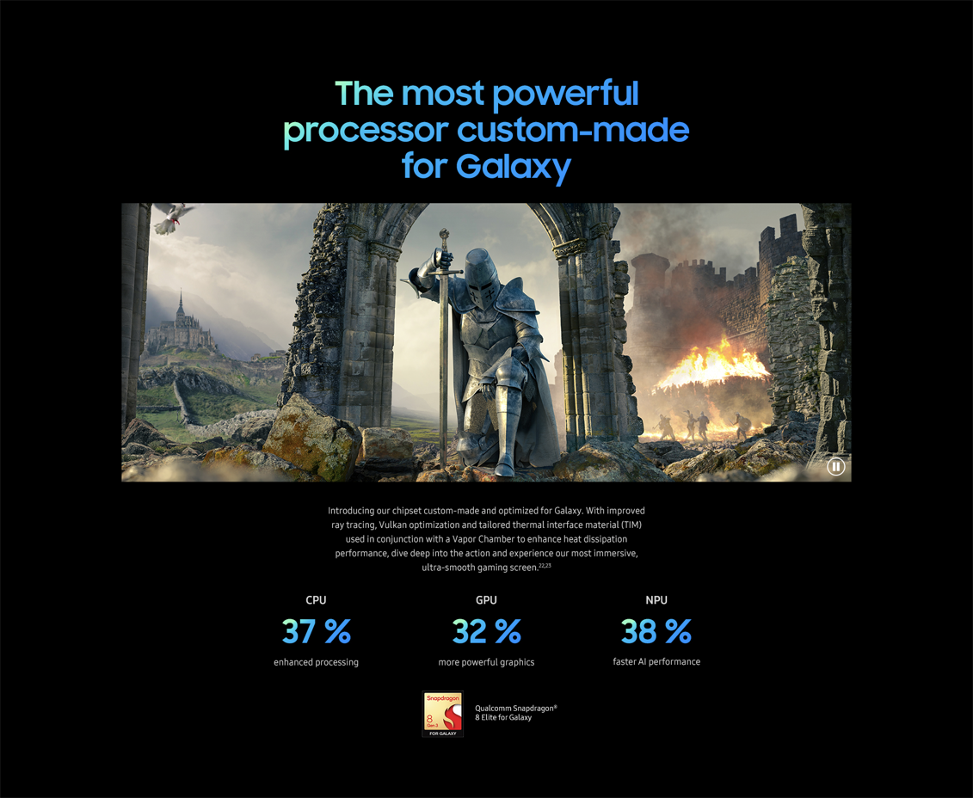
Features – Performance
1 | 클릭 시, 영상 Play
2 | 클릭 시, 영상 Pause
1
2
No. |  | Tagging Source
1 |  | Click to Play
 | AA | data-omni-type="microsite_contentinter" data-omni="galaxy-s25-ultra:features:performance^next-gen-ap:movi-play:main-movie"
 | GA | ga-ca="content click" ga-ac="feature" ga-la="galaxy-s25-ultra:features:performance^next-gen-ap:movi-play:main-movie"
2 |  | Click to Pause
 | AA | data-omni-type="microsite_contentinter" data-omni="galaxy-s25-ultra:features:performance^next-gen-ap:movi-pause:main-movie"
 | GA | ga-ca="content click" ga-ac="feature" ga-la="galaxy-s25-ultra:features:performance^next-gen-ap:movi-pause:main-movie"

Slide 37
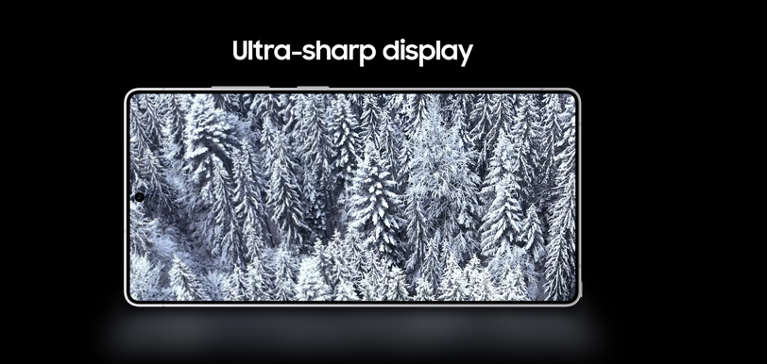
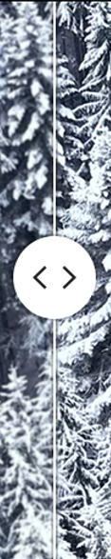
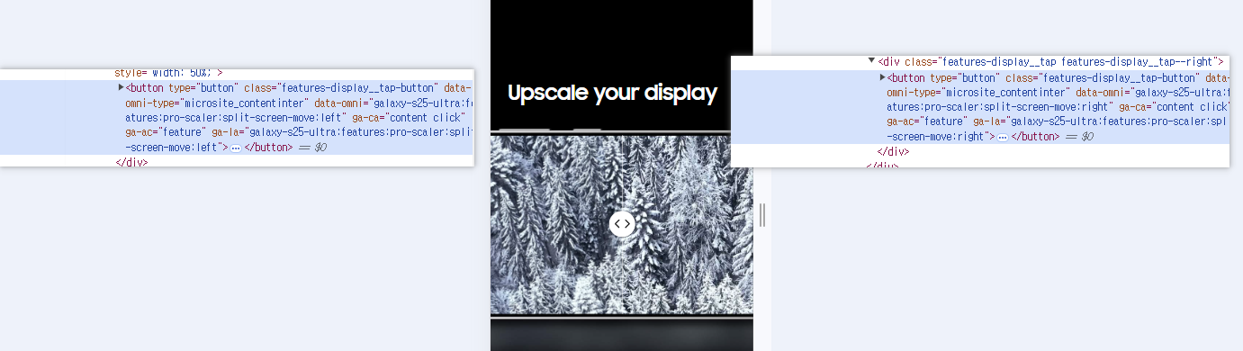
Features – Pro Sclaer
1 | 클릭 시, 바가 왼쪽으로 이동
2 | 클릭 시, 바가 오른쪽으로 이동
1
2
No. |  | Tagging Source
1 |  | Click to Move Left
 | AA | data-omni-type="microsite_contentinter" data-omni="galaxy-s25-ultra:features:pro-scaler:split-screen-move:left"
 | GA | ga-ca="content click" ga-ac="feature" ga-la="galaxy-s25-ultra:features:pro-scaler:split-screen-move:left"
2 |  | Click to Move Right
 | AA | data-omni-type="microsite_contentinter" data-omni="galaxy-s25-ultra:features:pro-scaler:split-screen-move:right"
 | GA | ga-ca="content click" ga-ac="feature" ga-la="galaxy-s25-ultra:features:pro-scaler:split-screen-move:right"

Slide 38
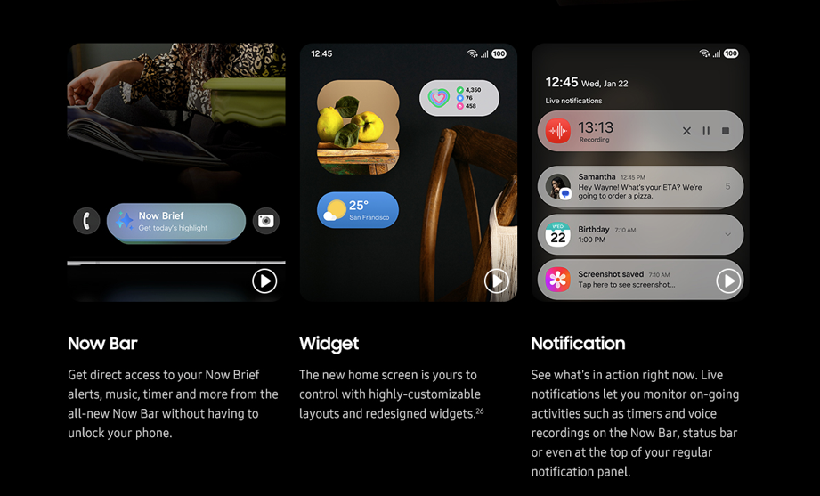

Features – One UI
1 | 클릭 시, 영상 Play
2 | 클릭 시, 영상 Pause
3 | 클릭 시, 영상 Play
4 | 클릭 시, 영상 Pause
5 | 클릭 시, 영상 Play
6 | 클릭 시, 영상 Pause
1
3
5
2
4
6
No. |  | Tagging Source
1 |  | Click to Play
 | AA | data-omni-type="microsite_contentinter" data-omni="galaxy-s25-ultra:features:one-ui^now-bar:movi-play:main-movie"
 | GA | ga-ca="content click" ga-ac="feature" ga-la="galaxy-s25-ultra:features:one-ui^now-bar:movi-play:main-movie"
2 |  | Click to Pause
 | AA | data-omni-type="microsite_contentinter" data-omni="galaxy-s25-ultra:features:one-ui^now-bar:movi-pause:main-movie"
 | GA | ga-ca="content click" ga-ac="feature" ga-la="galaxy-s25-ultra:features:one-ui^now-bar:movi-pause:main-movie"
3 |  | Click to Play
 | AA | data-omni-type="microsite_contentinter" data-omni="galaxy-s25-ultra:features:one-ui^widget:movi-play:main-movie"
 | GA | ga-ca="content click" ga-ac="feature" ga-la="galaxy-s25-ultra:features:one-ui^widget:movi-play:main-movie"
4 |  | Click to Pause
 | AA | data-omni-type="microsite_contentinter" data-omni="galaxy-s25-ultra:features:one-ui^widget:movi-pause:main-movie"
 | GA | ga-ca="content click" ga-ac="feature" ga-la="galaxy-s25-ultra:features:one-ui^widget:movi-pause:main-movie"
5 |  | Click to Play
 | AA | data-omni-type="microsite_contentinter" data-omni="galaxy-s25-ultra:features:one-ui^notification:movi-play:main-movie"
 | GA | ga-ca="content click" ga-ac="feature" ga-la="galaxy-s25-ultra:features:one-ui^notification:movi-play:main-movie"
6 |  | Click to Pause
 | AA | data-omni-type="microsite_contentinter" data-omni="galaxy-s25-ultra:features:one-ui^notification:movi-pause:main-movie"
 | GA | ga-ca="content click" ga-ac="feature" ga-la="galaxy-s25-ultra:features:one-ui^notification:movi-pause:main-movie"

Slide 39
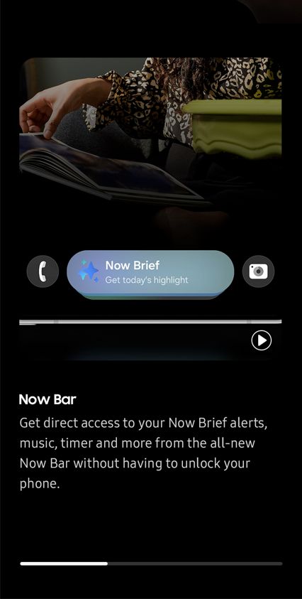
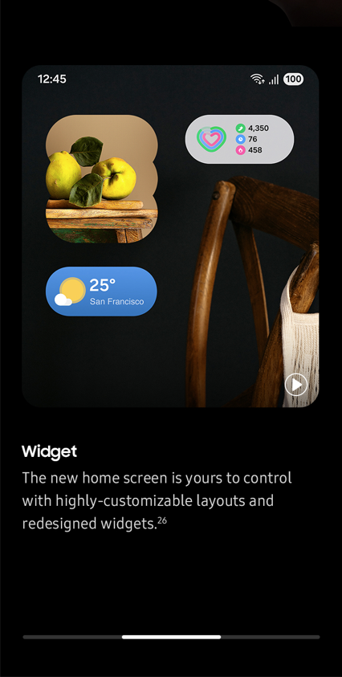
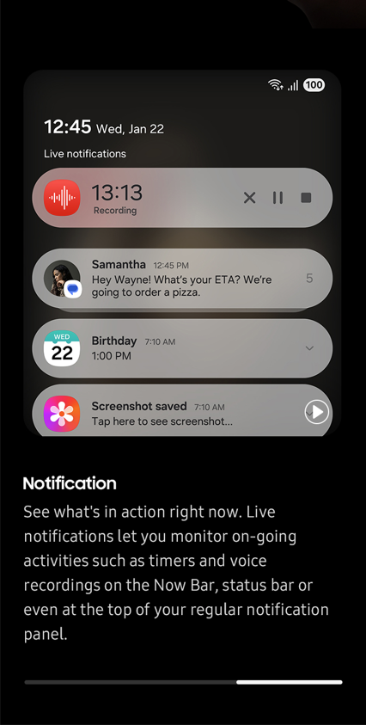
Features – Why Switch to Galaxy (MO)
1 | 클릭 시, 첫번째 Carousel 로 이동
2 | 클릭 시, 두번째 Carousel 로 이동
3 | 클릭 시, 세번째 Carousel 로 이동
1
2
3
No. |  | Tagging Source
1 |  | Click to go Carousel 1
 | AA | data-omni-type="microsite_gallery" data-omni="galaxy-s25-ultra:features:one-ui:sldr-dots:1"
 | GA | ga-ca="gallery" ga-ac="feature gallery" ga-la="galaxy-s25-ultra:features:one-ui:sldr-dots:1"
2 |  | Click to go Carousel 2
 | AA | data-omni-type="microsite_gallery" data-omni="galaxy-s25-ultra:features:one-ui:sldr-dots:2"
 | GA | ga-ca="gallery" ga-ac="feature gallery" ga-la="galaxy-s25-ultra:features:one-ui:sldr-dots:2"
3 |  | Click to go Carousel 3
 | AA | data-omni-type="microsite_gallery" data-omni="galaxy-s25-ultra:features:one-ui:sldr-dots:3"
 | GA | ga-ca="gallery" ga-ac="feature gallery" ga-la="galaxy-s25-ultra:features:one-ui:sldr-dots:3"

Slide 40
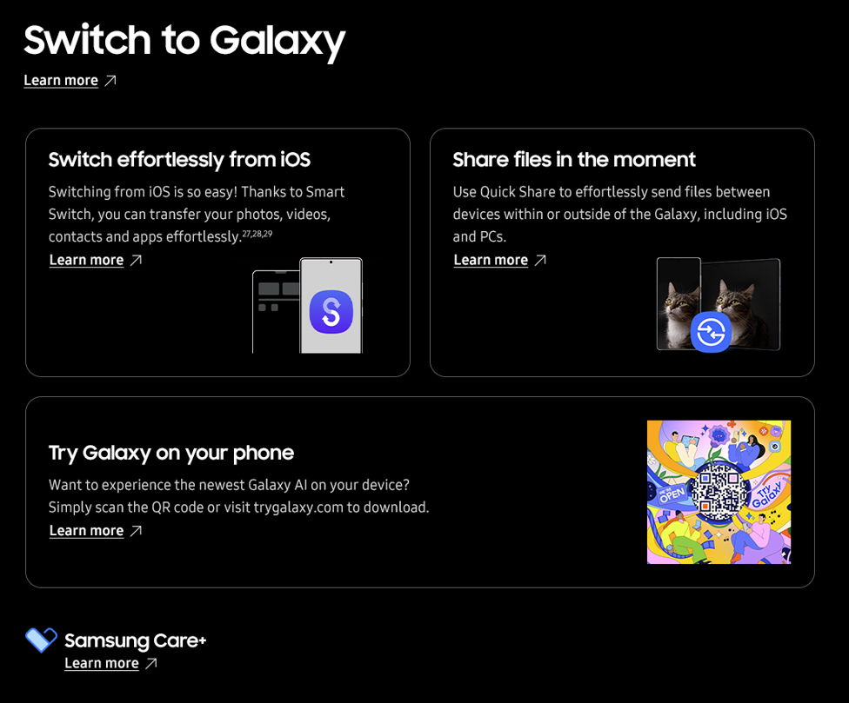
Features – Why Switch to Galaxy
1
1 | 클릭 시, Switch to Galaxy Page 로 이동
2 | 클릭 시, Smart Switch Page 로 이동
3 | 클릭 시, Quick Share Page 로 이동
4 | 클릭 시, Try Galaxy Page 로 이동
5 | 클릭 시, Samsung Care+ Page 로 이동
2
3
4
4
No. |  | Tagging Source
1 |  | Click to go Switch to Galaxy Page
 | AA | data-omni-type="microsite_contentinter" data-omni="galaxy-s25-ultra:features:switch-to-galaxy:link-page:apps^switch-to-galaxy"
 | GA | ga-ca="content click" ga-ac="feature" ga-la="galaxy-s25-ultra:features:switch-to-galaxy:link-page:apps^switch-to-galaxy"
2 |  | Click to go Smart Switch Page
 | AA | data-omni-type="microsite_contentinter" data-omni="galaxy-s25-ultra:features:switch-to-galaxy^smart-switch:link-page:apps^smart-switch"
 | GA | ga-ca="content click" ga-ac="feature" ga-la="galaxy-s25-ultra:features:switch-to-galaxy^smart-switch:link-page:apps^smart-switch"
3 |  | Click to go Quick Share Page
 | AA | data-omni-type="microsite_contentinter" data-omni="galaxy-s25-ultra:features:switch-to-galaxy^quick-share:link-page:apps^quick-share"
 | GA | ga-ca="content click" ga-ac="feature" ga-la="galaxy-s25-ultra:features:switch-to-galaxy^quick-share:link-page:apps^quick-share"
4 |  | Click to go Try Galaxy Page
 | AA | data-omni-type="microsite_contentinter" data-omni="galaxy-s25-ultra:features:switch-to-galaxy^try-galaxy:link-page:try-galaxy"
 | GA | ga-ca="content click" ga-ac="feature" ga-la="galaxy-s25-ultra:features:switch-to-galaxy^try-galaxy:link-page:try-galaxy"
5 |  | Click to go Samsung Care+ Page
 | AA | data-omni-type="microsite_contentinter" data-omni="galaxy-s25-ultra:features:switch-to-galaxy:link-page:apps^samsung-care-plus"
 | GA | ga-ca="content click" ga-ac="feature" ga-la="galaxy-s25-ultra:features:switch-to-galaxy:link-page:apps^samsung-care-plus"

Slide 41
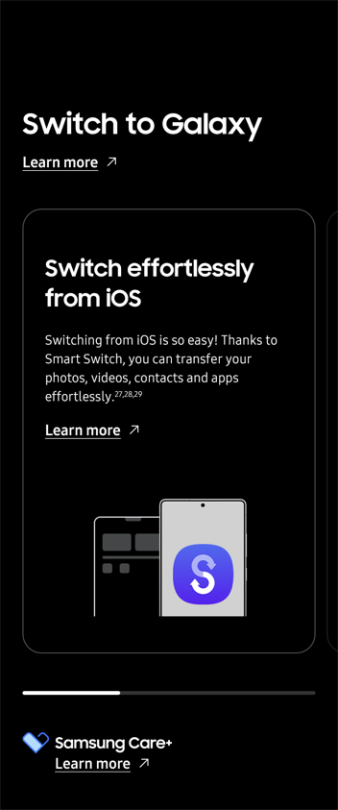
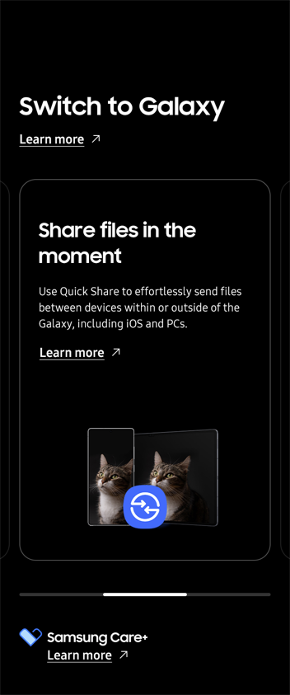
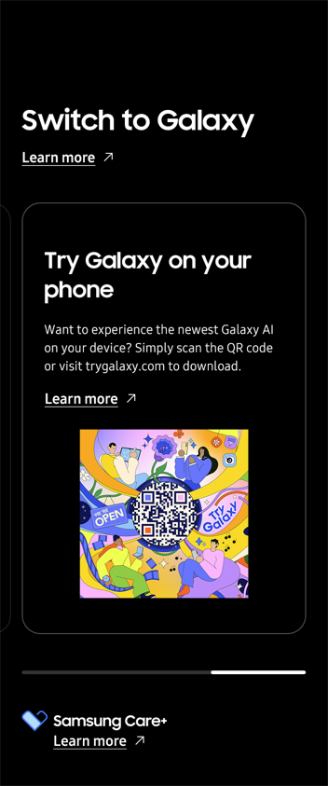
Features – Why Switch to Galaxy (MO)
1 | 클릭 시, 첫번째 Carousel 로 이동
2 | 클릭 시, 두번째 Carousel 로 이동
3 | 클릭 시, 세번째 Carousel 로 이동
1
2
3
No. |  | Tagging Source
1 |  | Click to go Carousel 1
 | AA | data-omni-type="microsite_gallery" data-omni="galaxy-s25-ultra:features:switch-to-galaxy:sldr-dots:1"
 | GA | ga-ca="gallery" ga-ac="feature gallery" ga-la="galaxy-s25-ultra:features:switch-to-galaxy:sldr-dots:1"
2 |  | Click to go Carousel 2
 | AA | data-omni-type="microsite_gallery" data-omni="galaxy-s25-ultra:features:switch-to-galaxy:sldr-dots:2"
 | GA | ga-ca="gallery" ga-ac="feature gallery" ga-la="galaxy-s25-ultra:features:switch-to-galaxy:sldr-dots:2"
3 |  | Click to go Carousel 3
 | AA | data-omni-type="microsite_gallery" data-omni="galaxy-s25-ultra:features:switch-to-galaxy:sldr-dots:3"
 | GA | ga-ca="gallery" ga-ac="feature gallery" ga-la="galaxy-s25-ultra:features:switch-to-galaxy:sldr-dots:3"

Slide 42
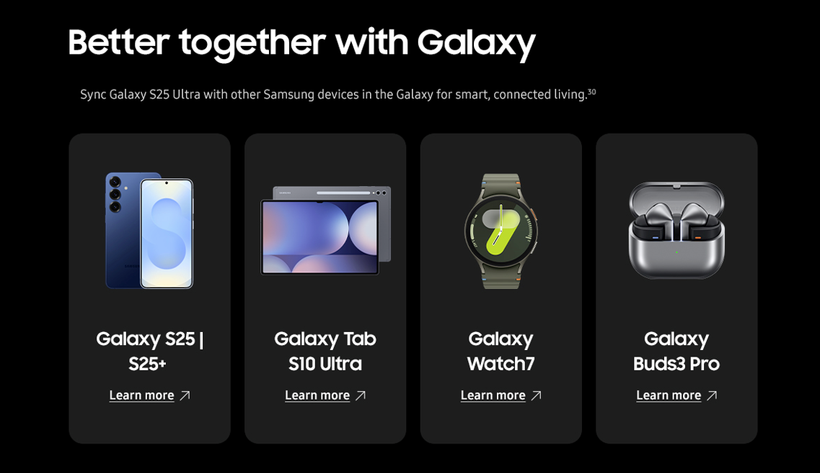
Features – Ecosystem
1 | 클릭 시, Galaxy S25 PD Page 로 이동
2 | 클릭 시, Galaxy Tab S10 Ultra PD Page 로 이동
3 | 클릭 시, Galaxy Watch7 PD Page 로 이동
4 | 클릭 시, Galaxy Buds3 Pro PD Page 로 이동
1
2
3
4
No. |  | Tagging Source
1 |  | Click to go Galaxy S25 | S25+ MKT PD
 | AA | data-omni-type="microsite_contentinter" data-omni="galaxy-s25-ultra:features:ecosystem:link-page:galaxy-s25"
 | GA | ga-ca="content click" ga-ac="feature" ga-la="galaxy-s25-ultra:features:ecosystem:link-page:galaxy-s25"
2 |  | Click to go Galaxy Tab S10 Ultra MKT PD
 | AA | data-omni-type="microsite_contentinter" data-omni="galaxy-s25-ultra:features:ecosystem:link-page:galaxy-tab-s10-ultra"
 | GA | ga-ca="content click" ga-ac="feature" ga-la="galaxy-s25-ultra:features:ecosystem:link-page:galaxy-tab-s10-ultra"
3 |  | Click to go Galaxy Watch7 MKT PD
 | AA | data-omni-type="microsite_contentinter" data-omni="galaxy-s25-ultra:features:ecosystem:link-page:galaxy-watch7"
 | GA | ga-ca="content click" ga-ac="feature" ga-la="galaxy-s25-ultra:features:ecosystem:link-page:galaxy-watch7"
4 |  | Click to go Galaxy Buds3 Pro MKT PD
 | AA | data-omni-type="microsite_contentinter" data-omni="galaxy-s25-ultra:features:ecosystem:link-page:galaxy-buds3-pro"
 | GA | ga-ca="content click" ga-ac="feature" ga-la="galaxy-s25-ultra:features:ecosystem:link-page:galaxy-buds3-pro"

Slide 43
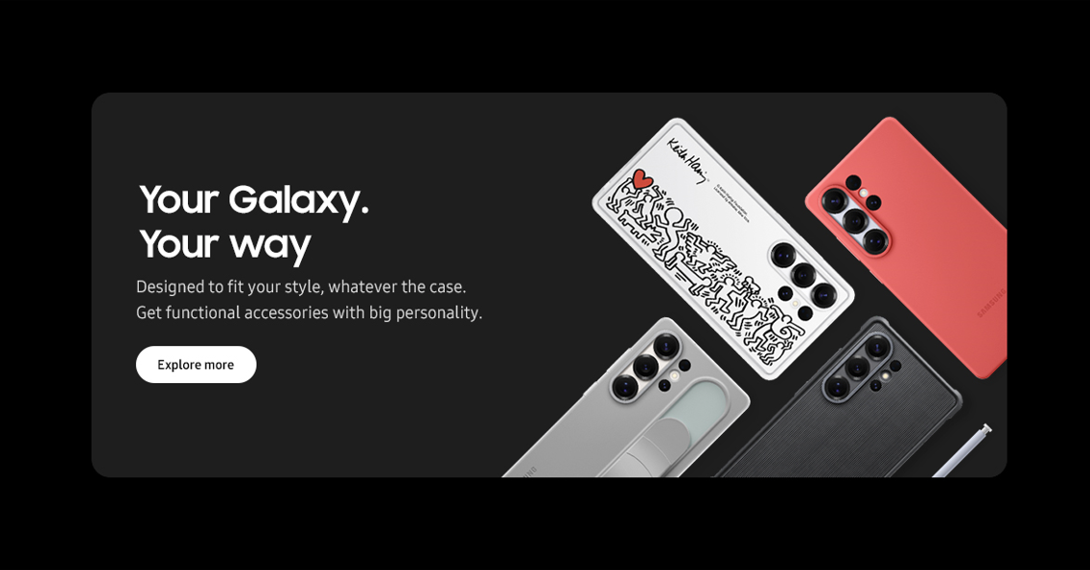
Features – Accessories
1 | 클릭 시, Acc PD Page 이동
1
No. |  | Tagging Source
1 |  | Click to go Accessories page in Galaxy S25 Ultra MKT PD
 | AA | data-omni-type="microsite_contentinter" data-omni="galaxy-s25-ultra:features:accessories:link-page:accessories"
 | GA | ga-ca="content click" ga-ac="feature" ga-la="galaxy-s25-ultra:features:accessories:link-page:accessories"

Slide 44
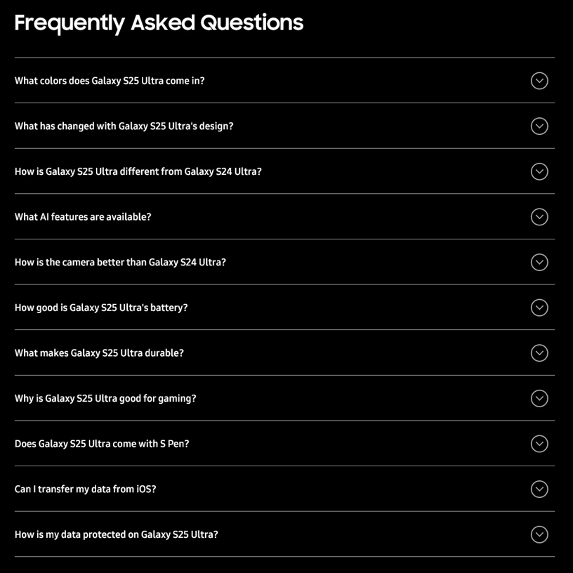
Features-FAQ (1/2)
1 | 클릭 시, Colors FAQ 열림
2 | 클릭 시, Design FAQ 열림
3 | 클릭 시, Compare FAQ 열림
4 | 클릭 시, Galaxy AI FAQ 열림
5 | 클릭 시, Camera FAQ 열림
6 | 클릭 시, Battery FAQ 열림
7 | 클릭 시, Durability FAQ 열림
8 | 클릭 시, Performance FAQ 열림
9 | 클릭 시, Design FAQ 열림
10 | 클릭 시, Switch to Galaxy FAQ 열림
11 | 클릭 시, Privacy FAQ 열림
1
2
3
4
5
6
7
8
9
10
11
No. |  | Tagging Source
1 |  | Click to open Colors FAQ
 | AA | data-omni-type="microsite_pcontentinter" data-omni="galaxy-s25-ultra:features:faq:acdn-open:colors"
 | GA | ga-ca="indication" ga-ac="accordion" ga-la="galaxy-s25-ultra:features:faq:acdn-open:colors"
2 |  | Click to open Design FAQ
 | AA | data-omni-type="microsite_pcontentinter" data-omni="galaxy-s25-ultra:features:faq:acdn-open:design-1"
 | GA | ga-ca="indication" ga-ac="accordion" ga-la="galaxy-s25-ultra:features:faq:acdn-open:design-1"
3 |  | Click to open Compare FAQ
 | AA | data-omni-type="microsite_pcontentinter" data-omni="galaxy-s25-ultra:features:faq:acdn-open:compare"
 | GA | ga-ca="indication" ga-ac="accordion" ga-la="galaxy-s25-ultra:features:faq:acdn-open:compare"
4 |  | Click to open Galaxy AI FAQ
 | AA | data-omni-type="microsite_pcontentinter" data-omni="galaxy-s25-ultra:features:faq:acdn-open:galaxy-ai"
 | GA | ga-ca="indication" ga-ac="accordion" ga-la="galaxy-s25-ultra:features:faq:acdn-open:galaxy-ai"
5 |  | Click to open Camera FAQ
 | AA | data-omni-type="microsite_pcontentinter" data-omni="galaxy-s25-ultra:features:faq:acdn-open:camera"
 | GA | ga-ca="indication" ga-ac="accordion" ga-la="galaxy-s25-ultra:features:faq:acdn-open:camera"
6 |  | Click to open Battery FAQ
 | AA | data-omni-type="microsite_pcontentinter" data-omni="galaxy-s25-ultra:features:faq:acdn-open:battery"
 | GA | ga-ca="indication" ga-ac="accordion" ga-la="galaxy-s25-ultra:features:faq:acdn-open:battery"
7 |  | Click to Open Durability FAQ
 | AA | data-omni-type="microsite_pcontentinter" data-omni="galaxy-s25-ultra:features:faq:acdn-open:durability"
 | GA | ga-ca="indication" ga-ac="accordion" ga-la="galaxy-s25-ultra:features:faq:acdn-open:durability"

Slide 45
Features-FAQ (2/2)
No. |  | Tagging Source
8 |  | Click to Open Performance FAQ
 | AA | data-omni-type="microsite_pcontentinter" data-omni="galaxy-s25-ultra:features:faq:acdn-open:performance"
 | GA | ga-ca="indication" ga-ac="accordion" ga-la="galaxy-s25-ultra:features:faq:acdn-open:performance"
9 |  | Click to Open Design FAQ
 | AA | data-omni-type="microsite_pcontentinter" data-omni="galaxy-s25-ultra:features:faq:acdn-open:design-2"
 | GA | ga-ca="indication" ga-ac="accordion" ga-la="galaxy-s25-ultra:features:faq:acdn-close:design-2"
10 |  | Click to Open Switch to Galaxy FAQ
 | AA | data-omni-type="microsite_pcontentinter" data-omni="galaxy-s25-ultra:features:faq:acdn-open:smart-switch"
 | GA | ga-ca="indication" ga-ac="accordion" ga-la="galaxy-s25-ultra:features:faq:acdn-open:smart-switch"
11 |  | Click to Open Privacy FAQ
 | AA | data-omni-type="microsite_pcontentinter" data-omni="galaxy-s25-ultra:features:faq:acdn-open:privacy"
 | GA | ga-ca="indication" ga-ac="accordion" ga-la="galaxy-s25-ultra:features:faq:acdn-open:privacy"

Slide 46
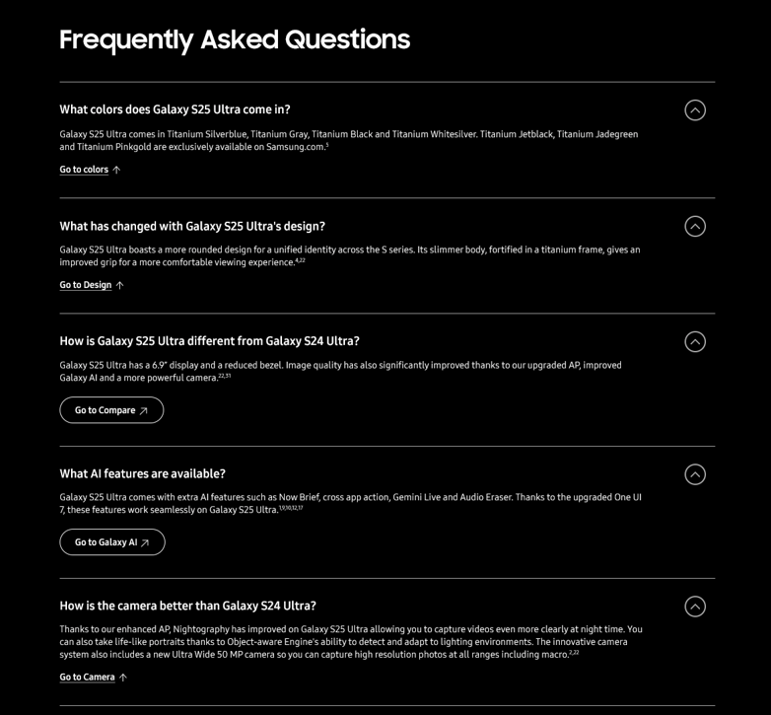
Highlights – FAQ (1/2)
1 | 클릭 시, Colors Feature 앵커 이동
2 | 클릭 시, Design Feature 앵커 이동
3 | 클릭 시, Compare 페이지 이동
4 | 클릭 시, Galaxy AI 페이지 이동
5 | 클릭 시, Camera Feature 앵커 이동
1
2
3
4
5
No. |  | Tagging Source
1 |  | Click to go Colors feature in Features page
 | AA | data-omni-type="microsite_contentinter" data-omni="galaxy-s25-ultra:features:faq^colors:link-anchor:design^colors"
 | GA | ga-ca="content click" ga-ac="feature" ga-la="galaxy-s25-ultra:features:faq^colors:link-anchor:design^colors"
2 |  | Click to go Design feature in Features page
 | AA | data-omni-type="microsite_contentinter" data-omni="galaxy-s25-ultra:features:faq^design:link-anchor:design"
 | GA | ga-ca="content click" ga-ac="feature" ga-la="galaxy-s25-ultra:features:faq^design:link-anchor:design"
3 |  | Click to go Compare PD Page
 | AA | data-omni-type="microsite_contentinter" data-omni="galaxy-s25-ultra:features:faq^compare:link-anchor:compare^upgrade"
 | GA | ga-ca="content click" ga-ac="feature" ga-la="galaxy-s25-ultra:features:faq^compare:link-anchor:compare^upgrade"
4 |  | Click to go AI PD Page
 | AA | data-omni-type="microsite_contentinter" data-omni="galaxy-s25-ultra:features:faq^galaxy-ai:link-anchor:galaxy-ai"
 | GA | ga-ca="content click" ga-ac="feature" ga-la="galaxy-s25-ultra:features:faq^galaxy-ai:link-anchor:galaxy-ai"
5 |  | Click to go Camera feature in Features page
 | AA | data-omni-type="microsite_contentinter" data-omni="galaxy-s25-ultra:features:faq^camera:link-anchor:camera"
 | GA | ga-ca="content click" ga-ac="feature" ga-la="galaxy-s25-ultra:features:faq^camera:link-anchor:camera"

Slide 47
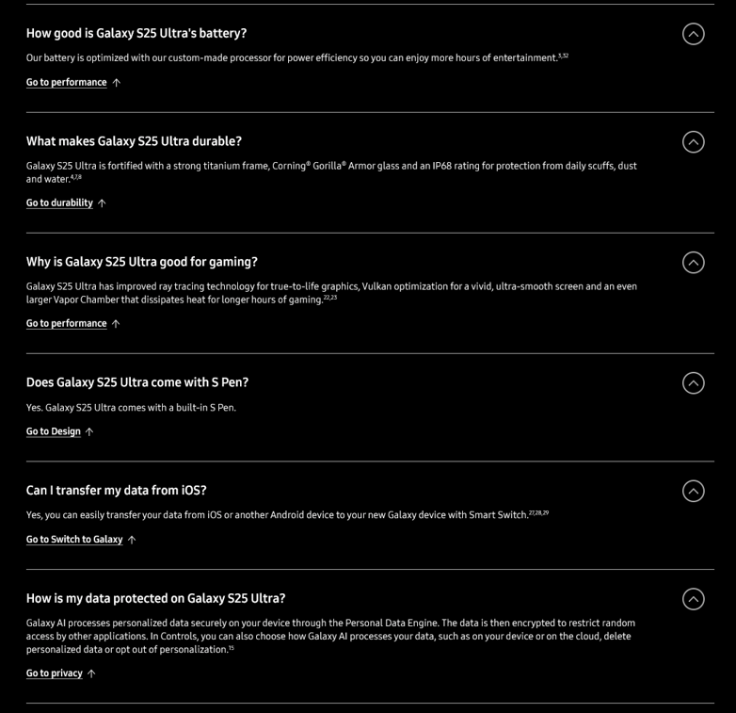
Highlights – FAQ (2/2)
6
6 | 클릭 시, Battery Feature 이동
7 | 클릭 시, Durability Feature 이동
8 | 클릭 시, Performance Feature 이동
9 | 클릭 시, Design Feature 이동
10 | 클릭 시, Switch to Galaxy Feature 이동
11 | 클릭 시, Privacy Feature 이동
7
8
9
10
11
No. |  | Tagging Source
6 |  | Click to go Performance feature in Features page
 | AA | data-omni-type="microsite_contentinter" data-omni="galaxy-s25-ultra:features:faq^battery:link-anchor:performance-1"
 | GA | ga-ca="content click" ga-ac="feature" ga-la="galaxy-s25-ultra:features:faq^battery:link-anchor:performance-1"
7 |  | Click to go Durability feature in Features page
 | AA | data-omni-type="microsite_contentinter" data-omni="galaxy-s25-ultra:features:faq^durability:link-anchor:design^durability"
 | GA | ga-ca="content click" ga-ac="feature" ga-la="galaxy-s25-ultra:features:faq^durability:link-anchor:design^durability"
8 |  | Click to go Performance feature in Features page
 | AA | data-omni-type="microsite_contentinter" data-omni="galaxy-s25-ultra:features:faq^performance:link-anchor:performance-2"
 | GA | ga-ca="content click" ga-ac="feature" ga-la="galaxy-s25-ultra:features:faq^performance:link-anchor:performance-2"
9 |  | Click to go Design feature in Features page
 | AA | data-omni-type="microsite_contentinter" data-omni="galaxy-s25-ultra:features:faq^design:link-anchor:design^form-factor"
 | GA | ga-ca="content click" ga-ac="feature" ga-la="galaxy-s25-ultra:features:faq^design:link-anchor:design^form-factor"
10 |  | Click to go Switch to Galaxy feature in Features page
 | AA | data-omni-type="microsite_contentinter" data-omni="galaxy-s25-ultra:features:faq^smart-switch:link-anchor:smart-switch"
 | GA | ga-ca="content click" ga-ac="feature" ga-la="galaxy-s25-ultra:features:faq^smart-switch:link-anchor:smart-switch"
11 |  | Click to go Privacy feature in Features page
 | AA | data-omni-type="microsite_contentinter" data-omni="galaxy-s25-ultra:features:faq^privacy:link-anchor:ai^privacy"
 | GA | ga-ca="content click" ga-ac="feature" ga-la="galaxy-s25-ultra:features:faq^privacy:link-anchor:ai^privacy"

Slide 48

Features-FAQ (1/2)
1
1 | 클릭 시, Colors FAQ 닫힘
2 | 클릭 시, Design FAQ 닫힘
3 | 클릭 시, Compare FAQ 닫힘
4 | 클릭 시, Galaxy AI FAQ 닫힘
5 | 클릭 시, Camera FAQ 닫힘
6 | 클릭 시, Battery FAQ 닫힘
7 | 클릭 시, Durability FAQ 닫힘
8 | 클릭 시, Performance FAQ 닫힘
9 | 클릭 시, Design FAQ 닫힘
10 | 클릭 시, Switch to Galaxy FAQ 닫힘
11 | 클릭 시, Privacy FAQ 닫힘
2
3
4
5
6
7
8
9
10
11
No. |  | Tagging Source
1 |  | Click to Close Colors FAQ
 | AA | data-omni-type="microsite_pcontentinter" data-omni="galaxy-s25-ultra:features:faq:acdn-close:colors"
 | GA | ga-ca="indication" ga-ac="accordion" ga-la="galaxy-s25-ultra:features:faq:acdn-close:colors"
2 |  | Click to Close Design FAQ
 | AA | data-omni-type="microsite_pcontentinter" data-omni="galaxy-s25-ultra:features:faq:acdn-close:design-1"
 | GA | ga-ca="indication" ga-ac="accordion" ga-la="galaxy-s25-ultra:features:faq:acdn-close:design-1"
3 |  | Click to Close Compare FAQ
 | AA | data-omni-type="microsite_pcontentinter" data-omni="galaxy-s25-ultra:features:faq:acdn-close:compare"
 | GA | ga-ca="indication" ga-ac="accordion" ga-la="galaxy-s25-ultra:features:faq:acdn-close:compare"
4 |  | Click to Close Galaxy AI FAQ
 | AA | data-omni-type="microsite_pcontentinter" data-omni="galaxy-s25-ultra:features:faq:acdn-close:galaxy-ai"
 | GA | ga-ca="indication" ga-ac="accordion" ga-la="galaxy-s25-ultra:features:faq:acdn-close:galaxy-ai"
5 |  | Click to Close Camera FAQ
 | AA | data-omni-type="microsite_pcontentinter" data-omni="galaxy-s25-ultra:features:faq:acdn-close:camera"
 | GA | ga-ca="indication" ga-ac="accordion" ga-la="galaxy-s25-ultra:features:faq:acdn-close:camera"
6 |  | Click to Close Battery FAQ
 | AA | data-omni-type="microsite_pcontentinter" data-omni="galaxy-s25-ultra:features:faq:acdn-close:battery"
 | GA | ga-ca="indication" ga-ac="accordion" ga-la="galaxy-s25-ultra:features:faq:acdn-close:battery"
7 |  | Click to Close Durability FAQ
 | AA | data-omni-type="microsite_pcontentinter" data-omni="galaxy-s25-ultra:features:faq:acdn-close:durability"
 | GA | ga-ca="indication" ga-ac="accordion" ga-la="galaxy-s25-ultra:features:faq:acdn-close:durability"

Slide 49
Features-FAQ (2/2)
No. |  | Tagging Source
8 |  | Click to Close Performance FAQ
 | AA | data-omni-type="microsite_pcontentinter" data-omni="galaxy-s25-ultra:features:faq:acdn-close:performance"
 | GA | ga-ca="indication" ga-ac="accordion" ga-la="galaxy-s25-ultra:features:faq:acdn-close:performance"
9 |  | Click to Close Design FAQ
 | AA | data-omni-type="microsite_pcontentinter" data-omni="galaxy-s25-ultra:features:faq:acdn-close:design-2"
 | GA | ga-ca="indication" ga-ac="accordion" ga-la="galaxy-s25-ultra:features:faq:acdn-close:design-2"
10 |  | Click to Close Switch to Galaxy FAQ
 | AA | data-omni-type="microsite_pcontentinter" data-omni="galaxy-s25-ultra:features:faq:acdn-close:smart-switch"
 | GA | ga-ca="indication" ga-ac="accordion" ga-la="galaxy-s25-ultra:features:faq:acdn-close:smart-switch"
11 |  | Click to Close Privacy FAQ
 | AA | data-omni-type="microsite_pcontentinter" data-omni="galaxy-s25-ultra:features:faq:acdn-close:privacy"
 | GA | ga-ca="indication" ga-ac="accordion" ga-la="galaxy-s25-ultra:features:faq:acdn-close:privacy"

Slide 50

Features – Bottom Disclaimer
1
1 | 클릭 시, Samsung business Page 이동
2 | 클릭 시, 이전 클릭한 Disclaimer 넘버로 이동
2
No. |  | Tagging Source
1 |  | Click to go Samsung business Page
 | AA | data-omni-type="microsite_contentinter" data-omni="galaxy-s25-ultra:features:bottom^bnn:link-page:business-site"
 | GA | ga-ca="content click" ga-ac="feature" ga-la="galaxy-s25-ultra:features:bottom^bnn:link-page:business-site"
2 |  | Click to return Feature
 | AA | data-omni-type="microsite_contentinter" data-omni="galaxy-s25-ultra:features:disclaimer:slct-tap:go-to-top"
 | GA | ga-ca="content click" ga-ac="feature" ga-la="galaxy-s25-ultra:features:disclaimer:slct-tap:go-to-top"

Slide 51
Accessories

Slide 52

Accessories – Overview
1 | 클릭 시 Accesoires tab 페이지 내 Cases 영역으로 이동
2 | 클릭 시 Accesoires tab 페이지 내 Galaxy Watch & Ring 영역으로 이동
3 | 클릭 시 Accesoires tab 페이지 내 Galaxy Buds 영역으로 이동
4 | 클릭 시 Accesoires tab 페이지 내 Chargers & SmartTag영역으로 이동
1
2
3
4
No. |  | Tagging Source
1 |  | Click to go CASES Section in Accessories page
 | AA | data-omni-type="microsite_contentinter" data-omni="galaxy-s25-ultra:accessories:overview:link-anchor:cases"
 | GA | ga-ca="content click" ga-ac="feature" ga-la="galaxy-s25-ultra:accessories:overview:link-anchor:cases"
2 |  | Click to go GALAXY WATCH & RING Section in Accessories page
 | AA | data-omni-type="microsite_contentinter" data-omni="galaxy-s25-ultra:accessories:overview:link-anchor:watch-and-ring"
 | GA | ga-ca="content click" ga-ac="feature" ga-la="galaxy-s25-ultra:accessories:overview:link-anchor:watch-and-ring"
3 |  | Click to go GALAXY BUDS Section in Accessories page
 | AA | data-omni-type="microsite_contentinter" data-omni="galaxy-s25-ultra:accessories:overview:link-anchor:galaxy-buds"
 | GA | ga-ca="content click" ga-ac="feature" ga-la="galaxy-s25-ultra:accessories:overview:link-anchor:galaxy-buds"
4 |  | Click to go CHARGERS & SMARTTAG Section in Accessories page
 | AA | data-omni-type="microsite_contentinter" data-omni="galaxy-s25-ultra:accessories:overview:link-anchor:galaxy-chargers-and-smarttag"
 | GA | ga-ca="content click" ga-ac="feature" ga-la="galaxy-s25-ultra:accessories:overview:link-anchor:galaxy-chargers-and-smarttag"

Slide 53


Accessories – Cases_ Flipsuit Case(Rugged)
1 | 클릭 시 Galaxy-S25-Ultra Flipsuit Case(Rugged) Colorchip1(Black) 제품 노출
2 | 클릭 시 Galaxy-S25-Ultra Flipsuit Case(Rugged) Colorchip1(Black) 제품 PDP로 이동
1
2
No. |  | Tagging Source
1 |  | Galaxy S25 Ultra Flipsuit Case - Colorchip1 (Black)
 | AA | data-omni-type="microsite_gallery" data-omni="galaxy-s25-ultra:accessories:cases^flipsuit-case:slct-color:black"
 | GA | ga-ca="gallery" ga-ac="feature gallery" ga-la="galaxy-s25-ultra:accessories:cases^flipsuit-case:slct-color:black"
2 |  | Galaxy S25 Ultra Flipsuit Case - Click to go case PDP (Black)
 | AA | data-omni-type="microsite_contentinter" data-omni="galaxy-s25-ultra:accessories:cases^flipsuit-case:conv-oth:black"
 | GA | ga-ca="content click" ga-ac="feature" ga-la="galaxy-s25-ultra:accessories:cases^flipsuit-case:conv-oth:black"

Slide 54

Accessories – Cases_ Flipsuit Case
1 | 클릭 시 Galaxy-S25-Ultra Flipsuit Case Colorchip1(White) 제품 노출
2 | 클릭 시 Galaxy-S25-Ultra Flipsuit Case Colorchip1(White) 제품 PDP로 이동
1
2
No. |  | Tagging Source
1 |  | Galaxy S25 Ultra Flipsuit Case - Colorchip1 (White)
 | AA | data-omni-type="microsite_gallery" data-omni="galaxy-s25-ultra:accessories:cases^flipsuit-case:slct-color:white"
 | GA | ga-ca="gallery" ga-ac="feature gallery" ga-la="galaxy-s25-ultra:accessories:cases^flipsuit-case:slct-color:white"
2 |  | Galaxy S25 Ultra Flipsuit Case - Click to go case PDP (White)
 | AA | data-omni-type="microsite_contentinter" data-omni="galaxy-s25-ultra:accessories:cases^flipsuit-case:conv-oth:white"
 | GA | ga-ca="content click" ga-ac="feature" ga-la="galaxy-s25-ultra:accessories:cases^flipsuit-case:conv-oth:white"

Slide 55

Accessories – Cases_ Rugged Case
1 | 클릭 시 Galaxy-S25-Ultra Rugged Case Colorchip1(Black) 제품 노출
2 | 클릭 시 Galaxy-S25-Ultra Rugged Case Colorchip1(Black) 제품 PDP로 이동
1
2
No. |  | Tagging Source
1 |  | Galaxy S25 Ultra Rugged Case - Colorchip1 (Black)
 | AA | data-omni-type="microsite_gallery" data-omni="galaxy-s25-ultra:accessories:cases^rugged-case:slct-color:black"
 | GA | ga-ca="gallery" ga-ac="feature gallery" ga-la="galaxy-s25-ultra:accessories:cases^rugged-case:slct-color:black"
2 |  | Galaxy S25 Ultra Rugged Case - Click to go case PDP (Black)
 | AA | data-omni-type="microsite_contentinter" data-omni="galaxy-s25-ultra:accessories:cases^rugged-case:conv-oth:black"
 | GA | ga-ca="content click" ga-ac="feature" ga-la="galaxy-s25-ultra:accessories:cases^rugged-case:conv-oth:black"

Slide 56



Accessories – Cases_Standing Grip Case
Mobile
1 | 클릭 시 Galaxy-S25-Ultra Standing Grip Case Colorchip1(Black) 제품 노출
2 | 클릭 시 Galaxy-S25-Ultra Standing Grip Case Colorchip2(Gray) 제품 노출
3 | 클릭 시 Galaxy-S25-Ultra Standing Grip Case Colorchip3(White) 제품 노출
4 | 클릭 시 Galaxy-S25-Ultra Standing Grip Case Colorchip1(Black) 제품 PDP로 이동
5 | 클릭 시 Galaxy-S25-Ultra Standing Grip Case Colorchip2(Gray) 제품 PDP로 이동
6 | 클릭 시 Galaxy-S25-Ultra Standing Grip Case Colorchip3(White) 제품 PDP로 이동
7 | 클릭 시 Galaxy-S25-Ultra Standing Grip Case Colorchip변경
8 | 클릭 시 Galaxy-S25-Ultra Standing Grip Case Colorchip 변경
7
8
1
2
3
4
5
6
No. |  | Tagging Source
1 |  | Galaxy S25 Ultra Standing Grip Case - Colorchip1 (Black)
 | AA | data-omni-type="microsite_gallery" data-omni="galaxy-s25-ultra:accessories:cases^standing-grip-case:slct-color:black"
 | GA | ga-ca="gallery" ga-ac="feature gallery" ga-la="galaxy-s25-ultra:accessories:cases^standing-grip-case:slct-color:black"
2 |  | Galaxy S25 Ultra Standing Grip Case - Colorchip2 (Gray)
 | AA | data-omni-type="microsite_gallery" data-omni="galaxy-s25-ultra:accessories:cases^standing-grip-case:slct-color:gray"
 | GA | ga-ca="gallery" ga-ac="feature gallery" ga-la="galaxy-s25-ultra:accessories:cases^standing-grip-case:slct-color:gray"
3 |  | Galaxy S25 Ultra Standing Grip Case – Colorchip3 (White)
 | AA | data-omni-type="microsite_gallery" data-omni="galaxy-s25-ultra:accessories:cases^standing-grip-case:slct-color:white"
 | GA | ga-ca="gallery" ga-ac="feature gallery" ga-la="galaxy-s25-ultra:accessories:cases^standing-grip-case:slct-color:white"
4 |  | Galaxy S25 Ultra Standing Grip Case - Click to go case PDP (Black)
 | AA | data-omni-type="microsite_contentinter" data-omni="galaxy-s25-ultra:accessories:cases^standing-grip-case:conv-oth:black"
 | GA | ga-ca="content click" ga-ac="feature" ga-la="galaxy-s25-ultra:accessories:cases^standing-grip-case:conv-oth:black"
5 |  | Galaxy S25 Ultra Standing Grip Case - Click to go case PDP (Gray)
 | AA | data-omni-type="microsite_contentinter" data-omni="galaxy-s25-ultra:accessories:cases^standing-grip-case:conv-oth:gray"
 | GA | ga-ca="content click" ga-ac="feature" ga-la="galaxy-s25-ultra:accessories:cases^standing-grip-case:conv-oth:gray"
6 |  | Galaxy S25 Ultra Standing Grip Case - Click to go case PDP (White)
 | AA | data-omni-type="microsite_contentinter" data-omni="galaxy-s25-ultra:accessories:cases^standing-grip-case:conv-oth:white"
 | GA | ga-ca="content click" ga-ac="feature" ga-la="galaxy-s25-ultra:accessories:cases^standing-grip-case:conv-oth:white"
7 |  | Click to go previous colorchip
 | AA | data-omni-type="microsite_pcontentinter" data-omni="galaxy-s25-ultra:accessories:cases^standing-grip-case:sldr-arrow:left"
 | GA | ga-ca="indication" ga-ac="carousel" ga-la="galaxy-s25-ultra:accessories:cases^standing-grip-case:sldr-arrow:left"
8 |  | Click to go next colorchip
 | AA | data-omni-type="microsite_pcontentinter" data-omni="galaxy-s25-ultra:accessories:cases^standing-grip-case:sldr-arrow:right"
 | GA | ga-ca="indication" ga-ac="carousel" ga-la="galaxy-s25-ultra:accessories:cases^standing-grip-case:sldr-arrow:right"

Slide 57

Accessories – Silicone Case
1 | 클릭 시 Galaxy-S25-Ultra Silicone Case Colorchip1(Mint) 제품 노출
2 | 클릭 시 Galaxy-S25-Ultra Silicone Case Colorchip2(Black) 제품 노출
3 | 클릭 시 Galaxy-S25-Ultra Silicone Case Colorchip3(Light Blue) 제품 노출
4 | 클릭 시 Galaxy-S25-Ultra Silicone Case Colorchip4(Gray) 제품 노출
5 | 클릭 시 Galaxy-S25-Ultra Silicone Case Colorchip5(Red) 제품 노출
6 | 클릭 시 Galaxy-S25-Ultra Silicone Case Colorchip1(Mint) 제품 PDP로 이동
7 | 클릭 시 Galaxy-S25-Ultra Silicone Case Colorchip2(Black) 제품 PDP로 이동
8 | 클릭 시 Galaxy-S25-Ultra Silicone Case Colorchip3(Light Blue) 제품 PDP로 이동
9 | 클릭 시 Galaxy-S25-Ultra Silicone Case Colorchip4(Gray) 제품 PDP로 이동
10 | 클릭 시 Galaxy-S25-Ultra Silicone Case Colorchip5(Red) 제품 PDP로 이동
1
2
3
4
5
6
7
8
9
10
No. |  | Tagging Source
1 |  | Galaxy S25 Ultra Silicone Case- Colorchip1 (Mint)
 | AA | data-omni-type="microsite_gallery" data-omni="galaxy-s25-ultra:accessories:cases^silicone-case:slct-color:mint"
 | GA | ga-ca="gallery" ga-ac="feature gallery" ga-la="galaxy-s25-ultra:accessories:cases^silicone-case:slct-color:mint"
2 |  | Galaxy S25 Ultra Silicone Case- Colorchip2 (Black)
 | AA | data-omni-type="microsite_gallery" data-omni="galaxy-s25-ultra:accessories:cases^silicone-case:slct-color:black"
 | GA | ga-ca="gallery" ga-ac="feature gallery" ga-la="galaxy-s25-ultra:accessories:cases^silicone-case:slct-color:black"
3 |  | Galaxy S25 Ultra Silicone Case- Colorchip3 (Light Blue)
 | AA | data-omni-type="microsite_gallery" data-omni="galaxy-s25-ultra:accessories:cases^silicone-case:slct-color:light-blue"
 | GA | ga-ca="gallery" ga-ac="feature gallery" ga-la="galaxy-s25-ultra:accessories:cases^silicone-case:slct-color:light-blue"
4 |  | Galaxy S25 Ultra Silicone Case- Colorchip4 (Gray)
 | AA | data-omni-type="microsite_gallery" data-omni="galaxy-s25-ultra:accessories:cases^silicone-case:slct-color:gray"
 | GA | ga-ca="gallery" ga-ac="feature gallery" ga-la="galaxy-s25-ultra:accessories:cases^silicone-case:slct-color:gray"
5 |  | Galaxy S25 Ultra Silicone Case- Colorchip5 (Red)
 | AA | data-omni-type="microsite_gallery" data-omni="galaxy-s25-ultra:accessories:cases^silicone-case:slct-color:red"
 | GA | ga-ca="gallery" ga-ac="feature gallery" ga-la="galaxy-s25-ultra:accessories:cases^silicone-case:slct-color:red"
6 |  | Galaxy S25 Ultra Silicone Case- Click to go case PDP (Mint)
 | AA | data-omni-type="microsite_contentinter" data-omni="galaxy-s25-ultra:accessories:cases^silicone-case:conv-oth:mint"
 | GA | ga-ca="content click" ga-ac="feature" ga-la="galaxy-s25-ultra:accessories:cases^silicone-case:conv-oth:mint"
7 |  | Galaxy S25 Ultra Silicone Case- Click to go case PDP (Black)
 | AA | data-omni-type="microsite_contentinter" data-omni="galaxy-s25-ultra:accessories:cases^silicone-case:conv-oth:black"
 | GA | ga-ca="content click" ga-ac="feature" ga-la="galaxy-s25-ultra:accessories:cases^silicone-case:conv-oth:black"
8 |  | Galaxy S25 Ultra Silicone Case- Click to go case PDP (Light Blue)
 | AA | data-omni-type="microsite_contentinter" data-omni="galaxy-s25-ultra:accessories:cases^silicone-case:conv-oth:light-blue"
 | GA | ga-ca="content click" ga-ac="feature" ga-la="galaxy-s25-ultra:accessories:cases^silicone-case:conv-oth:light-blue"
9 |  | Galaxy S25 Ultra Silicone Case- Click to go case PDP (Gray)
 | AA | data-omni-type="microsite_contentinter" data-omni="galaxy-s25-ultra:accessories:cases^silicone-case:conv-oth:gray"
 | GA | ga-ca="content click" ga-ac="feature" ga-la="galaxy-s25-ultra:accessories:cases^silicone-case:conv-oth:gray"
10 |  | Galaxy S25 Ultra Silicone Case- Click to go case PDP (Red)
 | AA | data-omni-type="microsite_contentinter" data-omni="galaxy-s25-ultra:accessories:cases^silicone-case:conv-oth:red"
 | GA | ga-ca="content click" ga-ac="feature" ga-la="galaxy-s25-ultra:accessories:cases^silicone-case:conv-oth:red"

Slide 58


Accessories – Silicone Case
Mobile
1 | 클릭 시 Galaxy-S25-Ultra Silicone Case Colorchip변경
2 | 클릭 시 Galaxy-S25-Ultra S Pen Case Colorchip 변경
5
6
No. |  | Tagging Source
1 |  | Click to go previous colorchip
 | AA | data-omni-type="microsite_pcontentinter" data-omni="galaxy-s25-ultra:accessories:cases^silicone-case:sldr-arrow:left"
 | GA | ga-ca="indication" ga-ac="carousel" ga-la="galaxy-s25-ultra:accessories:cases^silicone-case:sldr-arrow:left"
2 |  | Click to go next colorchip
 | AA | data-omni-type="microsite_pcontentinter" data-omni="galaxy-s25-ultra:accessories:cases^silicone-case:sldr-arrow:right"
 | GA | ga-ca="indication" ga-ac="carousel" ga-la="galaxy-s25-ultra:accessories:cases^silicone-case:sldr-arrow:right"

Slide 59

Accessories – Cases_ Kindsuit Case
1 | 클릭 시 Galaxy-S25-Ultra Kindsuit Case Colorchip1(Gray) 제품 노출
2 | 클릭 시 Galaxy-S25-Ultra Kindsuit Case Colorchip2(Black) 제품 노출
3 | 클릭 시 Galaxy-S25-Ultra Kindsuit Case Colorchip3(Light Blue) 제품 노출
4 | 클릭 시 Galaxy-S25-Ultra Kindsuit Case Colorchip4(Camel) 제품 노출
5 | 클릭 시 Galaxy-S25-Ultra Kindsuit Case Colorchip1(Gray) 제품 PDP로 이동
6 | 클릭 시 Galaxy-S25-Ultra Kindsuit Case Colorchip2(Black) 제품 PDP로 이동
7 | 클릭 시 Galaxy-S25-Ultra Kindsuit Case Colorchip3(Light Blue) 제품 PDP로 이동
8 | 클릭 시 Galaxy-S25-Ultra Kindsuit Case Colorchip4(Camel) 제품 PDP로 이동
1
2
3
4
5
6
7
8
No. |  | Tagging Source
1 |  | Galaxy S25 Ultra Kindsuit Case – Colorchip1 (Gray)
 | AA | data-omni-type="microsite_gallery" data-omni="galaxy-s25-ultra:accessories:cases^kindsuit-case:slct-color:gray"
 | GA | ga-ca="gallery" ga-ac="feature gallery" ga-la="galaxy-s25-ultra:accessories:cases^kindsuit-case:slct-color:gray"
2 |  | Galaxy S25 Ultra Kindsuit Case – Colorchip2 (Black)
 | AA | data-omni-type="microsite_gallery" data-omni="galaxy-s25-ultra:accessories:cases^kindsuit-case:slct-color:black"
 | GA | ga-ca="gallery" ga-ac="feature gallery" ga-la="galaxy-s25-ultra:accessories:cases^kindsuit-case:slct-color:black"
3 |  | Galaxy S25 Ultra Kindsuit Case – Colorchip3 (Light Blue)
 | AA | data-omni-type="microsite_gallery" data-omni="galaxy-s25-ultra:accessories:cases^kindsuit-case:slct-color:light-blue"
 | GA | ga-ca="gallery" ga-ac="feature gallery" ga-la="galaxy-s25-ultra:accessories:cases^kindsuit-case:slct-color:light-blue"
4 |  | Galaxy S25 Ultra Kindsuit Case – Colorchip4 (Camel)
 | AA | data-omni-type="microsite_gallery" data-omni="galaxy-s25-ultra:accessories:cases^kindsuit-case:slct-color:camel"
 | GA | ga-ca="gallery" ga-ac="feature gallery" ga-la="galaxy-s25-ultra:accessories:cases^kindsuit-case:slct-color:camel"
5 |  | Galaxy S25 Ultra Kindsuit Case - Click to go case PDP (Gray)
 | AA | data-omni-type="microsite_contentinter" data-omni="galaxy-s25-ultra:accessories:cases^kindsuit-case:conv-oth:gray"
 | GA | ga-ca="content click" ga-ac="feature" ga-la="galaxy-s25-ultra:accessories:cases^kindsuit-case:conv-oth:gray"
6 |  | Galaxy S25 Ultra Kindsuit Case - Click to go case PDP (Black)
 | AA | data-omni-type="microsite_contentinter" data-omni="galaxy-s25-ultra:accessories:cases^kindsuit-case:conv-oth:black"
 | GA | ga-ca="content click" ga-ac="feature" ga-la="galaxy-s25-ultra:accessories:cases^kindsuit-case:conv-oth:black"
7 |  | Galaxy S25 Ultra Kindsuit Case - Click to go case PDP (Light Blue)
 | AA | data-omni-type="microsite_contentinter" data-omni="galaxy-s25-ultra:accessories:cases^kindsuit-case:conv-oth:light-blue"
 | GA | ga-ca="content click" ga-ac="feature" ga-la="galaxy-s25-ultra:accessories:cases^kindsuit-case:conv-oth:light-blue"
8 |  | Galaxy S25 Ultra Kindsuit Case - Click to go case PDP (Camel)
 | AA | data-omni-type="microsite_contentinter" data-omni="galaxy-s25-ultra:accessories:cases^kindsuit-case:conv-oth:camel"
 | GA | ga-ca="content click" ga-ac="feature" ga-la="galaxy-s25-ultra:accessories:cases^kindsuit-case:conv-oth:camel"

Slide 60

Accessories – Cases_ Kindsuit Case
Mobile
1 | 클릭 시 Galaxy-S25-Ultra Kindsuit Case Colorchip변경
2 | 클릭 시 Galaxy-S25-Ultra Kindsuit Case Colorchip 변경
1
2
No. |  | Tagging Source
1 |  | Click to go previous colorchip
 | AA | data-omni-type="microsite_pcontentinter" data-omni="galaxy-s25-ultra:accessories:cases^kindsuit-case:sldr-arrow:left"
 | GA | ga-ca="indication" ga-ac="carousel" ga-la="galaxy-s25-ultra:accessories:cases^kindsuit-case:sldr-arrow:left"
2 |  | Click to go next colorchip
 | AA | data-omni-type="microsite_pcontentinter" data-omni="galaxy-s25-ultra:accessories:cases^kindsuit-case:sldr-arrow:right"
 | GA | ga-ca="indication" ga-ac="carousel" ga-la="galaxy-s25-ultra:accessories:cases^kindsuit-case:sldr-arrow:right"

Slide 61

Accessories – Cases_ Clear Case
1 | 클릭 시 Galaxy-S25-Ultra Clear Case Colorchip1(Transparent) 제품 노출
2 | 클릭 시 Galaxy-S25-Ultra Clear Case Colorchip1(Transparent) 제품 PDP로 이동
1
2
No. |  | Tagging Source
1 |  | Galaxy S25 Ultra Clear Case - Colorchip1 (Transparent)
 | AA | data-omni-type="microsite_gallery" data-omni="galaxy-s25-ultra:accessories:cases^clear-case:slct-color:transparent"
 | GA | ga-ca="gallery" ga-ac="feature gallery" ga-la="galaxy-s25-ultra:accessories:cases^clear-case:slct-color:transparent"
2 |  | Galaxy S25 Ultra Clear Case - Click to go case PDP (Transparent)
 | AA | data-omni-type="microsite_contentinter" data-omni="galaxy-s25-ultra:accessories:cases^clear-case:conv-oth:transparent"
 | GA | ga-ca="content click" ga-ac="feature" ga-la="galaxy-s25-ultra:accessories:cases^clear-case:conv-oth:transparent"

Slide 62

Accessories – Cases_Anti-reflecting Film
1 | 클릭 시 Anti-reflecting Film Colorchip1(Transparent) 제품 노출
2 | 클릭 시 Anti-reflecting Film Colorchip1(Transparent) 제품 PDP로 이동
1
2
No. |  | Tagging Source
1 |  | Galaxy S25 Ultra Anti Reflecting Screen Protector - Colorchip1 (Transparent)
 | AA | data-omni-type="microsite_gallery" data-omni="galaxy-s25-ultra:accessories:cases^anti-reflecting-film:slct-color:transparent"
 | GA | ga-ca="gallery" ga-ac="feature gallery" ga-la="galaxy-s25-ultra:accessories:cases^anti-reflecting-film:slct-color:transparent"
2 |  | Galaxy S25 Ultra Anti Reflecting Screen Protector - Click to go case PDP (Transparent)
 | AA | data-omni-type="microsite_contentinter" data-omni="galaxy-s25-ultra:accessories:cases^anti-reflecting-film:conv-oth:transparent"
 | GA | ga-ca="content click" ga-ac="feature" ga-la="galaxy-s25-ultra:accessories:cases^anti-reflecting-film:conv-oth:transparent"

Slide 63

Accessories – Cases_Galaxy S25 Ultra S Pen
1 | 클릭 시 Galaxy S25 Ultra S Pen Colorchip1(Black) 제품 노출
2 | 클릭 시 Galaxy S25 Ultra S Pen Colorchip2(Light Gray) 제품 노출
3 | 클릭 시 Galaxy S25 Ultra S Pen Colorchip3(Light Silver) 제품 노출
4 | 클릭 시 Galaxy S25 Ultra S Pen Colorchip1(Black) 제품 PDP로 이동
5 | 클릭 시 Galaxy S25 Ultra S Pen Colorchip2(Light Gray) 제품 PDP로 이동
6 | 클릭 시 Galaxy S25 Ultra S Pen Colorchip3(Light Silver) 제품 PDP로 이동
1
2
3
4
5
6
No. |  | Tagging Source
1 |  | Galaxy S25 Ultra S Pen - Colorchip1 (Black)
 | AA | data-omni-type="microsite_gallery" data-omni="galaxy-s25-ultra:accessories:case^galaxy-s25-ultra-s-pen:slct-color:black"
 | GA | ga-ca="gallery" ga-ac="feature gallery" ga-la="galaxy-s25-ultra:accessories:case^galaxy-s25-ultra-s-pen:slct-color:black"
2 |  | Galaxy S25 Ultra S Pen – Colorchip2 (Light Gray)
 | AA | data-omni-type="microsite_gallery" data-omni="galaxy-s25-ultra:accessories:case^galaxy-s25-ultra-s-pen:slct-color:light-gray"
 | GA | ga-ca="gallery" ga-ac="feature gallery" ga-la="galaxy-s25-ultra:accessories:case^galaxy-s25-ultra-s-pen:slct-color:light-gray"
3 |  | Galaxy S25 Ultra S Pen – Colorchip2 (Light Silver)
 | AA | data-omni-type="microsite_gallery" data-omni="galaxy-s25-ultra:accessories:case^galaxy-s25-ultra-s-pen:slct-color:light-silver"
 | GA | ga-ca="gallery" ga-ac="feature gallery" ga-la="galaxy-s25-ultra:accessories:case^galaxy-s25-ultra-s-pen:slct-color:light-silver"
4 |  | Galaxy S25 Ultra S Pen - Click to go case PDP (Black)
 | AA | data-omni-type="microsite_contentinter" data-omni="galaxy-s25-ultra:accessories:case^galaxy-s25-ultra-s-pen:conv-oth:black"
 | GA | ga-ca="content click" ga-ac="feature" ga-la="galaxy-s25-ultra:accessories:case^galaxy-s25-ultra-s-pen:conv-oth:black"
5 |  | Galaxy S25 Ultra S Pen - Click to go case PDP (Light Gray)
 | AA | data-omni-type="microsite_contentinter" data-omni="galaxy-s25-ultra:accessories:case^galaxy-s25-ultra-s-pen:conv-oth:light-gray"
 | GA | ga-ca="content click" ga-ac="feature" ga-la="galaxy-s25-ultra:accessories:case^galaxy-s25-ultra-s-pen:conv-oth:light-gray"
6 |  | Galaxy S25 Ultra S Pen - Click to go case PDP (Light Silver)
 | AA | data-omni-type="microsite_contentinter" data-omni="galaxy-s25-ultra:accessories:case^galaxy-s25-ultra-s-pen:conv-oth:light-silver"
 | GA | ga-ca="content click" ga-ac="feature" ga-la="galaxy-s25-ultra:accessories:case^galaxy-s25-ultra-s-pen:conv-oth:light-silver"

Slide 64

Accessories – Chargers & SmartTag_45W Power Adapter
1 | 클릭 시 45W Power Adapter Colorchip1(Black) 제품 노출
2 | 클릭 시 45W Power Adapter Colorchip1(Black) 제품 PDP로 이동
1
2
No. |  | Tagging Source
1 |  | 45W Power Adapter – Colorchip1 (Black)
 | AA | data-omni-type="microsite_gallery" data-omni="galaxy-s25-ultra:accessories:chargers-and-smarttag^45w-power-adapter:slct-color:black"
 | GA | ga-ca="gallery" ga-ac="feature gallery" ga-la="galaxy-s25-ultra:accessories:chargers-and-smarttag^45w-power-adapter:slct-color:black"
2 |  | Click to go 45W Power Adapter Black Color PDP
 | AA | data-omni-type="microsite_contentinter" data-omni="galaxy-s25-ultra:accessories:chargers-and-smarttag^45w-power-adapter:conv-oth:black"
 | GA | ga-ca="content click" ga-ac="feature" ga-la="galaxy-s25-ultra:accessories:chargers-and-smarttag^45w-power-adapter:conv-oth:black"

Slide 65

Accessories – Chargers & SmartTag_50W Power Adapter
1 | 클릭 시 50W Power Adapter Colorchip1(Black) 제품 노출
2 | 클릭 시 50W Power Adapter Colorchip1(Black) 제품 PDP로 이동
1
2
No. |  | Tagging Source
1 |  | 50W Power Adapter – Colorchip1 (Black)
 | AA | data-omni-type="microsite_gallery" data-omni="galaxy-s25-ultra:accessories:chargers-and-smarttag^50w-power-adapter:slct-color:black"
 | GA | ga-ca="gallery" ga-ac="feature gallery" ga-la="galaxy-s25-ultra:accessories:chargers-and-smarttag^50w-power-adapter:slct-color:black"
2 |  | Click to go 50W Power Adapter Black Color PDP
 | AA | data-omni-type="microsite_contentinter" data-omni="galaxy-s25-ultra:accessories:chargers-and-smarttag^50w-power-adapter:conv-oth:black"
 | GA | ga-ca="content click" ga-ac="feature" ga-la="galaxy-s25-ultra:accessories:chargers-and-smarttag^50w-power-adapter:conv-oth:black"

Slide 66


Accessories – Chargers & SmartTag_ Galaxy SmartTag2
Mobile
1 | 클릭 시 Galaxy SmartTag2 Colorchip1(Black) 제품 노출
2 | 클릭 시 Galaxy SmartTag2 Colorchip2(White) 제품 노출
3 | 클릭 시 Galaxy SmartTag2 Colorchip1(Black) 제품 PDP로 이동
4 | 클릭 시 Galaxy SmartTag2 Colorchip2(White) 제품 PDP로 이동
5 | 클릭 시 Colorchip 변경
6 | 클릭 시 Colorchip 변경
5
6
1
2
3
4
No. |  | Tagging Source
1 |  | Galaxy SmartTag2 - Colorchip1 (Black)
 | AA | data-omni-type="microsite_gallery" data-omni="galaxy-s25-ultra:accessories:chargers-and-smarttag^galaxy-smarttag2:slct-color:black"
 | GA | ga-ca="gallery" ga-ac="feature gallery" ga-la="galaxy-s25-ultra:accessories:chargers-and-smarttag^galaxy-smarttag2:slct-color:black"
2 |  | Galaxy SmartTag2 – Colorchip2 (White)
 | AA | data-omni-type="microsite_gallery" data-omni="galaxy-s25-ultra:accessories:chargers-and-smarttag^galaxy-smarttag2:slct-color:white"
 | GA | ga-ca="gallery" ga-ac="feature gallery" ga-la="galaxy-s25-ultra:accessories:chargers-and-smarttag^galaxy-smarttag2:slct-color:white"
3 |  | Click to go Galaxy SmartTag2 Black Color PDP
 | AA | data-omni-type="microsite_contentinter" data-omni="galaxy-s25-ultra:accessories:chargers-and-smarttag^galaxy-smarttag2:conv-oth:black"
 | GA | ga-ca="content click" ga-ac="feature" ga-la="galaxy-s25-ultra:accessories:chargers-and-smarttag^galaxy-smarttag2:conv-oth:black"
4 |  | Click to go Galaxy SmartTag2 White Color PDP
 | AA | data-omni-type="microsite_contentinter" data-omni="galaxy-s25-ultra:accessories:chargers-and-smarttag^galaxy-smarttag2:conv-oth:white"
 | GA | ga-ca="content click" ga-ac="feature" ga-la="galaxy-s25-ultra:accessories:chargers-and-smarttag^galaxy-smarttag2:conv-oth:white"
5 |  | Click to go previous Colorchip
 | AA | data-omni-type="microsite_pcontentinter" data-omni="galaxy-s25-ultra:accessories:chargers-and-smarttag^galaxy-smarttag2:sldr-arrow:left"
 | GA | ga-ca="indication" ga-ac="carousel" ga-la="galaxy-s25-ultra:accessories:chargers-and-smarttag^galaxy-smarttag2:sldr-arrow:left"
6 |  | Click to go next Colorchip
 | AA | data-omni-type="microsite_pcontentinter" data-omni="galaxy-s25-ultra:accessories:chargers-and-smarttag^galaxy-smarttag2:sldr-arrow:right"
 | GA | ga-ca="indication" ga-ac="carousel" ga-la="galaxy-s25-ultra:accessories:chargers-and-smarttag^galaxy-smarttag2:sldr-arrow:right"

Slide 67


Accessories – Chargers & SmartTag_ Super Fast Wireless Charger Duo
Mobile
1 | 클릭 시 Super Fast Wireless Charger Duo Colorchip1(Black) 제품 노출
2 | 클릭 시 Super Fast Wireless Charger Duo Colorchip2(White) 제품 노출
3 | 클릭 시 Super Fast Wireless Charger Duo Colorchip1(Black) 제품 PDP로 이동
4 | 클릭 시 Super Fast Wireless Charger Duo Colorchip2(White) 제품 PDP로 이동
5 | 클릭 시 Colorchip 변경
6 | 클릭 시 Colorchip 변경
5
6
1
2
3
4
No. |  | Tagging Source
1 |  | Super Fast Wireless Charger Duo – Colorchip1 (Black)
 | AA | data-omni-type="microsite_gallery" data-omni="galaxy-s25-ultra:accessories:chargers-and-smarttag^super-fast-wireless-charger-duo:slct-color:black"
 | GA | ga-ca="gallery" ga-ac="feature gallery" ga-la="galaxy-s25-ultra:accessories:chargers-and-smarttag^super-fast-wireless-charger-duo:slct-color:black"
2 |  | Super Fast Wireless Charger Duo – Colorchip2 (White)
 | AA | data-omni-type="microsite_gallery" data-omni="galaxy-s25-ultra:accessories:chargers-and-smarttag^super-fast-wireless-charger-duo:slct-color:white"
 | GA | ga-ca="gallery" ga-ac="feature gallery" ga-la="galaxy-s25-ultra:accessories:chargers-and-smarttag^super-fast-wireless-charger-duo:slct-color:white"
3 |  | Click to go Super Fast Wireless Charger Duo Black Color PDP
 | AA | data-omni-type="microsite_contentinter" data-omni="galaxy-s25-ultra:accessories:chargers-and-smarttag^super-fast-wireless-charger-duo:conv-oth:black"
 | GA | ga-ca="content click" ga-ac="feature" ga-la="galaxy-s25-ultra:accessories:chargers-and-smarttag^super-fast-wireless-charger-duo:conv-oth:black"
4 |  | Click to go Super Fast Wireless Charger Duo White Color PDP
 | AA | data-omni-type="microsite_contentinter" data-omni="galaxy-s25-ultra:accessories:chargers-and-smarttag^super-fast-wireless-charger-duo:conv-oth:white"
 | GA | ga-ca="content click" ga-ac="feature" ga-la="galaxy-s25-ultra:accessories:chargers-and-smarttag^super-fast-wireless-charger-duo:conv-oth:white"
5 |  | Click to go previous Colorchip
 | AA | data-omni-type="microsite_pcontentinter" data-omni="galaxy-s25-ultra:accessories:chargers-and-smarttag^super-fast-wireless-charger-duo:sldr-arrow:left"
 | GA | ga-ca="indication" ga-ac="carousel" ga-la="galaxy-s25-ultra:accessories:chargers-and-smarttag^super-fast-wireless-charger-duo:sldr-arrow:left"
6 |  | Click to go next Colorchip
 | AA | data-omni-type="microsite_pcontentinter" data-omni="galaxy-s25-ultra:accessories:chargers-and-smarttag^super-fast-wireless-charger-duo:sldr-arrow:right"
 | GA | ga-ca="indication" ga-ac="carousel" ga-la="galaxy-s25-ultra:accessories:chargers-and-smarttag^super-fast-wireless-charger-duo:sldr-arrow:right"

Slide 68


Accessories – Galaxy Watch & Ring_ Galaxy Watch Ultra
Mobile
1 | 클릭 시 Galaxy Watch Ultra Colorchip1(Titanium Gray) 제품 노출
2 | 클릭 시 Galaxy Watch Ultra Colorchip2(Titanium Silver) 제품 노출
3 | 클릭 시 Galaxy Watch Ultra Colorchip3(Titanium White) 제품 노출
4 | 클릭 시 Galaxy Watch Ultra Colorchip1(Titanium Gray) 제품 PDP로 이동
5 | 클릭 시 Galaxy Watch Ultra Colorchip2(Titanium Silver) 제품 PDP로 이동
6 | 클릭 시 Galaxy Watch Ultra Colorchip3(Titanium White) 제품 PDP로 이동
7 | 클릭 시 Colorchip 변경
8 | 클릭 시 Colorchip 변경
7
8
1
2
3
4
5
6
No. |  | Tagging Source
1 |  | Galaxy Watch Ultra – Colorchip1 (Titanium Gray)
 | AA | data-omni-type="microsite_gallery" data-omni="galaxy-s25-ultra:accessories:galaxy-watch-and-ring^galaxy-watch-ultra:slct-color:titanium-gray"
 | GA | ga-ca="gallery" ga-ac="feature gallery" ga-la="galaxy-s25-ultra:accessories:galaxy-watch-and-ring^galaxy-watch-ultra:slct-color:titanium-gray"
2 |  | Galaxy Watch Ultra – Colorchip2 (Titanium Silver)
 | AA | data-omni-type="microsite_gallery" data-omni="galaxy-s25-ultra:accessories:galaxy-watch-and-ring^galaxy-watch-ultra:slct-color:titanium-silver"
 | GA | ga-ca="gallery" ga-ac="feature gallery" ga-la="galaxy-s25-ultra:accessories:galaxy-watch-and-ring^galaxy-watch-ultra:slct-color:titanium-silver"
3 |  | Galaxy Watch Ultra – Colorchip3 (Titanium White)
 | AA | data-omni-type="microsite_gallery" data-omni="galaxy-s25-ultra:accessories:galaxy-watch-and-ring^galaxy-watch-ultra:slct-color:titanium-white"
 | GA | ga-ca="gallery" ga-ac="feature gallery" ga-la="galaxy-s25-ultra:accessories:galaxy-watch-and-ring^galaxy-watch-ultra:slct-color:titanium-white"
4 |  | Click to go Galaxy Watch Ultra Titanium Gray Color PDP
 | AA | data-omni-type="microsite_contentinter" data-omni="galaxy-s25-ultra:accessories:galaxy-watch-and-ring^galaxy-watch-ultra:conv-oth:titanium-gray"
 | GA | ga-ca="content click" ga-ac="feature" ga-la="galaxy-s25-ultra:accessories:galaxy-watch-and-ring^galaxy-watch-ultra:conv-oth:titanium-gray"
5 |  | Click to go Galaxy Watch Ultra Titanium Silver Color PDP
 | AA | data-omni-type="microsite_contentinter" data-omni="galaxy-s25-ultra:accessories:galaxy-watch-and-ring^galaxy-watch-ultra:conv-oth:titanium-silver"
 | GA | ga-ca="content click" ga-ac="feature" ga-la="galaxy-s25-ultra:accessories:galaxy-watch-and-ring^galaxy-watch-ultra:conv-oth:titanium-silver"
6 |  | Click to go Galaxy Watch Ultra Titanium White Color PDP
 | AA | data-omni-type="microsite_contentinter" data-omni="galaxy-s25-ultra:accessories:galaxy-watch-and-ring^galaxy-watch-ultra:conv-oth:titanium-white"
 | GA | ga-ca="content click" ga-ac="feature" ga-la="galaxy-s25-ultra:accessories:galaxy-watch-and-ring^galaxy-watch-ultra:conv-oth:titanium-white"
7 |  | Click to go next Colorchip
 | AA | data-omni-type="microsite_pcontentinter" data-omni="galaxy-s25-ultra:accessories:galaxy-watch-and-ring^galaxy-watch-ultra:sldr-arrow:left"
 | GA | ga-ca="indication" ga-ac="carousel" ga-la="galaxy-s25-ultra:accessories:galaxy-watch-and-ring^galaxy-watch-ultra:sldr-arrow:left"
8 |  | Click to go next Colorchip
 | AA | data-omni-type="microsite_pcontentinter" data-omni="galaxy-s25-ultra:accessories:galaxy-watch-and-ring^galaxy-watch-ultra:sldr-arrow:right"
 | GA | ga-ca="indication" ga-ac="carousel" ga-la="galaxy-s25-ultra:accessories:galaxy-watch-and-ring^galaxy-watch-ultra:sldr-arrow:right"

Slide 69


Accessories – Galaxy Watch & Ring_ Galaxy Watch7(44mm)
Mobile
1 | 클릭 시 Galaxy Watch7 44mm Product Card 노출
2 | 클릭 시 Galaxy Watch7 44mm Colorchip1(Green) 제품 노출
3 | 클릭 시 Galaxy Watch7 44mm Colorchip2(Silver) 제품 노출
4 | 클릭 시 Galaxy Watch7 44mm Colorchip1(Green) 제품 PDP로 이동
5 | 클릭 시 Galaxy Watch7 44mm Colorchip2(Silver) 제품 PDP로 이동
6 | 클릭 시 Colorchip 변경
7 | 클릭 시 Colorchip 변경
6
7
1
2
3
4
5
No. |  | Tagging Source
1 |  | Click to go Galaxy Watch7 44mm
 | AA | data-omni-type="microsite_contentinter" data-omni="galaxy-s25-ultra:accessories:galaxy-watch-and-ring^galaxy-watch7:slct-item:44mm"
 | GA | ga-ca="content click" ga-ac="feature" ga-la="galaxy-s25-ultra:accessories:galaxy-watch-and-ring^galaxy-watch7:slct-item:44mm"
2 |  | Galaxy Watch7 44mm – Colorchip1 (Green)
 | AA | data-omni-type="microsite_gallery" data-omni="galaxy-s25-ultra:accessories:galaxy-watch-and-ring^galaxy-watch7-44mm:slct-color:green"
 | GA | ga-ca="gallery" ga-ac="feature gallery" ga-la="galaxy-s25-ultra:accessories:galaxy-watch-and-ring^galaxy-watch7-44mm:slct-color:green"
3 |  | Galaxy Watch7 44mm – Colorchip2 (Silver)
 | AA | data-omni-type="microsite_gallery" data-omni="galaxy-s25-ultra:accessories:galaxy-watch-and-ring^galaxy-watch7-44mm:slct-color:silver"
 | GA | ga-ca="gallery" ga-ac="feature gallery" ga-la="galaxy-s25-ultra:accessories:galaxy-watch-and-ring^galaxy-watch7-44mm:slct-color:silver"
4 |  | Click to go Galaxy Watch7 44mm green Color PDP
 | AA | data-omni-type="microsite_contentinter" data-omni="galaxy-s25-ultra:accessories:galaxy-watch-and-ring^galaxy-watch7-44mm:conv-oth:green"
 | GA | ga-ca="content click" ga-ac="feature" ga-la="galaxy-s25-ultra:accessories:galaxy-watch-and-ring^galaxy-watch7-44mm:conv-oth:green"
5 |  | Click to go Galaxy Watch7 44mm silver Color PDP
 | AA | data-omni-type="microsite_contentinter" data-omni="galaxy-s25-ultra:accessories:galaxy-watch-and-ring^galaxy-watch7-44mm:conv-oth:silver"
 | GA | ga-ca="content click" ga-ac="feature" ga-la="galaxy-s25-ultra:accessories:galaxy-watch-and-ring^galaxy-watch7-44mm:conv-oth:silver"
6 |  | Click to go previous Colorchip
 | AA | data-omni-type="microsite_pcontentinter" data-omni="galaxy-s25-ultra:accessories:galaxy-watch-and-ring^galaxy-watch7-44mm:sldr-arrow:left"
 | GA | ga-ca="indication" ga-ac="carousel" ga-la="galaxy-s25-ultra:accessories:galaxy-watch-and-ring^galaxy-watch7-44mm:sldr-arrow:left"
7 |  | Click to go next Colorchip
 | AA | data-omni-type="microsite_pcontentinter" data-omni="galaxy-s25-ultra:accessories:galaxy-watch-and-ring^galaxy-watch7-44mm:sldr-arrow:right"
 | GA | ga-ca="indication" ga-ac="carousel" ga-la="galaxy-s25-ultra:accessories:galaxy-watch-and-ring^galaxy-watch7-44mm:sldr-arrow:right"

Slide 70


Accessories – Galaxy Watch & Ring_ Galaxy Watch7(40mm)
Mobile
1 | 클릭 시 Galaxy Watch7 40mm Product Card 노출
2 | 클릭 시 Galaxy Watch7 40mm Colorchip1(Green) 제품 노출
3 | 클릭 시 Galaxy Watch7 40mm Colorchip2(Cream) 제품 노출
4 | 클릭 시 Galaxy Watch7 40mm Colorchip1(Green) 제품 PDP로 이동
5 | 클릭 시 Galaxy Watch7 40mm Colorchip2(Cream 제품 PDP로 이동
6 | 클릭 시 Colorchip 변경
7 | 클릭 시 Colorchip 변경
6
7
1
2
3
4
5
No. |  | Tagging Source
1 |  | Click to go Galaxy Watch7 40mm
 | AA | data-omni-type="microsite_contentinter" data-omni="galaxy-s25-ultra:accessories:galaxy-watch-and-ring^galaxy-watch7:slct-item:40mm"
 | GA | ga-ca="content click" ga-ac="feature" ga-la="galaxy-s25-ultra:accessories:galaxy-watch-and-ring^galaxy-watch7:slct-item:40mm"
2 |  | Galaxy Watch7 40mm – Colorchip1 (Green)
 | AA | data-omni-type="microsite_gallery" data-omni="galaxy-s25-ultra:accessories:galaxy-watch-and-ring^galaxy-watch7-40mm:slct-color:green"
 | GA | ga-ca="gallery" ga-ac="feature gallery" ga-la="galaxy-s25-ultra:accessories:galaxy-watch-and-ring^galaxy-watch7-40mm:slct-color:green"
3 |  | Galaxy Watch7 40mm – Colorchip2 (Cream)
 | AA | data-omni-type="microsite_gallery" data-omni="galaxy-s25-ultra:accessories:galaxy-watch-and-ring^galaxy-watch7-40mm:slct-color:cream"
 | GA | ga-ca="gallery" ga-ac="feature gallery" ga-la="galaxy-s25-ultra:accessories:galaxy-watch-and-ring^galaxy-watch7-40mm:slct-color:cream"
4 |  | Click to go Galaxy Watch7 40mm Green Color PDP
 | AA | data-omni-type="microsite_contentinter" data-omni="galaxy-s25-ultra:accessories:galaxy-watch-and-ring^galaxy-watch7-40mm:conv-oth:green"
 | GA | ga-ca="content click" ga-ac="feature" ga-la="galaxy-s25-ultra:accessories:galaxy-watch-and-ring^galaxy-watch7-40mm:conv-oth:green"
5 |  | Click to go Galaxy Watch7 40mm Cream Color page
 | AA | data-omni-type="microsite_contentinter" data-omni="galaxy-s25-ultra:accessories:galaxy-watch-and-ring^galaxy-watch7-40mm:conv-oth:cream"
 | GA | ga-ca="content click" ga-ac="feature" ga-la="galaxy-s25-ultra:accessories:galaxy-watch-and-ring^galaxy-watch7-40mm:conv-oth:cream"
6 |  | Click to go previous Colorchip
 | AA | data-omni-type="microsite_pcontentinter" data-omni="galaxy-s25-ultra:accessories:galaxy-watch-and-ring^galaxy-watch7-40mm:sldr-arrow:left"
 | GA | ga-ca="indication" ga-ac="carousel" ga-la="galaxy-s25-ultra:accessories:galaxy-watch-and-ring^galaxy-watch7-40mm:sldr-arrow:left"
7 |  | Click to go next Colorchip
 | AA | data-omni-type="microsite_pcontentinter" data-omni="galaxy-s25-ultra:accessories:galaxy-watch-and-ring^galaxy-watch7-40mm:sldr-arrow:right"
 | GA | ga-ca="indication" ga-ac="carousel" ga-la="galaxy-s25-ultra:accessories:galaxy-watch-and-ring^galaxy-watch7-40mm:sldr-arrow:right"

Slide 71


Accessories – Galaxy Watch & Ring_ Galaxy Ring
Mobile
1 | 클릭 시 Galaxy Ring Colorchip1(Titanium Black) 제품 노출
2 | 클릭 시 Galaxy Ring Colorchip2(Titanium Gold) 제품 노출
3 | 클릭 시 Galaxy Ring Colorchip3(Titanium Silver) 제품 노출
4 | 클릭 시 Galaxy Ring Colorchip1(Titanium Black) 제품 PDP로 이동
5 | 클릭 시 Galaxy Ring Colorchip2(Titanium Gold) 제품 PDP로 이동
6 | 클릭 시 Galaxy Ring Colorchip3(Titanium Silver) 제품 PDP로 이동
7 | 클릭 시 Colorchip 변경
8 | 클릭 시 Colorchip 변경
7
8
1
2
3
4
5
6
No. |  | Tagging Source
1 |  | Galaxy Ring – Colorchip1 (Titanium Black)
 | AA | data-omni-type="microsite_gallery" data-omni="galaxy-s25-ultra:accessories:galaxy-watch-and-ring^galaxy-ring:slct-color:titanium-black"
 | GA | ga-ca="gallery" ga-ac="feature gallery" ga-la="galaxy-s25-ultra:accessories:galaxy-watch-and-ring^galaxy-ring:slct-color:titanium-black"
2 |  | Galaxy Ring – Colorchip2 (Titanium Gold)
 | AA | data-omni-type="microsite_gallery" data-omni="galaxy-s25-ultra:accessories:galaxy-watch-and-ring^galaxy-ring:slct-color:titanium-gold"
 | GA | ga-ca="gallery" ga-ac="feature gallery" ga-la="galaxy-s25-ultra:accessories:galaxy-watch-and-ring^galaxy-ring:slct-color:titanium-gold"
3 |  | Galaxy Ring – Colorchip3 (Titanium Silver)
 | AA | data-omni-type="microsite_gallery" data-omni="galaxy-s25-ultra:accessories:galaxy-watch-and-ring^galaxy-ring:slct-color:titanium-silver"
 | GA | ga-ca="gallery" ga-ac="feature gallery" ga-la="galaxy-s25-ultra:accessories:galaxy-watch-and-ring^galaxy-ring:slct-color:titanium-silver"
4 |  | Click to go Galaxy Ring Titanium Black Color page
 | AA | data-omni-type="microsite_contentinter" data-omni="galaxy-s25-ultra:accessories:galaxy-watch-and-ring^galaxy-ring:conv-oth:titanium-black"
 | GA | ga-ca="content click" ga-ac="feature" ga-la="galaxy-s25-ultra:accessories:galaxy-watch-and-ring^galaxy-ring:conv-oth:titanium-black"
5 |  | Click to go Galaxy Ring Titanium Gold Color page
 | AA | data-omni-type="microsite_contentinter" data-omni="galaxy-s25-ultra:accessories:galaxy-watch-and-ring^galaxy-ring:conv-oth:titanium-gold"
 | GA | ga-ca="content click" ga-ac="feature" ga-la="galaxy-s25-ultra:accessories:galaxy-watch-and-ring^galaxy-ring:conv-oth:titanium-gold"
6 |  | Click to go Galaxy Ring Titanium Silver Color page
 | AA | data-omni-type="microsite_contentinter" data-omni="galaxy-s25-ultra:accessories:galaxy-watch-and-ring^galaxy-ring:conv-oth:titanium-silver"
 | GA | ga-ca="content click" ga-ac="feature" ga-la="galaxy-s25-ultra:accessories:galaxy-watch-and-ring^galaxy-ring:conv-oth:titanium-silver"
7 |  | Click to go previous Colorchip
 | AA | data-omni-type="microsite_pcontentinter" data-omni="galaxy-s25-ultra:accessories:galaxy-watch-and-ring^galaxy-ring:sldr-arrow:left"
 | GA | ga-ca="indication" ga-ac="carousel" ga-la="galaxy-s25-ultra:accessories:galaxy-watch-and-ring^galaxy-ring:sldr-arrow:left"
8 |  | Click to go next Colorchip
 | AA | data-omni-type="microsite_pcontentinter" data-omni="galaxy-s25-ultra:accessories:galaxy-watch-and-ring^galaxy-ring:sldr-arrow:right"
 | GA | ga-ca="indication" ga-ac="carousel" ga-la="galaxy-s25-ultra:accessories:galaxy-watch-and-ring^galaxy-ring:sldr-arrow:right"

Slide 72


Accessories – Galaxy Buds_ Galaxy Buds3 pro
Mobile
1 | 클릭 시 Galaxy Buds3 Pro Colorchip1(Gray)제품 노출
2 | 클릭 시 Galaxy Buds3 Pro Colorchip2(White) 제품 노출
3 | 클릭 시 Galaxy Buds3 Pro Colorchip1(Gray) 제품 PDP 로 이동
4 | 클릭 시 Galaxy Buds2 Pro Colorchip2(White) 제품 PDP 로 이동
5 | 클릭 시 Colorchip 변경
6 | 클릭 시 Colorchip 변경
5
6
1
2
3
4
No. |  | Tagging Source
1 |  | Galaxy Buds3 Pro – Colorchip1 (Gray)
 | AA | data-omni-type="microsite_gallery" data-omni="galaxy-s25-ultra:accessories:galaxy-buds^galaxy-buds3-pro:slct-color:gray"
 | GA | ga-ca="gallery" ga-ac="feature gallery" ga-la="galaxy-s25-ultra:accessories:galaxy-buds^galaxy-buds3-pro:slct-color:gray"
2 |  | Galaxy Buds3 Pro – Colorchip2 (White)
 | AA | data-omni-type="microsite_gallery" data-omni="galaxy-s25-ultra:accessories:galaxy-buds^galaxy-buds3-pro:slct-color:white"
 | GA | ga-ca="gallery" ga-ac="feature gallery" ga-la="galaxy-s25-ultra:accessories:galaxy-buds^galaxy-buds3-pro:slct-color:white"
4 |  | Click to go Galaxy Buds3 Pro Gray Color Page
 | AA | data-omni-type="microsite_contentinter" data-omni="galaxy-s25-ultra:accessories:galaxy-buds^galaxy-buds3-pro:conv-oth:gray"
 | GA | ga-ca="content click" ga-ac="feature" ga-la="galaxy-s25-ultra:accessories:galaxy-buds^galaxy-buds3-pro:conv-oth:gray"
5 |  | Click to go Galaxy Buds3 Pro White Color Page
 | AA | data-omni-type="microsite_contentinter" data-omni="galaxy-s25-ultra:accessories:galaxy-buds^galaxy-buds3-pro:conv-oth:white"
 | GA | ga-ca="content click" ga-ac="feature" ga-la="galaxy-s25-ultra:accessories:galaxy-buds^galaxy-buds3-pro:conv-oth:white"
6 |  | Click to go previous colorchip
 | AA | data-omni-type="microsite_pcontentinter" data-omni="galaxy-s25-ultra:accessories:galaxy-buds^galaxy-buds3-pro:sldr-arrow:left"
 | GA | ga-ca="indication" ga-ac="carousel" ga-la="galaxy-s25-ultra:accessories:galaxy-buds^galaxy-buds3-pro:sldr-arrow:left"
7 |  | Click to go next colorchip
 | AA | data-omni-type="microsite_pcontentinter" data-omni="galaxy-s25-ultra:accessories:galaxy-buds^galaxy-buds3-pro:sldr-arrow:right"
 | GA | ga-ca="indication" ga-ac="carousel" ga-la="galaxy-s25-ultra:accessories:galaxy-buds^galaxy-buds3-pro:sldr-arrow:right"

Slide 73


Accessories – Galaxy Buds_ Galaxy Buds3
Mobile
1 | 클릭 시 Galaxy Buds3 Colorchip1(Gray) 제품 노출
2 | 클릭 시 Galaxy Buds3 Colorchip2(White) 제품 노출
3 | 클릭 시 Galaxy Buds3 Colorchip1(Gray) 제품 PDP 로 이동
4 | 클릭 시 Galaxy Buds2 Colorchip2(White) 제품 PDP 로 이동
5 | 클릭 시 Colorchip 변경
6 | 클릭 시 Colorchip 변경
5
6
1
2
3
4
No. |  | Tagging Source
1 |  | Galaxy Buds3 – Colorchip1 (Gray)
 | AA | data-omni-type="microsite_gallery" data-omni="galaxy-s25-ultra:accessories:galaxy-buds^galaxy-buds3:slct-color:gray"
 | GA | ga-ca="gallery" ga-ac="feature gallery" ga-la="galaxy-s25-ultra:accessories:galaxy-buds^galaxy-buds3:slct-color:gray"
2 |  | Galaxy Buds3 – Colorchip2 (White)
 | AA | data-omni-type="microsite_gallery" data-omni="galaxy-s25-ultra:accessories:galaxy-buds^galaxy-buds3:slct-color:white"
 | GA | ga-ca="gallery" ga-ac="feature gallery" ga-la="galaxy-s25-ultra:accessories:galaxy-buds^galaxy-buds3:slct-color:white"
4 |  | Click to go Galaxy Buds3 Gray Color Page
 | AA | data-omni-type="microsite_contentinter" data-omni="galaxy-s25-ultra:accessories:galaxy-buds^galaxy-buds3:conv-oth:gray"
 | GA | ga-ca="content click" ga-ac="feature" ga-la="galaxy-s25-ultra:accessories:galaxy-buds^galaxy-buds3:conv-oth:gray"
5 |  | Click to go Galaxy Buds3 White Color Page
 | AA | data-omni-type="microsite_contentinter" data-omni="galaxy-s25-ultra:accessories:galaxy-buds^galaxy-buds3:conv-oth:white"
 | GA | ga-ca="content click" ga-ac="feature" ga-la="galaxy-s25-ultra:accessories:galaxy-buds^galaxy-buds3:conv-oth:white"
6 |  | Click to go previous colorchip
 | AA | data-omni-type="microsite_pcontentinter" data-omni="galaxy-s25-ultra:accessories:galaxy-buds^galaxy-buds3:sldr-arrow:left"
 | GA | ga-ca="indication" ga-ac="carousel" ga-la="galaxy-s25-ultra:accessories:galaxy-buds^galaxy-buds3:sldr-arrow:left"
7 |  | Click to go next colorchip
 | AA | data-omni-type="microsite_pcontentinter" data-omni="galaxy-s25-ultra:accessories:galaxy-buds^galaxy-buds3:sldr-arrow:right"
 | GA | ga-ca="indication" ga-ac="carousel" ga-la="galaxy-s25-ultra:accessories:galaxy-buds^galaxy-buds3:sldr-arrow:right"

Slide 74

Accessories – PCD Banner
1 | 클릭 시 Accessories PCD Page 이동 (https://www.samsung.com/{site-code}/mobile-accessories/)
1
No. |  | Tagging Source
1 |  | Click to go Accessories PCD page
 | AA | data-omni-type="microsite_contentinter“ data-omni="galaxy-s25-ultra:accessories:btn_bnn:link-page:accessories-pcd-site"
 | GA | ga-ca="content click" ga-ac="feature" ga-la="galaxy-s25-ultra:accessories:btn_bnn:link-page:accessories-pcd-site"

Slide 75


Accessories – Bottom Disclaimer
1
No. |  | Tagging Source
1 |  | Click to return Feature
 | AA | data-omni-type="microsite_contentinter" data-omni="galaxy-s25-ultra:accessories:disclaimer:slct-tap:go-to-top"
 | GA | ga-ca="content click" ga-ac="feature" ga-la="galaxy-s25-ultra:accessories:disclaimer:slct-tap:go-to-top"

Slide 76
Compare

Slide 77


Upgrade - Main
1
CASE
B,Q to P3
1 | 클릭 시 탭 이동
2 | 클릭 시 영상 재생
3 | 클릭 시 영상 멈춤
4 | 클릭 시 첫번째 캐러셀로 이동
5 | 클릭 시 두번째 캐러셀로 이동
2
3
4
5
No. |  | Tagging Source
1 |  | Click to tab - design
 | AA | data-omni-type="microsite_gallery" data-omni="galaxy-s25-ultra:compare:upgrade:slct:design"
 | GA | ga-ca="gallery" ga-ac="feature gallery" ga-la="galaxy-s25-ultra:compare:upgrade:slct:design"
2 |  | Click to play – Titanium & Whole New Design
 | AA | data-omni-type="microsite_contentinter" data-omni="galaxy-s25-ultra:compare:upgrade^design^titanium-whole-new-design:movi-play:main-movie"
 | GA | ga-ca="content click" ga-ac="feature" ga-la="galaxy-s25-ultra:compare:upgrade^design^titanium-whole-new-design:movi-play:main-movie"
3 |  | Click to pause – Titanium & Whole New Design
 | AA | data-omni-type="microsite_contentinter" data-omni="galaxy-s25-ultra:compare:upgrade^design^titanium-whole-new-design:movi-pause:main-movie"
 | GA | ga-ca="content click" ga-ac="feature" ga-la="galaxy-s25-ultra:compare:upgrade^design^titanium-whole-new-design:movi-pause:main-movie"
4 |  | Click to dot – Titanium & Whole New Design
 | AA | data-omni-type="microsite_gallery" data-omni="galaxy-s25-ultra:compare:upgrade^titanium-whole-new-design:sldr-dots:$"
 | GA | ga-ca="gallery" ga-ac="feature gallery" ga-la="galaxy-s25-ultra:compare:upgrade^titanium-whole-new-design:sldr-dots:$"
5 |  | Click to dot – Built-in S Pen * Fold Only
 | AA | data-omni-type="microsite_gallery" data-omni="galaxy-s25-ultra:compare:upgrade^built-in-s-pen:sldr-dots:$"
 | GA | ga-ca="gallery" ga-ac="feature gallery" ga-la="galaxy-s25-ultra:compare:upgrade^built-in-s-pen:sldr-dots:$"

Slide 78


Upgrade - Main
1
CASE
B,Q to P3
1 | 클릭 시 탭 이동
2 | 클릭 시 영상 재생
3 | 클릭 시 영상 멈춤
4 | 클릭 시 첫번째 캐러셀로 이동
5 | 클릭 시 두번째 캐러셀로 이동
2
3
4
5
No. |  | Tagging Source
1 |  | Click to tab - design
 | AA | data-omni-type="microsite_gallery" data-omni="galaxy-s25-ultra:compare:upgrade:slct:design"
 | GA | ga-ca="gallery" ga-ac="feature gallery" ga-la="galaxy-s25-ultra:compare:upgrade:slct:design"
2 |  | Click to play – Built-in S Pen
 | AA | data-omni-type="microsite_contentinter" data-omni="galaxy-s25-ultra:compare:upgrade^design^built-in-s-pen:movi-play:main-movie"
 | GA | ga-ca="content click" ga-ac="feature" ga-la="galaxy-s25-ultra:compare:upgrade^design^built-in-s-pen:movi-play:main-movie"
3 |  | Click to pause – Built-in S Pen
 | AA | data-omni-type="microsite_contentinter" data-omni="galaxy-s25-ultra:compare:upgrade^design^built-in-s-pen:movi-pause:main-movie"
 | GA | ga-ca="content click" ga-ac="feature" ga-la="galaxy-s25-ultra:compare:upgrade^design^built-in-s-pen:movi-pause:main-movie"
4 |  | Click to dot – Titanium & Whole New Design
 | AA | data-omni-type="microsite_gallery" data-omni="galaxy-s25-ultra:compare:upgrade^titanium-whole-new-design:sldr-dots:$"
 | GA | ga-ca="gallery" ga-ac="feature gallery" ga-la="galaxy-s25-ultra:compare:upgrade^titanium-whole-new-design:sldr-dots:$"
5 |  | Click to dot – Built-in S Pen
 | AA | data-omni-type="microsite_gallery" data-omni="galaxy-s25-ultra:compare:upgrade^built-in-s-pen:sldr-dots:$"
 | GA | ga-ca="gallery" ga-ac="feature gallery" ga-la="galaxy-s25-ultra:compare:upgrade^built-in-s-pen:sldr-dots:$"

Slide 79

Upgrade - Main
1
CASE
S to P3
1 | 클릭 시 탭 이동
2 | 클릭 시 영상 재생
3 | 클릭 시 영상 멈춤
4 | 클릭 시 첫번째 캐러셀로 이동
5 | 클릭 시 두번째 캐러셀로 이동
2
3
4
5
No. |  | Tagging Source
1 |  | Click to tab - design
 | AA | data-omni-type="microsite_gallery" data-omni="galaxy-s25-ultra:compare:upgrade:slct:design"
 | GA | ga-ca="gallery" ga-ac="feature gallery" ga-la="galaxy-s25-ultra:compare:upgrade:slct:design"
2 |  | Click to play – Slimmer device & Bezel
 | AA | data-omni-type="microsite_contentinter" data-omni="galaxy-s25-ultra:compare:upgrade^design^slimmer-device-bezel:movi-play:main-movie"
 | GA | ga-ca="content click" ga-ac="feature" ga-la="galaxy-s25-ultra:compare:upgrade^design^slimmer-device-bezel:movi-play:main-movie"
3 |  | Click to pause – Slimmer device & Bezel
 | AA | data-omni-type="microsite_contentinter" data-omni="galaxy-s25-ultra:compare:upgrade^design^slimmer-device-bezel:movi-pause:main-movie"
 | GA | ga-ca="content click" ga-ac="feature" ga-la="galaxy-s25-ultra:compare:upgrade^design^slimmer-device-bezel:movi-pause:main-movie"
4 |  | Click to dot – Slimmer device & Bezel
 | AA | data-omni-type="microsite_gallery" data-omni="galaxy-s25-ultra:compare:upgrade^slimmer-device-bezel:sldr-dots:$"
 | GA | ga-ca="gallery" ga-ac="feature gallery" ga-la="galaxy-s25-ultra:compare:upgrade^slimmer-device-bezel:sldr-dots:$"
5 |  | Click to dot – Built-in S Pen * Fold Only
 | AA | data-omni-type="microsite_gallery" data-omni="galaxy-s25-ultra:compare:upgrade^lighter-weight-w-s-pen:sldr-dots:$"
 | GA | ga-ca="gallery" ga-ac="feature gallery" ga-la="galaxy-s25-ultra:compare:upgrade^lighter-weight-w-s-pen:sldr-dots:$"

Slide 80

Upgrade - Main
1
CASE
S to P3
1 | 클릭 시 탭 이동
2 | 클릭 시 영상 재생
3 | 클릭 시 영상 멈춤
4 | 클릭 시 첫번째 캐러셀로 이동
5 | 클릭 시 두번째 캐러셀로 이동
2
3
4
5
No. |  | Tagging Source
1 |  | Click to tab - design
 | AA | data-omni-type="microsite_gallery" data-omni="galaxy-s25-ultra:compare:upgrade:slct:design"
 | GA | ga-ca="gallery" ga-ac="feature gallery" ga-la="galaxy-s25-ultra:compare:upgrade:slct:design"
2 |  | Click to play – Lighter weight w/ S Pen
 | AA | data-omni-type="microsite_contentinter" data-omni="galaxy-s25-ultra:compare:upgrade^design^lighter-weight-w-s-pen:movi-play:main-movie"
 | GA | ga-ca="content click" ga-ac="feature" ga-la="galaxy-s25-ultra:compare:upgrade^design^lighter-weight-w-s-pen:movi-play:main-movie"
3 |  | Click to pause – Lighter weight w/ S Pen
 | AA | data-omni-type="microsite_contentinter" data-omni="galaxy-s25-ultra:compare:upgrade^design^lighter-weight-w-s-pen:movi-pause:main-movie"
 | GA | ga-ca="content click" ga-ac="feature" ga-la="galaxy-s25-ultra:compare:upgrade^design^lighter-weight-w-s-pen:movi-pause:main-movie"
4 |  | Click to dot – Slimmer device & Bezel
 | AA | data-omni-type="microsite_gallery" data-omni="galaxy-s25-ultra:compare:upgrade^slimmer-device-bezel:sldr-dots:$"
 | GA | ga-ca="gallery" ga-ac="feature gallery" ga-la="galaxy-s25-ultra:compare:upgrade^slimmer-device-bezel:sldr-dots:$"
5 |  | Click to dot – Built-in S Pen
 | AA | data-omni-type="microsite_gallery" data-omni="galaxy-s25-ultra:compare:upgrade^lighter-weight-w-s-pen:sldr-dots:$"
 | GA | ga-ca="gallery" ga-ac="feature gallery" ga-la="galaxy-s25-ultra:compare:upgrade^lighter-weight-w-s-pen:sldr-dots:$"

Slide 81

Upgrade - Main
1
CASE
B,Q to P12
1 | 클릭 시 탭 이동
2 | 클릭 시 영상 재생
3 | 클릭 시 영상 멈춤
2
3
No. |  | Tagging Source
1 |  | Click to tab - design
 | AA | data-omni-type="microsite_gallery" data-omni="galaxy-s25-ultra:compare:upgrade:slct:design"
 | GA | ga-ca="gallery" ga-ac="feature gallery" ga-la="galaxy-s25-ultra:compare:upgrade:slct:design"
2 |  | Click to play – New Design
 | AA | data-omni-type="microsite_contentinter" data-omni="galaxy-s25-ultra:compare:upgrade^design^new-design:movi-play:main-movie"
 | GA | ga-ca="content click" ga-ac="feature" ga-la="galaxy-s25-ultra:compare:upgrade^design^new-design:movi-play:main-movie"
3 |  | Click to pause – New Design
 | AA | data-omni-type="microsite_contentinter" data-omni="galaxy-s25-ultra:compare:upgrade^design^new-design:movi-pause:main-movie"
 | GA | ga-ca="content click" ga-ac="feature" ga-la="galaxy-s25-ultra:compare:upgrade^design^new-design:movi-pause:main-movie"

Slide 82

Upgrade - Main
1
CASE
S to P12
1 | 클릭 시 탭 이동
2 | 클릭 시 영상 재생
3 | 클릭 시 영상 멈춤
4 | 클릭 시 첫번째 캐러셀로 이동
5 | 클릭 시 두번째 캐러셀로 이동
2
3
4
5
No. |  | Tagging Source
1 |  | Click to tab - design
 | AA | data-omni-type="microsite_gallery" data-omni="galaxy-s25-ultra:compare:upgrade:slct:design"
 | GA | ga-ca="gallery" ga-ac="feature gallery" ga-la="galaxy-s25-ultra:compare:upgrade:slct:design"
2 |  | Click to play – Lighter & Slimmer
 | AA | data-omni-type="microsite_contentinter" data-omni="galaxy-s25-ultra:compare:upgrade^design^lighter-slimmer:movi-play:main-movie"
 | GA | ga-ca="content click" ga-ac="feature" ga-la="galaxy-s25-ultra:compare:upgrade^design^lighter-slimmer:movi-play:main-movie"
3 |  | Click to pause – Lighter & Slimmer
 | AA | data-omni-type="microsite_contentinter" data-omni="galaxy-s25-ultra:compare:upgrade^design^lighter-slimmer:movi-pause:main-movie"
 | GA | ga-ca="content click" ga-ac="feature" ga-la="galaxy-s25-ultra:compare:upgrade^design^lighter-slimmer:movi-pause:main-movie"
4 |  | Click to dot – Lighter & Slimmer
 | AA | data-omni-type="microsite_gallery" data-omni="galaxy-s25-ultra:compare:upgrade^lighter-slimmer:sldr-dots:$"
 | GA | ga-ca="gallery" ga-ac="feature gallery" ga-la="galaxy-s25-ultra:compare:upgrade^lighter-slimmer:sldr-dots:$"
5 |  | Click to dot – New Design
 | AA | data-omni-type="microsite_gallery" data-omni="galaxy-s25-ultra:compare:upgrade^new-design:sldr-dots:$"
 | GA | ga-ca="gallery" ga-ac="feature gallery" ga-la="galaxy-s25-ultra:compare:upgrade^new-design:sldr-dots:$"

Slide 83

Upgrade - Main
1
CASE
B,Q to B6
1 | 클릭 시 탭 이동
2 | 클릭 시 영상 재생
3 | 클릭 시 영상 멈춤
4 | 클릭 시 첫번째 캐러셀로 이동
5 | 클릭 시 두번째 캐러셀로 이동
6 | 클릭시 세번째 캐러셀로 이동
2
3
4
5
6
No. |  | Tagging Source
1 |  | Click to tab - design
 | AA | data-omni-type="microsite_gallery" data-omni="galaxy-s25-ultra:compare:upgrade:slct:design"
 | GA | ga-ca="gallery" ga-ac="feature gallery" ga-la="galaxy-s25-ultra:compare:upgrade:slct:design"
2 |  | Click to play – Bigger FlexWindow
 | AA | data-omni-type="microsite_contentinter" data-omni="galaxy-s25-ultra:compare:upgrade^design^bigger-flex-window:movi-play:main-movie"
 | GA | ga-ca="content click" ga-ac="feature" ga-la="galaxy-s25-ultra:compare:upgrade^design^bigger-flex-window:movi-play:main-movie"
3 |  | Click to pause – Bigger FlexWindow
 | AA | data-omni-type="microsite_contentinter" data-omni="galaxy-s25-ultra:compare:upgrade^design^bigger-flex-window:movi-pause:main-movie"
 | GA | ga-ca="content click" ga-ac="feature" ga-la="galaxy-s25-ultra:compare:upgrade^design^bigger-flex-window:movi-pause:main-movie"
4 |  | Click to dot – Bigger FlexWindow
 | AA | data-omni-type="microsite_gallery" data-omni="galaxy-s25-ultra:compare:upgrade^bigger-flex-window:sldr-dots:$"
 | GA | ga-ca="gallery" ga-ac="feature gallery" ga-la="galaxy-s25-ultra:compare:upgrade^bigger-flex-window:sldr-dots:$"
5 |  | Click to dot – Customizable FlexWindow
 | AA | data-omni-type="microsite_gallery" data-omni="galaxy-s25-ultra:compare:upgrade^customizable-flexwindow:sldr-dots:$"
 | GA | ga-ca="gallery" ga-ac="feature gallery" ga-la="galaxy-s25-ultra:compare:upgrade^customizable-flexwindow:sldr-dots:$"
6 |  | Click to dot – Pocketability
 | AA | data-omni-type="microsite_gallery" data-omni="galaxy-s25-ultra:compare:upgrade^pocketability:sldr-dots:$"
 | GA | ga-ca="gallery" ga-ac="feature gallery" ga-la="galaxy-s25-ultra:compare:upgrade^pocketability:sldr-dots:$"

Slide 84

Upgrade - Main
1
CASE
B,Q to B6
S to B6
1 | 클릭 시 탭 이동
2 | 클릭 시 영상 재생
3 | 클릭 시 영상 멈춤
4 | 클릭 시 첫번째 캐러셀로 이동
5 | 클릭 시 두번째 캐러셀로 이동
6 | 클릭시 세번째 캐러셀로 이동
2
3
4
5
6
No. |  | Tagging Source
1 |  | Click to tab - design
 | AA | data-omni-type="microsite_gallery" data-omni="galaxy-s25-ultra:compare:upgrade:slct:design"
 | GA | ga-ca="gallery" ga-ac="feature gallery" ga-la="galaxy-s25-ultra:compare:upgrade:slct:design"
2 |  | Click to play – Customizable FlexWindow
 | AA | data-omni-type="microsite_contentinter" data-omni="galaxy-s25-ultra:compare:upgrade^design^customizable-flexwindow:movi-play:main-movie"
 | GA | ga-ca="content click" ga-ac="feature" ga-la="galaxy-s25-ultra:compare:upgrade^design^customizable-flexwindow:movi-play:main-movie"
3 |  | Click to pause – Customizable FlexWindow
 | AA | data-omni-type="microsite_contentinter" data-omni="galaxy-s25-ultra:compare:upgrade^design^customizable-flexwindow:movi-pause:main-movie"
 | GA | ga-ca="content click" ga-ac="feature" ga-la="galaxy-s25-ultra:compare:upgrade^design^customizable-flexwindow:movi-pause:main-movie"
4 |  | Click to dot – Bigger FlexWindow
 | AA | data-omni-type="microsite_gallery" data-omni="galaxy-s25-ultra:compare:upgrade^bigger-flex-window:sldr-dots:$"
 | GA | ga-ca="gallery" ga-ac="feature gallery" ga-la="galaxy-s25-ultra:compare:upgrade^bigger-flex-window:sldr-dots:$"
5 |  | Click to dot – Customizable FlexWindow
 | AA | data-omni-type="microsite_gallery" data-omni="galaxy-s25-ultra:compare:upgrade^customizable-flexwindow:sldr-dots:$"
 | GA | ga-ca="gallery" ga-ac="feature gallery" ga-la="galaxy-s25-ultra:compare:upgrade^customizable-flexwindow:sldr-dots:$"
6 |  | Click to dot – Pocketability
 | AA | data-omni-type="microsite_gallery" data-omni="galaxy-s25-ultra:compare:upgrade^pocketability:sldr-dots:$"
 | GA | ga-ca="gallery" ga-ac="feature gallery" ga-la="galaxy-s25-ultra:compare:upgrade^pocketability:sldr-dots:$"

Slide 85

Upgrade - Main
1
CASE
B,Q to B6
S to B6
1 | 클릭 시 탭 이동
2 | 클릭 시 영상 재생
3 | 클릭 시 영상 멈춤
4 | 클릭 시 첫번째 캐러셀로 이동
5 | 클릭 시 두번째 캐러셀로 이동
6 | 클릭시 세번째 캐러셀로 이동
2
3
4
5
6
No. |  | Tagging Source
1 |  | Click to tab - design
 | AA | data-omni-type="microsite_gallery" data-omni="galaxy-s25-ultra:compare:upgrade:slct:design"
 | GA | ga-ca="gallery" ga-ac="feature gallery" ga-la="galaxy-s25-ultra:compare:upgrade:slct:design"
2 |  | Click to play – Pocketability
 | AA | data-omni-type="microsite_contentinter" data-omni="galaxy-s25-ultra:compare:upgrade^design^pocketability:movi-play:main-movie"
 | GA | ga-ca="content click" ga-ac="feature" ga-la="galaxy-s25-ultra:compare:upgrade^design^pocketability:movi-play:main-movie"
3 |  | Click to pause – Pocketability
 | AA | data-omni-type="microsite_contentinter" data-omni="galaxy-s25-ultra:compare:upgrade^design^pocketability:movi-pause:main-movie"
 | GA | ga-ca="content click" ga-ac="feature" ga-la="galaxy-s25-ultra:compare:upgrade^design^pocketability:movi-pause:main-movie"
4 |  | Click to dot – Bigger FlexWindow
 | AA | data-omni-type="microsite_gallery" data-omni="galaxy-s25-ultra:compare:upgrade^bigger-flex-window:sldr-dots:$"
 | GA | ga-ca="gallery" ga-ac="feature gallery" ga-la="galaxy-s25-ultra:compare:upgrade^bigger-flex-window:sldr-dots:$"
5 |  | Click to dot – Customizable FlexWindow
 | AA | data-omni-type="microsite_gallery" data-omni="galaxy-s25-ultra:compare:upgrade^customizable-flexwindow:sldr-dots:$"
 | GA | ga-ca="gallery" ga-ac="feature gallery" ga-la="galaxy-s25-ultra:compare:upgrade^customizable-flexwindow:sldr-dots:$"
6 |  | Click to dot – Pocketability
 | AA | data-omni-type="microsite_gallery" data-omni="galaxy-s25-ultra:compare:upgrade^pocketability:sldr-dots:$"
 | GA | ga-ca="gallery" ga-ac="feature gallery" ga-la="galaxy-s25-ultra:compare:upgrade^pocketability:sldr-dots:$"

Slide 86

Upgrade - Main
1
CASE
B,Q to Q6
1 | 클릭 시 탭 이동
2 | 클릭 시 영상 재생
3 | 클릭 시 영상 멈춤
4 | 클릭 시 첫번째 캐러셀로 이동
5 | 클릭 시 두번째 캐러셀로 이동
6 | 클릭시 세번째 캐러셀로 이동
2
3
4
5
6
No. |  | Tagging Source
1 |  | Click to tab - design
 | AA | data-omni-type="microsite_gallery" data-omni="galaxy-s25-ultra:compare:upgrade:slct:design"
 | GA | ga-ca="gallery" ga-ac="feature gallery" ga-la="galaxy-s25-ultra:compare:upgrade:slct:design"
2 |  | Click to play – Lightest & Slimmest
 | AA | data-omni-type="microsite_contentinter" data-omni="galaxy-s25-ultra:compare:upgrade^design^lightest-slimmest:movi-play:main-movie"
 | GA | ga-ca="content click" ga-ac="feature" ga-la="galaxy-s25-ultra:compare:upgrade^design^lightest-slimmest:movi-play:main-movie"
3 |  | Click to pause – Lightest & Slimmest
 | AA | data-omni-type="microsite_contentinter" data-omni="galaxy-s25-ultra:compare:upgrade^design^lightest-slimmest:movi-pause:main-movie"
 | GA | ga-ca="content click" ga-ac="feature" ga-la="galaxy-s25-ultra:compare:upgrade^design^lightest-slimmest:movi-pause:main-movie"
4 |  | Click to dot – Lightest & Slimmest
 | AA | data-omni-type="microsite_gallery" data-omni="galaxy-s25-ultra:compare:upgrade^lightest-slimmest:sldr-dots:$"
 | GA | ga-ca="gallery" ga-ac="feature gallery" ga-la="galaxy-s25-ultra:compare:upgrade^lightest-slimmest:sldr-dots:$"
5 |  | Click to dot – New Design
 | AA | data-omni-type="microsite_gallery" data-omni="galaxy-s25-ultra:compare:upgrade^new-design:sldr-dots:$"
 | GA | ga-ca="gallery" ga-ac="feature gallery" ga-la="galaxy-s25-ultra:compare:upgrade^new-design:sldr-dots:$"
6 |  | Click to dot – Massive Screen
 | AA | data-omni-type="microsite_gallery" data-omni="galaxy-s25-ultra:compare:upgrade^massive-screen:sldr-dots:$"
 | GA | ga-ca="gallery" ga-ac="feature gallery" ga-la="galaxy-s25-ultra:compare:upgrade^massive-screen:sldr-dots:$"

Slide 87

Upgrade - Main
1
CASE
B,Q to Q6
S to Q6
1 | 클릭 시 탭 이동
2 | 클릭 시 영상 재생
3 | 클릭 시 영상 멈춤
4 | 클릭 시 첫번째 캐러셀로 이동
5 | 클릭 시 두번째 캐러셀로 이동
6 | 클릭시 세번째 캐러셀로 이동
2
3
4
5
6
No. |  | Tagging Source
1 |  | Click to tab - design
 | AA | data-omni-type="microsite_gallery" data-omni="galaxy-s25-ultra:compare:upgrade:slct:design"
 | GA | ga-ca="gallery" ga-ac="feature gallery" ga-la="galaxy-s25-ultra:compare:upgrade:slct:design"
2 |  | Click to play – New Design
 | AA | data-omni-type="microsite_contentinter" data-omni="galaxy-s25-ultra:compare:upgrade^design^new-design:movi-play:main-movie"
 | GA | ga-ca="content click" ga-ac="feature" ga-la="galaxy-s25-ultra:compare:upgrade^design^new-design:movi-play:main-movie"
3 |  | Click to pause – New Design
 | AA | data-omni-type="microsite_contentinter" data-omni="galaxy-s25-ultra:compare:upgrade^design^new-design:movi-pause:main-movie"
 | GA | ga-ca="content click" ga-ac="feature" ga-la="galaxy-s25-ultra:compare:upgrade^design^new-design:movi-pause:main-movie"
4 |  | Click to dot – Lightest & Slimmest
 | AA | data-omni-type="microsite_gallery" data-omni="galaxy-s25-ultra:compare:upgrade^lightest-slimmest:sldr-dots:$"
 | GA | ga-ca="gallery" ga-ac="feature gallery" ga-la="galaxy-s25-ultra:compare:upgrade^lightest-slimmest:sldr-dots:$"
5 |  | Click to dot – New Design
 | AA | data-omni-type="microsite_gallery" data-omni="galaxy-s25-ultra:compare:upgrade^new-design:sldr-dots:$"
 | GA | ga-ca="gallery" ga-ac="feature gallery" ga-la="galaxy-s25-ultra:compare:upgrade^new-design:sldr-dots:$"
6 |  | Click to dot – Massive Screen
 | AA | data-omni-type="microsite_gallery" data-omni="galaxy-s25-ultra:compare:upgrade^massive-screen:sldr-dots:$"
 | GA | ga-ca="gallery" ga-ac="feature gallery" ga-la="galaxy-s25-ultra:compare:upgrade^massive-screen:sldr-dots:$"

Slide 88

Upgrade - Main
1
CASE
B,Q to Q6
S to Q6
1 | 클릭 시 탭 이동
2 | 클릭 시 영상 재생
3 | 클릭 시 영상 멈춤
4 | 클릭 시 첫번째 캐러셀로 이동
5 | 클릭 시 두번째 캐러셀로 이동
6 | 클릭시 세번째 캐러셀로 이동
2
3
4
5
6
No. |  | Tagging Source
1 |  | Click to tab - design
 | AA | data-omni-type="microsite_gallery" data-omni="galaxy-s25-ultra:compare:upgrade:slct:design"
 | GA | ga-ca="gallery" ga-ac="feature gallery" ga-la="galaxy-s25-ultra:compare:upgrade:slct:design"
2 |  | Click to play – Massive Screen
 | AA | data-omni-type="microsite_contentinter" data-omni="galaxy-s25-ultra:compare:upgrade^design^massive-screen:movi-play:main-movie"
 | GA | ga-ca="content click" ga-ac="feature" ga-la="galaxy-s25-ultra:compare:upgrade^design^massive-screen:movi-play:main-movie"
3 |  | Click to pause – Massive Screen
 | AA | data-omni-type="microsite_contentinter" data-omni="galaxy-s25-ultra:compare:upgrade^design^massive-screen:movi-pause:main-movie"
 | GA | ga-ca="content click" ga-ac="feature" ga-la="galaxy-s25-ultra:compare:upgrade^design^massive-screen:movi-pause:main-movie"
4 |  | Click to dot – Lightest & Slimmest
 | AA | data-omni-type="microsite_gallery" data-omni="galaxy-s25-ultra:compare:upgrade^lightest-slimmest:sldr-dots:$"
 | GA | ga-ca="gallery" ga-ac="feature gallery" ga-la="galaxy-s25-ultra:compare:upgrade^lightest-slimmest:sldr-dots:$"
5 |  | Click to dot – New Design
 | AA | data-omni-type="microsite_gallery" data-omni="galaxy-s25-ultra:compare:upgrade^new-design:sldr-dots:$"
 | GA | ga-ca="gallery" ga-ac="feature gallery" ga-la="galaxy-s25-ultra:compare:upgrade^new-design:sldr-dots:$"
6 |  | Click to dot – Massive Screen
 | AA | data-omni-type="microsite_gallery" data-omni="galaxy-s25-ultra:compare:upgrade^massive-screen:sldr-dots:$"
 | GA | ga-ca="gallery" ga-ac="feature gallery" ga-la="galaxy-s25-ultra:compare:upgrade^massive-screen:sldr-dots:$"

Slide 89

Upgrade - Main
1
CASE
B,Q to P3
1 | 클릭 시 탭 이동
2 | 클릭 시 영상 재생
3 | 클릭 시 영상 멈춤
4 | 클릭 시 첫번째 캐러셀로 이동
5 | 클릭 시 두번째 캐러셀로 이동
2
3
4
5
No. |  | Tagging Source
1 |  | Click to tab – Galaxy AI
 | AA | data-omni-type="microsite_gallery" data-omni="galaxy-s25-ultra:compare:upgrade:slct:galaxy-ai"
 | GA | ga-ca="gallery" ga-ac="feature gallery" ga-la="galaxy-s25-ultra:compare:upgrade:slct:galaxy-ai"
2 |  | Click to play – Cross-app Action
 | AA | data-omni-type="microsite_contentinter" data-omni="galaxy-s25-ultra:compare:upgrade^ai^cross-app-action:movi-play:main-movie"
 | GA | ga-ca="content click" ga-ac="feature" ga-la="galaxy-s25-ultra:compare:upgrade^ai^cross-app-action:movi-play:main-movie"
3 |  | Click to pause – Cross-app Action
 | AA | data-omni-type="microsite_contentinter" data-omni="galaxy-s25-ultra:compare:upgrade^ai^cross-app-action:movi-pause:main-movie"
 | GA | ga-ca="content click" ga-ac="feature" ga-la="galaxy-s25-ultra:compare:upgrade^ai^cross-app-action:movi-pause:main-movie"
4 |  | Click to dot – Cross-app Action
 | AA | data-omni-type="microsite_gallery" data-omni="galaxy-s25-ultra:compare:upgrade^cross-app-action:sldr-dots:$"
 | GA | ga-ca="gallery" ga-ac="feature gallery" ga-la="galaxy-s25-ultra:compare:upgrade^cross-app-action:sldr-dots:$"
5 |  | Click to dot – Now Brief
 | AA | data-omni-type="microsite_gallery" data-omni="galaxy-s25-ultra:compare:upgrade^now-brief:sldr-dots:$"
 | GA | ga-ca="gallery" ga-ac="feature gallery" ga-la="galaxy-s25-ultra:compare:upgrade^now-brief:sldr-dots:$"

Slide 90

Upgrade - Main
1
CASE
B,Q to P3
S to P3
1 | 클릭 시 탭 이동
2 | 클릭 시 영상 재생
3 | 클릭 시 영상 멈춤
4 | 클릭 시 첫번째 캐러셀로 이동
5 | 클릭 시 두번째 캐러셀로 이동
2
3
4
5
No. |  | Tagging Source
1 |  | Click to tab – Galaxy AI
 | AA | data-omni-type="microsite_gallery" data-omni="galaxy-s25-ultra:compare:upgrade:slct:galaxy-ai"
 | GA | ga-ca="gallery" ga-ac="feature gallery" ga-la="galaxy-s25-ultra:compare:upgrade:slct:galaxy-ai"
2 |  | Click to play – Now Brief
 | AA | data-omni-type="microsite_contentinter" data-omni="galaxy-s25-ultra:compare:upgrade^ai^now-brief:movi-play:main-movie"
 | GA | ga-ca="content click" ga-ac="feature" ga-la="galaxy-s25-ultra:compare:upgrade^ai^now-brief:movi-play:main-movie"
3 |  | Click to pause – Now Brief
 | AA | data-omni-type="microsite_contentinter" data-omni="galaxy-s25-ultra:compare:upgrade^ai^now-brief:movi-pause:main-movie"
 | GA | ga-ca="content click" ga-ac="feature" ga-la="galaxy-s25-ultra:compare:upgrade^ai^now-brief:movi-pause:main-movie"
4 |  | Click to dot – Cross-app Action
 | AA | data-omni-type="microsite_gallery" data-omni="galaxy-s25-ultra:compare:upgrade^cross-app-action:sldr-dots:$"
 | GA | ga-ca="gallery" ga-ac="feature gallery" ga-la="galaxy-s25-ultra:compare:upgrade^cross-app-action:sldr-dots:$"
5 |  | Click to dot – Now Brief
 | AA | data-omni-type="microsite_gallery" data-omni="galaxy-s25-ultra:compare:upgrade^now-brief:sldr-dots:$"
 | GA | ga-ca="gallery" ga-ac="feature gallery" ga-la="galaxy-s25-ultra:compare:upgrade^now-brief:sldr-dots:$"

Slide 91

Upgrade - Main
1
CASE
B,Q to B6
1 | 클릭 시 탭 이동
2 | 클릭 시 영상 재생
3 | 클릭 시 영상 멈춤
4 | 클릭 시 첫번째 캐러셀로 이동
5 | 클릭 시 두번째 캐러셀로 이동
2
3
4
5
No. |  | Tagging Source
1 |  | Click to tab – Galaxy AI
 | AA | data-omni-type="microsite_gallery" data-omni="galaxy-s25-ultra:compare:upgrade:slct:galaxy-ai"
 | GA | ga-ca="gallery" ga-ac="feature gallery" ga-la="galaxy-s25-ultra:compare:upgrade:slct:galaxy-ai"
2 |  | Click to play – FlexCam / Auto Zoom
 | AA | data-omni-type="microsite_contentinter" data-omni="galaxy-s25-ultra:compare:upgrade^ai^flexcam-auto-zoom:movi-play:main-movie"
 | GA | ga-ca="content click" ga-ac="feature" ga-la="galaxy-s25-ultra:compare:upgrade^ai^flexcam-auto-zoom:movi-play:main-movie"
3 |  | Click to pause – FlexCam / Auto Zoom
 | AA | data-omni-type="microsite_contentinter" data-omni="galaxy-s25-ultra:compare:upgrade^ai^flexcam-auto-zoom:movi-pause:main-movie"
 | GA | ga-ca="content click" ga-ac="feature" ga-la="galaxy-s25-ultra:compare:upgrade^ai^flexcam-auto-zoom:movi-pause:main-movie"
4 |  | Click to dot – FlexCam / Auto Zoom
 | AA | data-omni-type="microsite_gallery" data-omni="galaxy-s25-ultra:compare:upgrade^flexcam-auto-zoom:sldr-dots:$"
 | GA | ga-ca="gallery" ga-ac="feature gallery" ga-la="galaxy-s25-ultra:compare:upgrade^flexcam-auto-zoom:sldr-dots:$"
5 |  | Click to dot – Interpreter
 | AA | data-omni-type="microsite_gallery" data-omni="galaxy-s25-ultra:compare:upgrade^interpreter:sldr-dots:$"
 | GA | ga-ca="gallery" ga-ac="feature gallery" ga-la="galaxy-s25-ultra:compare:upgrade^interpreter:sldr-dots:$"

Slide 92

Upgrade - Main
1
CASE
B,Q to B6
S to B6
B,Q to Q6
S to Q6
1 | 클릭 시 탭 이동
2 | 클릭 시 영상 재생
3 | 클릭 시 영상 멈춤
4 | 클릭 시 첫번째 캐러셀로 이동
5 | 클릭 시 두번째 캐러셀로 이동
2
3
4
5
No. |  | Tagging Source
1 |  | Click to tab – Galaxy AI
 | AA | data-omni-type="microsite_gallery" data-omni="galaxy-s25-ultra:compare:upgrade:slct:galaxy-ai"
 | GA | ga-ca="gallery" ga-ac="feature gallery" ga-la="galaxy-s25-ultra:compare:upgrade:slct:galaxy-ai"
2 |  | Click to play – Interpreter
 | AA | data-omni-type="microsite_contentinter" data-omni="galaxy-s25-ultra:compare:upgrade^ai^interpreter:movi-play:main-movie"
 | GA | ga-ca="content click" ga-ac="feature" ga-la="galaxy-s25-ultra:compare:upgrade^ai^interpreter:movi-play:main-movie"
3 |  | Click to pause – Interpreter
 | AA | data-omni-type="microsite_contentinter" data-omni="galaxy-s25-ultra:compare:upgrade^ai^interpreter:movi-pause:main-movie"
 | GA | ga-ca="content click" ga-ac="feature" ga-la="galaxy-s25-ultra:compare:upgrade^ai^interpreter:movi-pause:main-movie"
4 |  | Click to dot – FlexCam / Auto Zoom
 | AA | data-omni-type="microsite_gallery" data-omni="galaxy-s25-ultra:compare:upgrade^flexcam-auto-zoom:sldr-dots:$"
 | GA | ga-ca="gallery" ga-ac="feature gallery" ga-la="galaxy-s25-ultra:compare:upgrade^flexcam-auto-zoom:sldr-dots:$"
5 |  | Click to dot – Interpreter
 | AA | data-omni-type="microsite_gallery" data-omni="galaxy-s25-ultra:compare:upgrade^interpreter:sldr-dots:$"
 | GA | ga-ca="gallery" ga-ac="feature gallery" ga-la="galaxy-s25-ultra:compare:upgrade^interpreter:sldr-dots:$"

Slide 93

Upgrade - Main
1
CASE
S to Q6
1 | 클릭 시 탭 이동
2 | 클릭 시 영상 재생
3 | 클릭 시 영상 멈춤
4 | 클릭 시 첫번째 캐러셀로 이동
5 | 클릭 시 두번째 캐러셀로 이동
2
3
4
5
No. |  | Tagging Source
1 |  | Click to tab – Galaxy AI
 | AA | data-omni-type="microsite_gallery" data-omni="galaxy-s25-ultra:compare:upgrade:slct:galaxy-ai"
 | GA | ga-ca="gallery" ga-ac="feature gallery" ga-la="galaxy-s25-ultra:compare:upgrade:slct:galaxy-ai"
2 |  | Click to play – CtS on Big Screen
 | AA | data-omni-type="microsite_contentinter" data-omni="galaxy-s25-ultra:compare:upgrade^ai^cts-on-big-screen:movi-play:main-movie"
 | GA | ga-ca="content click" ga-ac="feature" ga-la="galaxy-s25-ultra:compare:upgrade^ai^cts-on-big-screen:movi-play:main-movie"
3 |  | Click to pause – CtS on Big Screen
 | AA | data-omni-type="microsite_contentinter" data-omni="galaxy-s25-ultra:compare:upgrade^ai^cts-on-big-screen:movi-pause:main-movie"
 | GA | ga-ca="content click" ga-ac="feature" ga-la="galaxy-s25-ultra:compare:upgrade^ai^cts-on-big-screen:movi-pause:main-movie"
4 |  | Click to dot – CtS on Big Screen
 | AA | data-omni-type="microsite_gallery" data-omni="galaxy-s25-ultra:compare:upgrade^cts-on-big-screen:sldr-dots:$"
 | GA | ga-ca="gallery" ga-ac="feature gallery" ga-la="galaxy-s25-ultra:compare:upgrade^cts-on-big-screen:sldr-dots:$"
5 |  | Click to dot – Interpreter
 | AA | data-omni-type="microsite_gallery" data-omni="galaxy-s25-ultra:compare:upgrade^interpreter:sldr-dots:$"
 | GA | ga-ca="gallery" ga-ac="feature gallery" ga-la="galaxy-s25-ultra:compare:upgrade^interpreter:sldr-dots:$"

Slide 94

Upgrade - Main
1
CASE
B,Q to S24 FE
S to S24 FE
1 | 클릭 시 탭 이동
2 | 클릭 시 영상 재생
3 | 클릭 시 영상 멈춤
4 | 클릭 시 첫번째 캐러셀로 이동
5 | 클릭 시 두번째 캐러셀로 이동
2
3
4
5
No. |  | Tagging Source
1 |  | Click to tab – Galaxy AI
 | AA | data-omni-type="microsite_gallery" data-omni="galaxy-s25-ultra:compare:upgrade:slct:galaxy-ai"
 | GA | ga-ca="gallery" ga-ac="feature gallery" ga-la="galaxy-s25-ultra:compare:upgrade:slct:galaxy-ai"
2 |  | Click to play – Photo Assist
 | AA | data-omni-type="microsite_contentinter" data-omni="galaxy-s25-ultra:compare:upgrade^ai^photo-assist:movi-play:main-movie"
 | GA | ga-ca="content click" ga-ac="feature" ga-la="galaxy-s25-ultra:compare:upgrade^ai^photo-assist:movi-play:main-movie"
3 |  | Click to pause – Photo Assist
 | AA | data-omni-type="microsite_contentinter" data-omni="galaxy-s25-ultra:compare:upgrade^ai^photo-assist:movi-pause:main-movie"
 | GA | ga-ca="content click" ga-ac="feature" ga-la="galaxy-s25-ultra:compare:upgrade^ai^photo-assist:movi-pause:main-movie"
4 |  | Click to dot – Photo Assist
 | AA | data-omni-type="microsite_gallery" data-omni="galaxy-s25-ultra:compare:upgrade^photo-assist:sldr-dots:$"
 | GA | ga-ca="gallery" ga-ac="feature gallery" ga-la="galaxy-s25-ultra:compare:upgrade^photo-assist:sldr-dots:$"
5 |  | Click to dot – Circle to Search
 | AA | data-omni-type="microsite_gallery" data-omni="galaxy-s25-ultra:compare:upgrade^circle-to-search:sldr-dots:$"
 | GA | ga-ca="gallery" ga-ac="feature gallery" ga-la="galaxy-s25-ultra:compare:upgrade^circle-to-search:sldr-dots:$"

Slide 95

Upgrade - Main
1
CASE
B,Q to P3
S to P3
B,Q to P12
S to P12
1 | 클릭 시 탭 이동
2 | 클릭 시 영상 재생
3 | 클릭 시 영상 멈춤
4 | 클릭 시 첫번째 캐러셀로 이동
5 | 클릭 시 두번째 캐러셀로 이동
2
3
4
5
No. |  | Tagging Source
1 |  | Click to tab – Performance
 | AA | data-omni-type="microsite_gallery" data-omni="galaxy-s25-ultra:compare:upgrade:slct:performance"
 | GA | ga-ca="gallery" ga-ac="feature gallery" ga-la="galaxy-s25-ultra:compare:upgrade:slct:performance"
2 |  | Click to play – ProScaler
 | AA | data-omni-type="microsite_contentinter" data-omni="galaxy-s25-ultra:compare:upgrade^performance^proscaler:movi-play:main-movie"
 | GA | ga-ca="content click" ga-ac="feature" ga-la="galaxy-s25-ultra:compare:upgrade^performance^proscaler:movi-play:main-movie"
3 |  | Click to pause – ProScaler
 | AA | data-omni-type="microsite_contentinter" data-omni="galaxy-s25-ultra:compare:upgrade^performance^proscaler:movi-pause:main-movie"
 | GA | ga-ca="content click" ga-ac="feature" ga-la="galaxy-s25-ultra:compare:upgrade^performance^proscaler:movi-pause:main-movie"
4 |  | Click to dot – ProScaler
 | AA | data-omni-type="microsite_gallery" data-omni="galaxy-s25-ultra:compare:upgrade^proscaler:sldr-dots:$"
 | GA | ga-ca="gallery" ga-ac="feature gallery" ga-la="galaxy-s25-ultra:compare:upgrade^proscaler:sldr-dots:$"
5 |  | Click to dot – Battery
 | AA | data-omni-type="microsite_gallery" data-omni="galaxy-s25-ultra:compare:upgrade^battery:sldr-dots:$"
 | GA | ga-ca="gallery" ga-ac="feature gallery" ga-la="galaxy-s25-ultra:compare:upgrade^battery:sldr-dots:$"

Slide 96

Upgrade - Main
1
CASE
B,Q to P3
B,Q to B6
S to P3
B,Q to Q6
B,Q to P12
S to Q6
S to P12
B,Q to S24 FE
1 | 클릭 시 탭 이동
2 | 클릭 시 영상 재생
3 | 클릭 시 영상 멈춤
4 | 클릭 시 첫번째 캐러셀로 이동
5 | 클릭 시 두번째 캐러셀로 이동
2
3
4
5
No. |  | Tagging Source
1 |  | Click to tab – Performance
 | AA | data-omni-type="microsite_gallery" data-omni="galaxy-s25-ultra:compare:upgrade:slct:performance"
 | GA | ga-ca="gallery" ga-ac="feature gallery" ga-la="galaxy-s25-ultra:compare:upgrade:slct:performance"
2 |  | Click to play – Battery
 | AA | data-omni-type="microsite_contentinter" data-omni="galaxy-s25-ultra:compare:upgrade^performance^battery:movi-play:main-movie"
 | GA | ga-ca="content click" ga-ac="feature" ga-la="galaxy-s25-ultra:compare:upgrade^performance^battery:movi-play:main-movie"
3 |  | Click to pause – Battery
 | AA | data-omni-type="microsite_contentinter" data-omni="galaxy-s25-ultra:compare:upgrade^performance^battery:movi-pause:main-movie"
 | GA | ga-ca="content click" ga-ac="feature" ga-la="galaxy-s25-ultra:compare:upgrade^performance^battery:movi-pause:main-movie"
4 |  | Click to dot – ProScaler
 | AA | data-omni-type="microsite_gallery" data-omni="galaxy-s25-ultra:compare:upgrade^proscaler:sldr-dots:$"
 | GA | ga-ca="gallery" ga-ac="feature gallery" ga-la="galaxy-s25-ultra:compare:upgrade^proscaler:sldr-dots:$"
5 |  | Click to dot – Battery
 | AA | data-omni-type="microsite_gallery" data-omni="galaxy-s25-ultra:compare:upgrade^battery:sldr-dots:$"
 | GA | ga-ca="gallery" ga-ac="feature gallery" ga-la="galaxy-s25-ultra:compare:upgrade^battery:sldr-dots:$"

Slide 97

Upgrade - Main
1
CASE
S to B6
1 | 클릭 시 탭 이동
No. |  | Tagging Source
1 |  | Click to tab – Performance
 | AA | data-omni-type="microsite_gallery" data-omni="galaxy-s25-ultra:compare:upgrade:slct:performance"
 | GA | ga-ca="gallery" ga-ac="feature gallery" ga-la="galaxy-s25-ultra:compare:upgrade:slct:performance"

Slide 98
Upgrade - Main
1
CASE
B,Q to B6
B,Q to Q6
S to Q6
1 | 클릭 시 탭 이동
2 | 클릭 시 첫번째 캐러셀로 이동
3 | 클릭 시 두번째 캐러셀로 이동
2
3
No. |  | Tagging Source
1 |  | Click to tab – Performance
 | AA | data-omni-type="microsite_gallery" data-omni="galaxy-s25-ultra:compare:upgrade:slct:performance"
 | GA | ga-ca="gallery" ga-ac="feature gallery" ga-la="galaxy-s25-ultra:compare:upgrade:slct:performance"
2 |  | Click to dot – AP
 | AA | data-omni-type="microsite_gallery" data-omni="galaxy-s25-ultra:compare:upgrade^ap:sldr-dots:$"
 | GA | ga-ca="gallery" ga-ac="feature gallery" ga-la="galaxy-s25-ultra:compare:upgrade^ap:sldr-dots:$"
3 |  | Click to dot – Battery
 | AA | data-omni-type="microsite_gallery" data-omni="galaxy-s25-ultra:compare:upgrade^battery:sldr-dots:$"
 | GA | ga-ca="gallery" ga-ac="feature gallery" ga-la="galaxy-s25-ultra:compare:upgrade^battery:sldr-dots:$"

Slide 99

Upgrade - Main
1
CASE
B,Q to S24 FE S to S24 FE
1 | 클릭 시 탭 이동
2 | 클릭 시 영상 재생
3 | 클릭 시 영상 멈춤
4 | 클릭 시 첫번째 캐러셀로 이동
5 | 클릭 시 두번째 캐러셀로 이동
6 | 클릭 시 세번째 캐러셀로 이동
2
3
4
5
6
No. |  | Tagging Source
1 |  | Click to tab – Performance
 | AA | data-omni-type="microsite_gallery" data-omni="galaxy-s25-ultra:compare:upgrade:slct:performance"
 | GA | ga-ca="gallery" ga-ac="feature gallery" ga-la="galaxy-s25-ultra:compare:upgrade:slct:performance"
2 |  | Click to play – Batter
 | AA | data-omni-type="microsite_contentinter" data-omni="galaxy-s25-ultra:compare:upgrade^performance^ap:movi-pause:main-movie"
 | GA | data-omni-type="microsite_contentinter" data-omni="galaxy-s25-ultra:compare:upgrade^performance^ap:movi-pause:main-movie"
3 |  | Click to pause – Batter
 | AA | data-omni-type="microsite_contentinter" data-omni="galaxy-s25-ultra:compare:upgrade^performance^ap:movi-pause:main-movie"
 | GA | data-omni-type="microsite_contentinter" data-omni="galaxy-s25-ultra:compare:upgrade^performance^ap:movi-pause:main-movie"
4 |  | Click to dot – AP
 | AA | data-omni-type="microsite_gallery" data-omni="galaxy-s25-ultra:compare:upgrade^ap:sldr-dots:$"
 | GA | ga-ca="gallery" ga-ac="feature gallery" ga-la="galaxy-s25-ultra:compare:upgrade^ap:sldr-dots:$"
5 |  | Click to dot – Battery
 | AA | data-omni-type="microsite_gallery" data-omni="galaxy-s25-ultra:compare:upgrade^battery:sldr-dots:$"
 | GA | ga-ca="gallery" ga-ac="feature gallery" ga-la="galaxy-s25-ultra:compare:upgrade^battery:sldr-dots:$"
6 |  | Click to dot – Display
 | AA | data-omni-type="microsite_gallery" data-omni="galaxy-s25-ultra:compare:upgrade^display:sldr-dots:$"
 | GA | ga-ca="gallery" ga-ac="feature gallery" ga-la="galaxy-s25-ultra:compare:upgrade^display:sldr-dots:$"

Slide 100


Upgrade - Main
1
CASE
B,Q to S24 FE
S to S24 FE
1 | 클릭 시 탭 이동
2 | 클릭 시 영상 재생
3 | 클릭 시 영상 멈춤
4 | 클릭 시 첫번째 캐러셀로 이동
5 | 클릭 시 두번째 캐러셀로 이동
6 | 클릭시 세번째 캐러셀로 이동
2
3
4
5
6
No. |  | Tagging Source
1 |  | Click to tab - Performance
 | AA | data-omni-type="microsite_gallery" data-omni="galaxy-s25-ultra:compare:upgrade:slct:performance"
 | GA | ga-ca="gallery" ga-ac="feature gallery" ga-la="galaxy-s25-ultra:compare:upgrade:slct:performance"
2 |  | Click to play – Display
 | AA | data-omni-type="microsite_contentinter" data-omni="galaxy-s25-ultra:compare:upgrade^performance^display:movi-play:main-movie"
 | GA | ga-ca="content click" ga-ac="feature" ga-la="galaxy-s25-ultra:compare:upgrade^performance^display:movi-play:main-movie"
3 |  | Click to pause – Display
 | AA | data-omni-type="microsite_contentinter" data-omni="galaxy-s25-ultra:compare:upgrade^performance^display:movi-pause:main-movie"
 | GA | ga-ca="content click" ga-ac="feature" ga-la="galaxy-s25-ultra:compare:upgrade^performance^display:movi-pause:main-movie"
4 |  | Click to dot – AP
 | AA | data-omni-type="microsite_gallery" data-omni="galaxy-s25-ultra:compare:upgrade^ap:sldr-dots:$"
 | GA | ga-ca="gallery" ga-ac="feature gallery" ga-la="galaxy-s25-ultra:compare:upgrade^ap:sldr-dots:$"
5 |  | Click to dot – Battery
 | AA | data-omni-type="microsite_gallery" data-omni="galaxy-s25-ultra:compare:upgrade^battery:sldr-dots:$"
 | GA | ga-ca="gallery" ga-ac="feature gallery" ga-la="galaxy-s25-ultra:compare:upgrade^battery:sldr-dots:$"
6 |  | Click to dot – Display
 | AA | data-omni-type="microsite_gallery" data-omni="galaxy-s25-ultra:compare:upgrade^display:sldr-dots:$"
 | GA | ga-ca="gallery" ga-ac="feature gallery" ga-la="galaxy-s25-ultra:compare:upgrade^display:sldr-dots:$"

Slide 101

Upgrade - Main
1
CASE
B,Q to P3
S to P3
1 | 클릭 시 탭 이동
2 | 클릭 시 영상 재생
3 | 클릭 시 영상 멈춤
4 | 클릭 시 첫번째 캐러셀로 이동
5 | 클릭 시 두번째 캐러셀로 이동
6 | 클릭시 세번째 캐러셀로 이동
2
3
4
5
6
No. |  | Tagging Source
1 |  | Click to tab - Camera
 | AA | data-omni-type="microsite_gallery" data-omni="galaxy-s25-ultra:compare:upgrade:slct:camera"
 | GA | ga-ca="gallery" ga-ac="feature gallery" ga-la="galaxy-s25-ultra:compare:upgrade:slct:camera"
2 |  | Click to play – Clearer Nightography Video
 | AA | data-omni-type="microsite_contentinter" data-omni="galaxy-s25-ultra:compare:upgrade^camera^clearer-nightography-video:movi-play:main-movie"
 | GA | ga-ca="content click" ga-ac="feature" ga-la="galaxy-s25-ultra:compare:upgrade^camera^clearer-nightography-video:movi-play:main-movie"
3 |  | Click to pause – Clearer Nightography Video
 | AA | data-omni-type="microsite_contentinter" data-omni="galaxy-s25-ultra:compare:upgrade^camera^clearer-nightography-video:movi-pause:main-movie"
 | GA | ga-ca="content click" ga-ac="feature" ga-la="galaxy-s25-ultra:compare:upgrade^camera^clearer-nightography-video:movi-pause:main-movie"
4 |  | Click to dot – Accurate & natural portrait w / Next gen. ProVisual Engine
 | AA | data-omni-type="microsite_gallery" data-omni="galaxy-s25-ultra:compare:upgrade^accurate-natural-portrait-w-next-gen-provisual-engine:sldr-dots:$"
 | GA | ga-ca="gallery" ga-ac="feature gallery" ga-la="galaxy-s25-ultra:compare:upgrade^accurate-natural-portrait-w-next-gen-provisual-engine:sldr-dots:$"
5 |  | Click to dot – Clearer Nightography Video
 | AA | data-omni-type="microsite_gallery" data-omni="galaxy-s25-ultra:compare:upgrade^clearer-nightography-video:sldr-dots:$"
 | GA | ga-ca="gallery" ga-ac="feature gallery" ga-la="galaxy-s25-ultra:compare:upgrade^clearer-nightography-video:sldr-dots:$"
6 |  | Click to dot – High Res W / 50MP Ultra Wide
 | AA | data-omni-type="microsite_gallery" data-omni="galaxy-s25-ultra:compare:upgrade^high-res-w-50mp-ultra-wide:sldr-dots:$"
 | GA | ga-ca="gallery" ga-ac="feature gallery" ga-la="galaxy-s25-ultra:compare:upgrade^high-res-w-50mp-ultra-wide:sldr-dots:$"

Slide 102

Upgrade - Main
1
CASE
B,Q to B6
1 | 클릭 시 탭 이동
2 | 클릭 시 첫번째 캐러셀로 이동
3 | 클릭 시 두번째 캐러셀로 이동
2
3
No. |  | Tagging Source
1 |  | Click to tab - Camera
 | AA | data-omni-type="microsite_gallery" data-omni="galaxy-s25-ultra:compare:upgrade:slct:camera"
 | GA | ga-ca="gallery" ga-ac="feature gallery" ga-la="galaxy-s25-ultra:compare:upgrade:slct:camera"
2 |  | Click to dot – FlexCam
 | AA | data-omni-type="microsite_gallery" data-omni="galaxy-s25-ultra:compare:upgrade^flexcam:sldr-dots:$"
 | GA | ga-ca="gallery" ga-ac="feature gallery" ga-la="galaxy-s25-ultra:compare:upgrade^flexcam:sldr-dots:$"
3 |  | Click to dot – 50MP Camera
 | AA | data-omni-type="microsite_gallery" data-omni="galaxy-s25-ultra:compare:upgrade^50mp-camera:sldr-dots:$"
 | GA | ga-ca="gallery" ga-ac="feature gallery" ga-la="galaxy-s25-ultra:compare:upgrade^50mp-camera:sldr-dots:$"

Slide 103
Upgrade - Main
1
CASE
S to B6
1 | 클릭 시 탭 이동
2 | 클릭 시 첫번째 캐러셀로 이동
3 | 클릭 시 두번째 캐러셀로 이동
2
3
No. |  | Tagging Source
1 |  | Click to tab - Camera
 | AA | data-omni-type="microsite_gallery" data-omni="galaxy-s25-ultra:compare:upgrade:slct:camera"
 | GA | ga-ca="gallery" ga-ac="feature gallery" ga-la="galaxy-s25-ultra:compare:upgrade:slct:camera"
2 |  | Click to dot – FlexCam
 | AA | data-omni-type="microsite_gallery" data-omni="galaxy-s25-ultra:compare:upgrade^flexcam:sldr-dots:$"
 | GA | ga-ca="gallery" ga-ac="feature gallery" ga-la="galaxy-s25-ultra:compare:upgrade^flexcam:sldr-dots:$"
3 |  | Click to dot – Better Portrait w / Provisual Engine
 | AA | data-omni-type="microsite_gallery" data-omni="galaxy-s25-ultra:compare:upgrade^better-portrait-w-provisual-engine:sldr-dots:$"
 | GA | ga-ca="gallery" ga-ac="feature gallery" ga-la="galaxy-s25-ultra:compare:upgrade^better-portrait-w-provisual-engine:sldr-dots:$"

Slide 104

Upgrade - Main
1
CASE
B,Q to Q6
S to Q6
1 | 클릭 시 탭 이동
2 | 클릭 시 영상 재생
3 | 클릭 시 영상 멈춤
4 | 클릭 시 첫번째 캐러셀로 이동
5 | 클릭 시 두번째 캐러셀로 이동
2
3
4
5
No. |  | Tagging Source
1 |  | Click to tab - Camera
 | AA | data-omni-type="microsite_gallery" data-omni="galaxy-s25-ultra:compare:upgrade:slct:camera"
 | GA | ga-ca="gallery" ga-ac="feature gallery" ga-la="galaxy-s25-ultra:compare:upgrade:slct:camera"
2 |  | Click to play – Zoom
 | AA | data-omni-type="microsite_contentinter" data-omni="galaxy-s25-ultra:compare:upgrade^camera^zoom:movi-play:main-movie"
 | GA | ga-ca="content click" ga-ac="feature" ga-la="galaxy-s25-ultra:compare:upgrade^camera^zoom:movi-play:main-movie"
3 |  | Click to pause – Zoom
 | AA | data-omni-type="microsite_contentinter" data-omni="galaxy-s25-ultra:compare:upgrade^camera^zoom:movi-pause:main-movie"
 | GA | ga-ca="content click" ga-ac="feature" ga-la="galaxy-s25-ultra:compare:upgrade^camera^zoom:movi-pause:main-movie"
4 |  | Click to dot – Provisual engine
 | AA | data-omni-type="microsite_gallery" data-omni="galaxy-s25-ultra:compare:upgrade^provisual-engine:sldr-dots:$"
 | GA | ga-ca="gallery" ga-ac="feature gallery" ga-la="galaxy-s25-ultra:compare:upgrade^provisual-engine:sldr-dots:$"
5 |  | Click to dot – Zoom
 | AA | data-omni-type="microsite_gallery" data-omni="galaxy-s25-ultra:compare:upgrade^zoom:sldr-dots:$"
 | GA | ga-ca="gallery" ga-ac="feature gallery" ga-la="galaxy-s25-ultra:compare:upgrade^zoom:sldr-dots:$"

Slide 105


Upgrade - Main
1
CASE
B,Q to S24 FE
S to S24 FE
1 | 클릭 시 탭 이동
2 | 클릭 시 영상 재생
3 | 클릭 시 영상 멈춤
4 | 클릭 시 첫번째 캐러셀로 이동
5 | 클릭 시 두번째 캐러셀로 이동
2
3
4
5
No. |  | Tagging Source
1 |  | Click to tab - Camera
 | AA | data-omni-type="microsite_gallery" data-omni="galaxy-s25-ultra:compare:upgrade:slct:camera"
 | GA | ga-ca="gallery" ga-ac="feature gallery" ga-la="galaxy-s25-ultra:compare:upgrade:slct:camera"
2 |  | Click to play – Most Powerful Camera in FE Series
 | AA | data-omni-type="microsite_contentinter" data-omni="galaxy-s25-ultra:compare:upgrade^camera^most-powerful-camera-in-fe-series:movi-play:main-movie"
 | GA | ga-ca="content click" ga-ac="feature" ga-la="galaxy-s25-ultra:compare:upgrade^camera^most-powerful-camera-in-fe-series:movi-play:main-movie"
3 |  | Click to pause – Most Powerful Camera in FE Series
 | AA | data-omni-type="microsite_contentinter" data-omni="galaxy-s25-ultra:compare:upgrade^camera^most-powerful-camera-in-fe-series:movi-pause:main-movie"
 | GA | ga-ca="content click" ga-ac="feature" ga-la="galaxy-s25-ultra:compare:upgrade^camera^most-powerful-camera-in-fe-series:movi-pause:main-movie"
4 |  | Click to dot – Most Powerful Camera in FE Series
 | AA | data-omni-type="microsite_gallery" data-omni="galaxy-s25-ultra:compare:upgrade^most-powerful-camera-in-fe-series:sldr-dots:$"
 | GA | ga-ca="gallery" ga-ac="feature gallery" ga-la="galaxy-s25-ultra:compare:upgrade^most-powerful-camera-in-fe-series:sldr-dots:$"
5 |  | Click to dot – Low-light Portraits with Provisual Engine
 | AA | data-omni-type="microsite_gallery" data-omni="galaxy-s25-ultra:compare:upgrade^low-light-portraits-with-provisual-engine:sldr-dots:$"
 | GA | ga-ca="gallery" ga-ac="feature gallery" ga-la="galaxy-s25-ultra:compare:upgrade^low-light-portraits-with-provisual-engine:sldr-dots:$"

Slide 106


Upgrade - Main
1
CASE
B,Q to S24 FE
S to S24 FE
1 | 클릭 시 탭 이동
2 | 클릭 시 영상 재생
3 | 클릭 시 영상 멈춤
4 | 클릭 시 첫번째 캐러셀로 이동
5 | 클릭 시 두번째 캐러셀로 이동
2
3
4
5
No. |  | Tagging Source
1 |  | Click to tab - Camera
 | AA | data-omni-type="microsite_gallery" data-omni="galaxy-s25-ultra:compare:upgrade:slct:camera"
 | GA | ga-ca="gallery" ga-ac="feature gallery" ga-la="galaxy-s25-ultra:compare:upgrade:slct:camera"
2 |  | Click to play – Low-light Portraits with Provisual Engine
 | AA | data-omni-type="microsite_contentinter" data-omni="galaxy-s25-ultra:compare:upgrade^camera^low-light-portraits-with-provisual-engine:movi-play:main-movie"
 | GA | ga-ca="content click" ga-ac="feature" ga-la="galaxy-s25-ultra:compare:upgrade^camera^low-light-portraits-with-provisual-engine:movi-play:main-movie"
3 |  | Click to pause – Low-light Portraits with Provisual Engine
 | AA | data-omni-type="microsite_contentinter" data-omni="galaxy-s25-ultra:compare:upgrade^camera^low-light-portraits-with-provisual-engine:movi-pause:main-movie"
 | GA | ga-ca="content click" ga-ac="feature" ga-la="galaxy-s25-ultra:compare:upgrade^camera^low-light-portraits-with-provisual-engine:movi-pause:main-movie"
4 |  | Click to dot – Most Powerful Camera in FE Series
 | AA | data-omni-type="microsite_gallery" data-omni="galaxy-s25-ultra:compare:upgrade^most-powerful-camera-in-fe-series:sldr-dots:$"
 | GA | ga-ca="gallery" ga-ac="feature gallery" ga-la="galaxy-s25-ultra:compare:upgrade^most-powerful-camera-in-fe-series:sldr-dots:$"
5 |  | Click to dot – Low-light Portraits with Provisual Engine
 | AA | data-omni-type="microsite_gallery" data-omni="galaxy-s25-ultra:compare:upgrade^low-light-portraits-with-provisual-engine:sldr-dots:$"
 | GA | ga-ca="gallery" ga-ac="feature gallery" ga-la="galaxy-s25-ultra:compare:upgrade^low-light-portraits-with-provisual-engine:sldr-dots:$"

Slide 107

Upgrade - Main
1
1 | 클릭 시 전체 스펙 노출
No. |  | Tagging Source
1 |  | Click to CTA – View more
 | AA | data-omni-type="microsite_contentinter" data-omni="galaxy-s25-ultra:compare:all-tech-spec:view-more-all-tech-specs"
 | GA | ga-ca="content click" ga-ac="feature" ga-la="galaxy-s25-ultra:compare:all-tech-spec:view-more-all-tech-specs"

Slide 108

Upgrade - Main
1 | 클릭 시 첫번째 아코디언 열림
2 | 클릭 시 두번째 아코디언 열림
3 | 클릭 시 세번째 아코디언 열림
4 | 클릭 시 네번째 아코디언 열림
5 | 클릭 시 다섯번째 아코디언 열림
6 | 클릭 시 여섯번째 아코디언 열림
7 | 클릭 시 일곱번째 아코디언 열림
1
2
3
4
5
6
7
No. |  | Tagging Source
1 |  | Click to open - Design
 | AA | data-omni-type="microsite_pcontentinter" data-omni="galaxy-s25-ultra:compare:faq:acdn-open:design"
 | GA | ga-ca="indication" ga-ac="accordion" ga-la="galaxy-s25-ultra:compare:faq:acdn-open:design"
 |  | Click to close - Design
 | AA | data-omni-type="microsite_pcontentinter" data-omni="galaxy-s25-ultra:compare:faq:acdn-close:design"
 | GA | ga-ca="indication" ga-ac="accordion" ga-la="galaxy-s25-ultra:compare:faq:acdn-close:design"
2 |  | Click to open - Camera
 | AA | data-omni-type="microsite_pcontentinter" data-omni="galaxy-s25-ultra:compare:faq:acdn-open:camera"
 | GA | ga-ca="indication" ga-ac="accordion" ga-la="galaxy-s25-ultra:compare:faq:acdn-open:camera"
 |  | Click to close - Camera
 | AA | data-omni-type="microsite_pcontentinter" data-omni="galaxy-s25-ultra:compare:faq:acdn-close:camera"
 | GA | ga-ca="indication" ga-ac="accordion" ga-la="galaxy-s25-ultra:compare:faq:acdn-close:camera"
3 |  | Click to open - AP
 | AA | data-omni-type="microsite_pcontentinter" data-omni="galaxy-s25-ultra:compare:faq:acdn-open:ap"
 | GA | ga-ca="indication" ga-ac="accordion" ga-la="galaxy-s25-ultra:compare:faq:acdn-open:ap"
 |  | Click to close - AP
 | AA | data-omni-type="microsite_pcontentinter" data-omni="galaxy-s25-ultra:compare:faq:acdn-close:ap"
 | GA | ga-ca="indication" ga-ac="accordion" ga-la="galaxy-s25-ultra:compare:faq:acdn-close:ap"
4 |  | Click to open - Memory
 | AA | data-omni-type="microsite_pcontentinter" data-omni="galaxy-s25-ultra:compare:faq:acdn-open:memory"
 | GA | ga-ca="indication" ga-ac="accordion" ga-la="galaxy-s25-ultra:compare:faq:acdn-open:memory"
 |  | Click to close - Memory
 | AA | data-omni-type="microsite_pcontentinter" data-omni="galaxy-s25-ultra:compare:faq:acdn-close:memory"
 | GA | ga-ca="indication" ga-ac="accordion" ga-la="galaxy-s25-ultra:compare:faq:acdn-close:memory"

Slide 109
Upgrade - Main
No. |  | Tagging Source
5 |  | Click to open – Display
 | AA | data-omni-type="microsite_pcontentinter" data-omni="galaxy-s25-ultra:compare:faq:acdn-open:display"
 | GA | ga-ca="indication" ga-ac="accordion" ga-la="galaxy-s25-ultra:compare:faq:acdn-open:display"
 |  | Click to close – Display
 | AA | data-omni-type="microsite_pcontentinter" data-omni="galaxy-s25-ultra:compare:faq:acdn-close:display"
 | GA | ga-ca="indication" ga-ac="accordion" ga-la="galaxy-s25-ultra:compare:faq:acdn-close:display"
6 |  | Click to open - Battery
 | AA | data-omni-type="microsite_pcontentinter" data-omni="galaxy-s25-ultra:compare:faq:acdn-open:battery"
 | GA | ga-ca="indication" ga-ac="accordion" ga-la="galaxy-s25-ultra:compare:faq:acdn-open:battery"
 |  | Click to close - Battery
 | AA | data-omni-type="microsite_pcontentinter" data-omni="galaxy-s25-ultra:compare:faq:acdn-close:battery"
 | GA | ga-ca="indication" ga-ac="accordion" ga-la="galaxy-s25-ultra:compare:faq:acdn-close:battery"
7 |  | Click to open – Display2
 | AA | data-omni-type="microsite_pcontentinter" data-omni="galaxy-s25-ultra:compare:faq:acdn-open:display2"
 | GA | ga-ca="indication" ga-ac="accordion" ga-la="galaxy-s25-ultra:compare:faq:acdn-open:display2"
 |  | Click to close - Display2
 | AA | data-omni-type="microsite_pcontentinter" data-omni="galaxy-s25-ultra:compare:faq:acdn-close:display2"
 | GA | ga-ca="indication" ga-ac="accordion" ga-la="galaxy-s25-ultra:compare:faq:acdn-close:display2"

Slide 110

Upgrade - Main
1
1 | 클릭 시 웹 페이지 상단으로 이동
No. |  | Tagging Source
1 |  | Click to CTA – Go to top
 | AA | data-omni-type="microsite_contentinter" data-omni="galaxy-s25-ultra:compare:disclaimer:slct-tap:go-to-top"
 | GA | ga-ca="content click" ga-ac="feature" ga-la="galaxy-s25-ultra:compare:disclaimer:slct-tap:go-to-top"

Slide 111
EOD

